Slide 1
GenEpi-BioTrain – Virtual Training 7, Session 1
Sequence alignment in theory and practice
Preparation for phylogenetic analysis
Thor Bech Johannesen
Sequencing and Bioinformatics
Department of Bacteria, Parasites and Fungi
Statens Serum Institut, Copenhagen, Denmark
Notes:
Welcome everyone, to the seventh installment of a GenEpi-BioTrain virtual training. The goal in this two sessions is to teach you how to progress from genome assemblies or raw sequencing data to phylogenetic reconstructions that can be used in evolutionary analyses or outbreak investigations.
My name is Thor,
I have worked for more than 7 years in the Sequencing and Bioinformatics unit at Statens Serum Institut in Copenhagen, Denmark, which acts as a centralized surveillance/research hub and national reference laboratory for a long range of infectious diseases
During that time I have

Slide 2
Sequence alignment and phylogenetic analysis
Both sessions will be mostly focused on practical use, i.e. we will be running a lot of different programs and learn how to use them.
But it is also important that you understand the key theoretical concepts - you need to know about potential pitfalls that may lead to poor or incorrect analysis
The real fun of these sessions will be tomorrow. Then you will get to generate and visualize beautiful trees, were you can add neat markers for various types of metadata, which can help you if you want to explore evolutionary relationships or do outbreak investigations.
But you cannot infer a phylogeny from genetic data withouth first doing sequence alignment of your data!
And that will be the focus of this first session.
Notes:
Not to sell myself short, but tomorrows session is when you will really learn how to make the most of your sequencing data.
You will create phylogenetic trees, visualize them using different tools, use some nice interfaces to add metadata to those trees that can aid in evolutionary analyses or outbreak investigations.
But before we get to that, you need to learn how to generate the data necessary to generate phylogenetic trees. That means sequence alignment, and today will be focused on tools for just that.

Slide 3
The format today
A brief presentation on sequence alignment theory
How a sequence alignment algorithm works in practice
  Coffee break
Multiple sequence alignment on the command line: MAFFT and MUSCLE
Local sequence search and alignment: BLAST
  Coffee break
Generating core genome SNP alignments: Snippy
Wrap up
Notes:
So today we will have a very brief introduction to sequence alignment in theory.
A very thorough look at one particular sequence alignment algorithm in practice.
And do some exercises to get you comfortable with a few different sequence alignment tools on the command line:
MAFFT, MUSCLE, BLAST and Snippy
The sequence alignments you generate with these tools today will be used as input in tomorrows session phylogenetic analysis.

Slide 4
Intended learning outcomes
At the end of todays session you should be able to
Describe when and why we need to perform sequence alignment
Describe the different uses of global sequence alignment, local sequence alignment, and multiple sequence alignment (MSA)
Describe what substitution matrices and gap penalties are, and how they are used when evaluating and generating sequence alignments
Generate a pairwise sequence alignment using the Needleman-Wunsch algorithm
Generate a multiple sequence alignment (MSA) using two common command line alignment tools, Muscle and Mafft
Use Basic Local Alignment Search Tool (Blast) on command line
Use Snippy to generate a core genome alignment from reads and assemblies
Notes:
TIn slightly more detail, these are the intended learning outcomes of today

Slide 5
Data used in this Virtual Training
The data used for the exercises in these training sessions can be downloaded from EVA or github
It includes
A fasta file containing the v3-v4 region of the 16s rRNA gene from 14 isolates from various species
Paired-end Illumina reads from 22 Listeria monocytogenes isolates from an outbreak investigation
Genome assemblies generated from those read data
Various metadata files for the Listeria monocytogenes 22 isolates
Notes:
This is the data we will be working with both today and tomorrow.
Some of you have perhaps already downloaded the data, but for the most part it is quick to download at the start of each exercise.
The one exception is the raw read data which is a lot bigger than the rest. Downloading these take a while, so we will begin downloading this right away.

Slide 6
Getting the data and doing the exercises
A variety of tools and use cases will be demonstrated during these two sessions
If you wish to follow along and run the various tools yourself as we introduce them, the easiest way is likely via the markdown found here
https://github.com/ssi-dk/GenEpi-BioTrain_Virtual_Training_7/blob/main/practicals_s1_alignment.md
An html-version of this markdown file is also available on the EVA platform under Session1 -> exercise -> practicals_s1_alignment.html
For most exercises the example data used can be downloaded very swiftly, and we will do so at the beginning of each exercise.
The one exception to this is the raw read files, which are used for the very last exercises today.
Because downloading these take a while we will start right away. How to do this is detailed here:
https://github.com/ssi-dk/GenEpi-BioTrain_Virtual_Training_7/blob/main/README.md#download-raw-read-files-optional-and-only-used-in-one-optional-step-in-the-practicals
Notes:
The training material, presentations and exercises, are available on the EVA platform, but it is also available on a github repository. The markdown files on the github repository are likely more convenient as it is neatly formatted, and you can click to copy commands when you follow along.
If you wish to prepare for doing core genome SNP analysis based on raw read files later, I will show how to start the download.
(Follow link to github, use screen, cd back, copy paste command)

Slide 7
Why do we do sequence alignment?
To investigate evolutionary relationships
  - Alignments allow us to quantify genetic drift
To find common motifs between sequences
  - Identify the same gene in different isolates or species
  - Identify similar structures that appear in different genes
To analyze specific variation in a gene sequence
  Identify mutations which may alter protein structure
  Identify mutations in active sites
  - Identify nonsense or frame shift mutations that cause loss of function
Notes:
What is the point of sequence alignment.
When we align sequences we can look at antigenic drift, that is investigate and count the mutations, insertions, deletions that have appeared since the last common ancestor shared by two organisms
We can use it to look for what we might call moftifs shared between sequences. That can be the same gene, but different variants, found in different species. Or a particular structure in a gene that also occurs in a different gene with different function.
And we can use it to look for detailed variation in genes. Mutations that alter structure, or mutations in active sites that alter binding affinity with a substrate, or mutations which cause complete loss of function.

Slide 8
Types of sequence alignment?
Pairwise sequence alignment (global)
Align the full length of two similar sequences
Multiple sequence alignment, MSA (global)
Align the full length of multiple sequences
Local sequence alignment (f.x BLAST)
Identify similar regions in sequences, and align those regions
Notes:
We categorize three different types of sequence alignment.
Pairwise sequence alignment, in which we align the full length of two sequences.
Multiple sequence alignment, in which we align the full length of three or more sequences
Local sequence alignment, in which we do not attempt to align the full length of two sequences, but just a part of them.

Slide 9
Sequence alignment, how?
Have a look at the letters and composition of these names
Would you say any of them are similar?
KARSTEN
THOR
ASTRID
KIRSTEN
TORSTEN
KASPER
KIRSTINE
Notes:
Because you'll be spending plenty of time looking at DNA sequences in the exercises later, we'll start out with something different.
Looking for similarities between DNA or protein sequences and aligning those sequences, is really no different than doing the same for any type of word.
These are some names of colleagues of mine. Many have previously taught in virtual trainings on EVA.
Do you see any notable patterns between some of these names?
I cound also ask: Are any of these names "more" similar than others?

Slide 10
Global sequence alignment
Aim: to find the best alignment over the entire length of two sequences
How do we quantify the “goodness” of an alignment?
By a pre-defined
Scoring scheme:
F. ex.:
Match = +1
Mismatch = -1
KIRSTEN
| |||||
KARSTEN
KIRSTEN
|||||
TORSTEN
6 match
1 mismatch
5 match
2 mismatch
Score = 6-1 = 5
Score = 5-2 = 3
Notes:
This is what global sequence alignment helps us determine.
The aim of global sequence alignment is to find the best possible alignment over the entire length of two sequences.
So how do we quantify how good an alignment is?
-
We specifiy a scoring scheme. For instance we say that every time the letter at a position is the same we add one to the score, and every time they're different we subtract one.
[Follow slides]
So we can say the two names to the left are more similar than the names to the right.

Slide 11
Global sequence alignment
If all we had to do was count matches and mismatches, this would be trivial
But we also have to account for insertions and deletions
Scoring scheme:
Match = +1
Mismatch = -1
Gap = -1
KARSTEN
||
KASPER-
KARSTEN
|| | |
KA-SPER
2 match
4 mismatch
1 gap
4 match
2 mismatch
1 gap
Score = 2-4-1 = -3
Score = 4-2-1 = 1
Notes:
[follow slides]
Here are two suggestions for an alignment between the same two names. To determine which is better, we need another parameter. The gap score.

Slide 12
Global sequence alignment of DNA
We can further optimize our scoring system by using a substitution matrix instead of simply looking at match/mismatch
Substitution matrix with even weights
(Match = +1, mismatch = -1, just as before)
Weighted substitution matrix were purine <-> pyrimidine mutations are penalized more than purine <-> purine and pyrimidine <-> pyrimidine
 | C | T | A | G
C | 1 | -1 | -1 | -1
T | -1 | 1 | -1 | -1
A | -1 | -1 | 1 | -1
G | -1 | -1 | -1 | 1
 | C | T | A | G
C | 2 | 1 | -1 | -1
T | 1 | 2 | -1 | -1
A | -1 | -1 | 2 | 1
G | -1 | -1 | 1 | 2

Slide 13
What’s the score?
Score this alignment using the weighted matrix
(and a gap penalty of -2)
AT-CTTG
ATGCTGG
 | C | T | A | G
C | 2 | 1 | -1 | -1
T | 1 | 2 | -1 | -1
A | -1 | -1 | 2 | 1
G | -1 | -1 | 1 | 2
2+2-2+2+2-1+2 = +7
But how do we determine were to put the gap?
Notes:
Quiz!

Slide 14
The Needleman-Wunsch algorithm
The Needleman-Wunsch algorithm is an example of dynamic programming
Dynamic programming is an algorithmic paradigm in which complex problems are broken down into smaller, simpler to solve subproblems that can be solved one by one
Despite being reduced to simpler problems, the solution given by the algorithm should be optimized
In sequence alignent, this means the solution should give the highest possible alignment score, given your choice of substitution matrix and gap penalty
This is how it works
Notes:
Needleman-Wunsch is a dynamic programming algorithm.
This means that it solves a complex problem by breaking it down into smaller problems which can be solved one by one.
But the algorithms solution is the best possible one given your input parameters.
In pairwise sequence alignment our input parameters (apart from the two sequences) are the substitution matrix and the gap penalty score.

Slide 15
The Needleman-Wunsch algorithm
ATGCTCG
ATCTTG
 | C | T | A | G
C | 2 | 1 | -1 | -1
T | 1 | 2 | -1 | -1
A | -1 | -1 | 2 | 1
G | -1 | -1 | 1 | 2
Start in the top left corner
For each field (M_{i,j}), calculate three scores (C)
Deletion score:
C_{del}(M_{i,j}) = C(M_{i,j-1}) + GapPenalty
Insertion score:
C_{ins}(M_{i,j}) = C(M_{i-1,j}) + GapPenalty
Match score:
C_{match}(M_{i,j}) = C(M_{i-1,j-1}) + SubstitutionPenalty
Then fill out the field with whichever score is the best:
C = max(C_{del},C_{ins},C_{match})
Gap penalty = -2
 |  | A | T | G | C | T | C | G
 | 0
A
T
C
T
T
G
Notes:
Here are the two sequences we need to align.
-
We have our choice of substitution matrix and gap penalty.
-
And then we create an mXn matrix like this, were n is the length of sequence 1, plus one, and m is the length of sequence 2, plus one.
Position 1,1 is filled out with a 0.
And the rest of the matrix is filled out like this.

Slide 16
The Needleman-Wunsch algorithm
ATGCTCG
ATCTTG
 |  | A | T | G | C | T | C | G
 | 0 | -2 | -4 | -6 | -8 | -10 | -12 | -14
A | -2 | ?
T | -4
C | -6
T | -8
T | -10
G | -12
 | C | T | A | G
C | 2 | 1 | -1 | -1
T | 1 | 2 | -1 | -1
A | -1 | -1 | 2 | 1
G | -1 | -1 | 1 | 2
Gap penalty = -2
C_{del}=
C(M_{i,j-1}) + GapPenalty =
-2-2 = -4
C_{ins}=
C(M_{i-1,j}) + GapPenalty =
-2-2 = -4
C_{match}=
C(M_{i-1,j-1}) + SubstitutionPenalty =
0 + 2 = 2
Left score
Top score
Diagonal score
Notes:
First we use the value in the field to the left to calculate the deletion score
-
Then we use the value in the field above to calculate the insertion score
-
And lastly we use the value in the field above and to the left to calculate the match score
It can make things easier to simply refer to each field by where you get the value needed to calculate it.
---
After calculating the three scores we just need to take the highest of the three.

Slide 17
The Needleman-Wunsch algorithm
ATGCTCG
ATCTTG
 |  | A | T | G | C | T | C | G
 | 0 | -2 | -4 | -6 | -8 | -10 | -12 | -14
A | -2 | 2
T | -4
C | -6
T | -8
T | -10
G | -12
 | C | T | A | G
C | 2 | 1 | -1 | -1
T | 1 | 2 | -1 | -1
A | -1 | -1 | 2 | 1
G | -1 | -1 | 1 | 2
Gap penalty = -2
Notes:
And we add a little arrow. This is to indicate that the diagonal score was the one we used to calculate this value.
We will need this later.

Slide 18
The Needleman-Wunsch algorithm
ATGCTCG
ATCTTG
 |  | A | T | G | C | T | C | G
 | 0 | -2 | -4 | -6 | -8 | -10 | -12 | -14
A | -2 | 2 | ?
T | -4
C | -6
T | -8
T | -10
G | -12
 | C | T | A | G
C | 2 | 1 | -1 | -1
T | 1 | 2 | -1 | -1
A | -1 | -1 | 2 | 1
G | -1 | -1 | 1 | 2
Gap penalty = -2
C_{del}=
C(M_{i,j-1}) + GapPenalty =
2 - 2 = 0
C_{ins}=
C(M_{i,j-1}) + GapPenalty =
-4 - 2 = -6
C_{match}=
C(M_{i-1,j-1}) + SubstitutionPenalty =
-2 - 1 = -3
Notes:
Let's try one more for repetition.
We need to calculate the value in the field marked with a question mark here.

Slide 19
Exercise: Needleman-Wunsch algorithm
ATGCTCG
ATCTTG
 |  | A | T | G | C | T | C | G
 | 0 | -2 | -4 | -6 | -8 | -10 | -12 | -14
A | -2 | 2 | 0
T | -4
C | -6
T | -8
T | -10
G | -12
 | C | T | A | G
C | 2 | 1 | -1 | -1
T | 1 | 2 | -1 | -1
A | -1 | -1 | 2 | 1
G | -1 | -1 | 1 | 2
Gap penalty = -2

Slide 20
Exercise: Needleman-Wunsch algorithm
ATGCTCG
ATCTTG
 |  | A | T | G | C | T | C | G
 | 0 | -2 | -4 | -6 | -8 | -10 | -12 | -14
A | -2 | 2 | 0 | -2
T | -4 | 0 | 4
C | -6 | -2
T | -8
T | -10
G | -12
 | C | T | A | G
C | 2 | 1 | -1 | -1
T | 1 | 2 | -1 | -1
A | -1 | -1 | 2 | 1
G | -1 | -1 | 1 | 2
Gap penalty = -2
Let’s see if you’re all still awake

Slide 21
Exercise: Needleman-Wunsch algorithm
ATGCTCG
ATCTTG
 |  | A | T | G | C | T | C | G
 | 0 | -2 | -4 | -6 | -8 | -10 | -12 | -14
A | -2 | 2 | 0 | -2
T | -4 | 0 | 4
C | -6 | -2 | ?
T | -8
T | -10
G | -12
 | C | T | A | G
C | 2 | 1 | -1 | -1
T | 1 | 2 | -1 | -1
A | -1 | -1 | 2 | 1
G | -1 | -1 | 1 | 2
Gap penalty = -2
C_{del}=
C(M_{i,j-1}) + GapPenalty =
C_{ins}=
C(M_{i,j-1}) + GapPenalty =
C_{match}=
C(M_{i-1,j-1}) + SubstitutionPenalty =
-2 - 2 = -4
4 - 2 = 2
0 + 1 = 1

Slide 22
Exercise: Needleman-Wunsch algorithm
ATGCTCG
AT-CTTG
 |  | A | T | G | C | T | C | G
 | 0 | -2 | -4 | -6 | -8 | -10 | -12 | -14
A | -2 | 2 | 0 | -2 | -4 | -6 | -8 | -10
T | -4 | 0 | 4 | 2 | 0 | -2 | -4 | -6
C | -6 | -2 | 2 | 3 | 4 | 2 | 0 | -2
T | -8 | -4 | 0 | 1 | 4 | 6 | 4 | 2
T | -10 | -6 | -2 | -1 | 2 | 6 | 7 | 5
G | -12 | -8 | -4 | 0 | 0 | 4 | 5 | 9
 | C | T | A | G
C | 2 | 1 | -1 | -1
T | 1 | 2 | -1 | -1
A | -1 | -1 | 2 | 1
G | -1 | -1 | 1 | 2
Gap penalty = -2

Slide 23
Needleman-Wunsh: The traceback
A
|
A
T
|
T
G
-
C
|
C
T
|
T
C
T
G
|
G
 |  | A | T | G | C | T | C | G
 | done | left | left | left | left | left | left | left
A | up | diag | left | left | left | left | left | left
T | up | up | diag | left | left | diag | left | left
C | up | up | up | diag | diag | left | diag | left
T | up | up | diag | diag | diag | diag | left | left
T | up | up | diag | diag | diag | diag | diag | left
G | up | up | up | diag | up | up | diag | diag
Notes:
Every time I put a value into a field I also added an arrow indicating which was the highest score.
In a practical computer implementation of the Needleman-Wunsch algorithm, this information will instead be stored in a second matrix.
So there are two matrices, one with the scores and one indicating where the value came from.
We can use this second matrix to "follow the arrows" and do what's called a traceback.
And that is how you obtain a fully optimized pairwise sequence alignment.

Slide 24

15 Minute Break!
We will resume at xx:xx
If you have any questions you’d like answered before we proceed, write them in the chat and we will answer as best we can after the break.
Then we’ll proceed to the practical parts of today’s session.

Slide 25
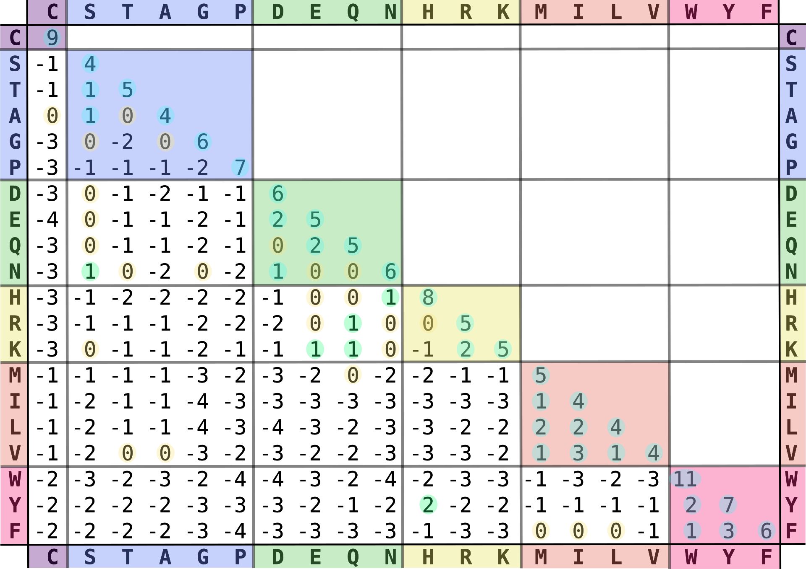
Protein sequence alignment?
We will be focusing on DNA sequence alignment today, but protein alignments work just the same, only with a more complex substitution matrix because there are 20 standard amino acids and only 4 types of nucleotides in DNA
Blosum62 substitution matrix
Notes:
When aligning nucleotide sequences we often just use a match score and a mismatch score rather than a substitution matrix.
But for protein alignments we absolutely need a substitution matrix. Protein substitutions are not equally likely to occur. Not only can some protein substitutions arise from a single nucleotide mutation, while others require replacing the entire codon, but they also impact protein structure in vastly different ways.

Slide 26
Multiple sequence alignments
Multiple sequence alignment is considerably more complex
than pairwise alignment
But we want you to take home some practical skills, so we will rather focus on some exercises
Note however, that Multiple Sequence Alignments are (for the most part) not guaranteed to provide you the best possible alignment.
KIRSTEN
KARSTEN
TORSTEN
KASPER
THOR
KIRSTINE
ASTRID
K-IRSTEN-
K-ARSTEN-
T-ORSTEN-
K-A-SPER-
THOR-----
K-IRSTINE
--A-STRID

Slide 27
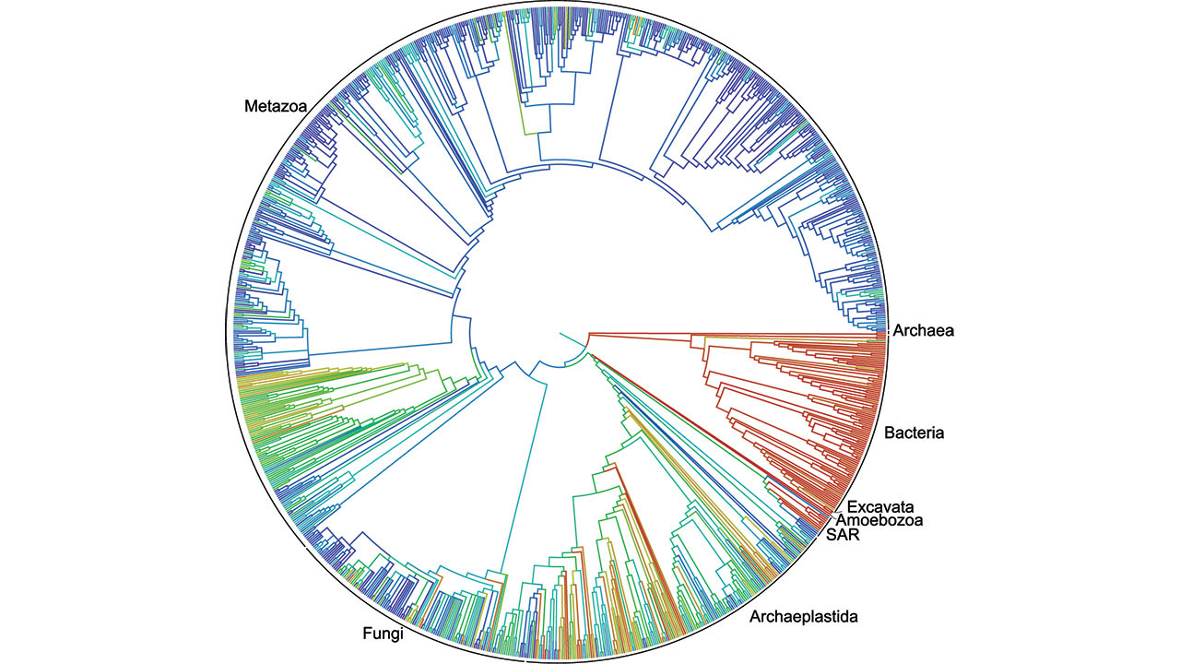
Phylogenetics
Investigating the evolutionary relationship between organisms
We have to align our sequences before we can infer a phylogenetic relationship
https://www.science.org/content/article/first-comprehensive-tree-life-shows-how-related-you-are-millions-species

Slide 28
Exercise: Inferring the evolutionary relationship between bacteria from the 16s rRNA gene
Run this command to download the fasta file with example data wget https://github.com/ssi-dk/GenEpi-BioTrain_Virtual_Training_7/raw/main/data/16s_data/16s_sequences.fasta
The file contains part of the 16s rRNA gene from 14 isolates, the v3-v4 region which is widely used for microbiome analysis
We can use these sequences to infer the evolutionary relationship between these species
But first we have to align them

Slide 29
Exercise: MAFFT, Multiple Alignment using Fast Fourier transform
MAFFT is one of the first published methods for rapid multiple sequence alignment, and is still widely used
https://www.ncbi.nlm.nih.gov/pmc/articles/PMC135756/
First, lets have a look at what the helper file can tell us
mafft -h
Now make an alignment for the 16s_sequences.fasta
mafft 16s_sequences.fasta > 16s_sequences_mafft_alignment.fasta

Slide 30
Exercise: MUSCLE, MUltiple Sequence Comparison by Log-Expectation
MUSCLE was published a few years after MAFFT, and is very fast when aligning large numbers of sequences (1000+)
https://www.ncbi.nlm.nih.gov/pmc/articles/PMC390337/
Again, lets have a look at what the helper file can tell us
muscle -h
Now make an alignment for the 16s_sequences.fasta
muscle -align 16s_sequences.fasta -output 16s_sequences_muscle_alignment.fasta

Slide 31
Exercise: MAAFT and MUSCLE
Have a look at the two alignments you generated
less 16s_sequences_mafft_alignment.fasta
less 16s_sequences_muscle_alignment.fasta
Tomorrow we will use these alignments to infer phylogenies and investigate the evolutionary relationship between these species
Before then we have a few more topics of sequence alignment we need to go over

Slide 32
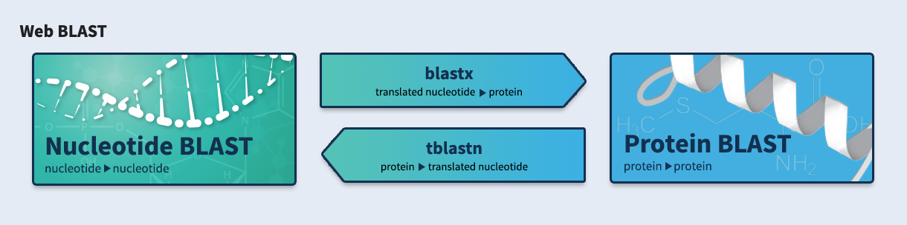
Basic Local Alignment Search Tool (BLAST)
https://blast.ncbi.nlm.nih.gov/Blast.cgi

Slide 33
Command line BLAST
There are two mandatory inputs for a BLAST search
-query: query sequence(s) (fasta format)
-subject OR -db: subject sequence(s) (fasta format) or blast-formatted database
Blast will perform local alignments between similar regions in your query and subject/database
There are many different options for output format.
We will look at two today:
Default: Easy to read with the naked eye, neatly visualizes hits and alignments between query and subject sequences
-outfmt 6: Tab-separated format where you choose what information to include in each column. Much nicer to use for anything programmatic

Slide 34
BLAST
Blast uses the Smith-Waterman algorithm, which is a variation of the Needleman-Wunsch algorithm, to perform local sequence alignment
Like Needleman-Wunsch , the Smith-Waterman algorithm is a dynamic programming algorithm, and therefore guaranteed to provide you the best possible alignment between your two sequences.
But Blast is not just an alignment tool!
The “search” part of Blast is a search for exact kmer matches between your query and subject sequences. This is necessary because aligning all parts of large query and subject sequences is way too demanding computationally, and exact kmer matching is very fast.
Notes:
Blast performs local alignment, and for that it uses a slightly modified variant of the Needleman-Wunsch algorithm called the Smith-Waterman algorithm. Because apparently you always need exactly two people do design an algorithm.
Smith-Waterman is also a dynamic programming algorithm, and therefore guaranteed to provide you the best possible alignment given your input parameters.
But Blast does not attempt to apply the Smith-Waterman algorithm to all parts of your query and subject sequences, that is way too demanding computationally when working with large sequences! It only does so in regions where it first identifies an exact sequence match between query and subject.

Slide 35
BLAST
Therefore there are three important parameters in blast that dictate what your alignment output looks like.
The substitution matrix (match and mismatch score)
The gap penalty
The kmer size (or word size) used for initial search (seeding)
Blast will only perform local alignment in regions where it identifies an exact match of at least k nucleotides between your query and subject sequences.
When you use default “blastn” on command line, this is equivalent of what is called “megablast” in the online version of blast. This uses a “word size” of 28.
Even if your query and subject sequence share a region with 96% similarity, Megablast will fail to do an alignment if the mismatches between the two are spread out so that there is no exact match of 28 nucleotides!

Slide 36
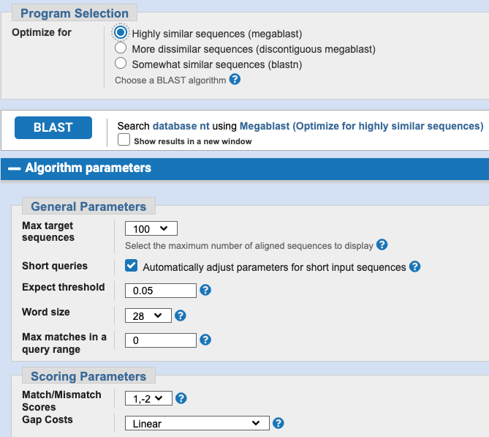
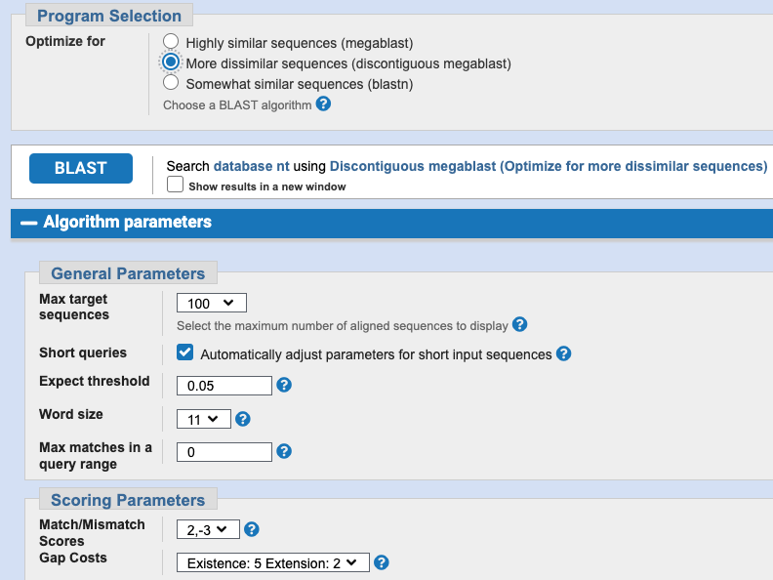
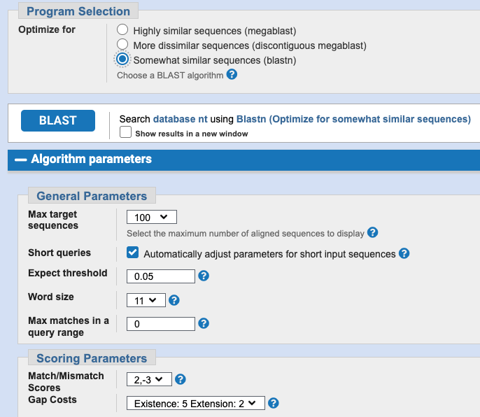
Basic Local Alignment Search Tool (BLAST)
You can pick which program to use with the -task option, i.e.
blastn -task blastn -query [query.fasta] -subject [subject.fasta]
You can also modify the exact match (-reward), mismatch (-penalty) and gap scores (-gapopen, -gapextend)

Slide 37
BLAST command line input and output
Megablast with bare minimum input options
  blastn -query [query.fasta] -subject [subject.fasta] -out [blast_output.txt]
Megablast with a more programmatic friendly output format
  blastn -query [query.fasta] -subject [subject.fasta] -out [blast_output.tsv] -outfmt 6
Megablast, programmatic friendly output with select info
  blastn -query [query.fasta] -subject [subject.fasta] -out [blast_output.tsv] -outfmt “6 qseqid sseqid pident length qlen evalue bitscore sseq”

Slide 38
BLAST exercises
Identifying the v3-v4 region of the 16s gene in genome assemblies
Running megablast (blastn)
Modifying output format
Setting up a blast database
Running megablast against a database

Slide 39
End of part 2 quiz!
That is it for part 2
We will do a very short speed quiz

Slide 40
15 Minute Break!
We will resume at xx:xx
If you have any questions you’d like answered before we proceed, write them in the chat and we will answer as best we can after the break.
Then we’ll proceed to the last part of today’s session:
core genome allignments

Slide 41
Core genome SNP analysis
Earlier we created the alignments necessary to infer the evolutionary relationship between isolates based on the 16s rRNA gene.
Using only a region of ~500 nucleotides naturally provides very low discriminatory power. Often different species will be identical in the specific region.
With whole-genome sequencing we have the option to not just look at a single gene (or a few genes as is the case for Multilocus Sequence Typing), but instead compare the full genomes
Notes:
As you saw earlier, looking at just the 500 bp v3-v4 region of the 16s rRNA gene provided absolutely no useful information when examining our 22 Listeria isolates, as they were all identical.
We need more discriminatory power. We can increase this by basing our analysis on more genes, like we do in Multilocus sequence typing, but even better is to analyze the entire core genome.
That is, the part of the genome that all our isolates have in common.
This is the purpose of core genome SNP analysis

Slide 42
Core genome SNP analysis tools
Snippy
https://github.com/tseemann/snippy
NASP (Northern Arizona SNP pipeline)
https://tgennorth.github.io/NASP/readme.html
CSI Phylogeny
https://bioinformaticshome.com/tools/descriptions/CSI_Phylogeny.html#gsc.tab=0

Slide 43
Core genome SNP analysis
All these tools work by aligning reads and/or assembled genomes to a specified reference genome, in order to identify variant sites (Single Nucleotide Polymorphisms, SNPs)
They can then compare the results across multiple isolates, and generate a output with all the variable sites in a convenient matrix or fasta-format. The fasta output can be used directly to generate a core genome phylogeny.
Some tools contain a bit more functionality than others, and can also assist you a lot in quality control.

Slide 44
Core genome SNP calling workflow
Sample1.fasta
Reference
mapping/
alignment
bwa-mem
bowtie2
Nucmer
…
Variant calling
gatk
samtools
Bcftools
varscan
…
Sample1.vcf
Core SNPs
Summary
Fasta alignment
tsv
Sample2.fasta
Sample2.vcf
Sample3_R1.fastq.gz
Sample3_R2.fastq.gz
Sample3.vcf
Sample4.vcf
Sample4_R1.fastq.gz
Sample4_R2.fastq.gz
Reference

Slide 45
Exercise: Snippy
The last exercise for today is to run Snippy to create a core genome alignment based on the reads or genome assemblies from the 22 Listeria isolates.
In tomorrows session on phylogenies we will use this alignment to do phylogenetic reconstruction and use this to aid in an oubtreak investigation.
This exercise takes a while to finish. Do not worry if you don’t have an output for tomorrows exercises! We will of course provide you with a finished core genome alignment to use.

Slide 46
Acknowledgements
The creation of this training material was commissioned by ECDC to Statens Serum Institut (SSI) and developed by Thor Bech Johannesen, for use in training at the ECDC Virtual Academy (EVA) platform

