Slide 1
Basic genome assembly QC
How do we evaluate the quality of a genome assembly?
A high quality draft assembly should…
Contain all or nearly all the DNA content of the sequenced organism, both chromosomal and plasmid.
Contain little noise and little or no DNA from other organisms (stemming from cross-contamination from other organisms, DNA from laboratory reagents, sequencing artifacts.)
Ideally contain a lot of long contigs, since this better allows us to analyze where genes are located relative to each other, and lowers the risk that individual genes will be interrupted by contig terminations or incorrectly missing from the genome.
Notes:
The assembly should represent the actual genome content of the target organism as accurately as possible
That means
Contain the full genome content of the sequenced organism, chromosomal and plasmid
Contain little or no DNA from other organisms. We typically work in labs with DNA from a lot of different organisms, and cross-contamination happens even in the best labs.
Many of the laboratory ingreadients we use contain DNA themselves, these may end up in our assembly.
Sequencing technology is not perfect
We would like to have an assembly with just one complete chromosome and plasmids if they’re present, but may be limited by technology and biology as Kirsten explained during the intros.

Slide 2
Basic assembly QC parameters
Genome size
Number of contigs
Distribution of contig lengths
  L50
  N50
  L90
  N90
  AuN

Slide 3
Basic assembly QC parameters
L50 is the smallest number of contigs required to cover 50% of the genome content of a draft assembly.
To find the L50 value
Calculate the total length of the assembly
Order all contigs from largest to smallest
Go through the contigs while summing up their lengths. L50 is the number of contigs you need to go through to get to 50% of total assembly length
The N50 value is the length of that same contig.

Slide 4
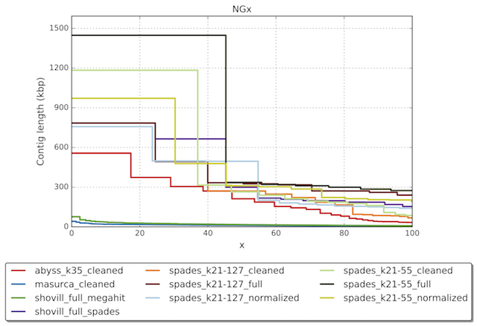
Basic assembly QC parameters
Same principle is applied to identify L90, N90 etc.
A more modern, slightly more sophisticated QC parameter is the ”Area under the Nx curve”, AuN.
AuN is obtained by plotting all Nxx values from N1 to N100 and calculating the area under the curve
https://lh3.github.io/2020/04/08/a-new-metric-on-assembly-contiguity

Slide 5
Basic assembly QC parameters
Genome size (should match expected size for the organism)
Number of contigs (lower is better)
Distribution of contig lengths
  L50 (lower is better)
  N50 (higher is better)
  L90 (lower is better)
  N90 (higher is better)
  AuN (higher is better)

Slide 6
Quast (Quality Assessment Tool for genome assemblies)
Quast is versatile python tool for calculating and visualizing various aspects of assembly QC
It has a lot of utility, but today we will focus on the most basic parameters, which can be generated purely based on assembly files.
By default Quast will exclude contigs < 500 bp
Lets have a look at the Quast helper file in the command line: quast.py -h

Slide 7
Quast demo
quast_report_spades_unicycler.html on EVA contains a summary of quast results from three different assemblies from the same E. coli isolate.
Illumina short read spades assembly with --careful option
Illumina short read spades assembly with --isolate option
Nanopore long read Unicycler assembly
If you have Quast installed you can run it yourself.
Download demo_assemblies.zip from EVA
Unzip
Run: quast.py -o [output_directory] demo_assemblies/*.fasta

Slide 8
Genome QC is context dependent
Whether an assembly is ”good enough” depends entirely on what you wish to use it for
Do you want to identify AMR or virulence genes?
Then it’s very important to make sure the genes in your assembly are not from a contaminant, and you must have sufficient sequencing depth to be confident that you aren’t missing large parts of the genome.
Outbreak analysis? (f.ex. examine whether multiple infections could stem from the same source)
Then you want high sequencing depth in large parts of the genome to do variant calling from with sufficient coverage
Gene annotation or genome wide analysis?
As complete a genome as possible with no contamination

Slide 9
A final note on noisy data
Some assembly software tends to include a lot of noise in the form of small, low coverage contigs with no relevance to your target organism.
Others are good at filtering out those contigs automatically (but may risk trimming ”real” data as well)
Spades tend to be very inclusive, which means a lot of noise by default.
Therefore it is often prudent to filter short contigs and/or contigs with very low kmer coverage.
Many public data repositories for assembly data (EBI, NCBI) requires filtering of contigs <200 bp (or will do it for you when you upload data)

Slide 10
Common causes for poor assembly
Error source | QC effect
Low sequencing depth Uneven sequencing depth | Large number of contigs High L50, L90 Low N50, N90, AuN Likely small genome size
Interspecies contamination | Genome size much larger than expected High L50, N50 Low N50, N90, AuN
Intraspecies contamination | Genome size larger than expected (could be just slightly) Very high L50, N50 Very low N50, N90, AuN Large number of ambiguous basecalls
We will discuss in more detail how contamination from other strains or species may impact assembly
Untill then you can have a look at the Quast results for short read spades assemblies from 16 E. coli isolates (quast_results_Illumina.zip) (or if you have the software set up you can generate it yourself, the assemblies can be found in spades_assemblies.zip)
Use: quast.py -m 0 -o [output_directory] *.fasta
Notes:
With low or uneven sequencing depth you will

