Slide 1

Genome assembly and QC
Virtual seminar, 4th and 7th Dec 2023
Welcome!

Slide 2
The purpose of this workshop
Upon completion of this workshop, participants will be able to:
1. Explain the basics of how raw sequencing reads are processed into genomes.
2. Explain why some organisms assemble into few contigs and others into a lot of contigs (when doing a de-novo assembly).
3. Describe the most common stats used for evaluating bacterial genome assemblies.
4. Understand the impact of read-length and base-calling quality for assembly.
5. Identify a contaminated genome assembly.
6. Be familiar with the software tools and strategies used for evaluating bacterial genome assemblies.

Slide 3
How the workshop will be done
Some lectures to introduce theory/concepts
  But we will keep the lectures to a minimum
”Demos” (mostly live) on how to run various software
Note:
No bioinformatics support!
Focus is on understanding/interpretation. We will provide you with any data/output that you need

Slide 4
Programme overview
Session 1 (4/12-2023)
Session 2 (7/12-2023)
10-10.15
Course intro/overview
Practical discussion
Genome assembly intro
(lecture)
Contamination
(lecture/”demo”)
10.15-11
SPAdes assembler
(“demo”)
Unicycler assembler – hybrid
(“demo”)
11-12
Small practical exercise
Unicycler assembler - long reads
(“demo”)
Tools for assembly comparison
(“demo”)
13-13.45
Basic asssembly QC
(”demo”)
Wrap-up and outlook
(lecture)
13.45-14.30

Slide 5
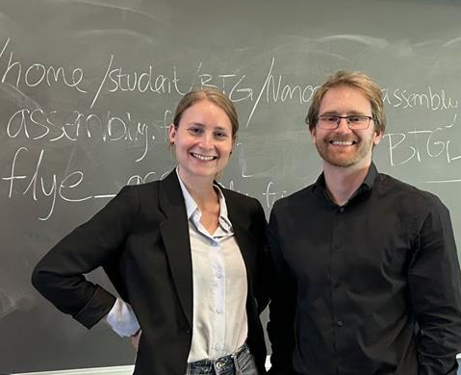

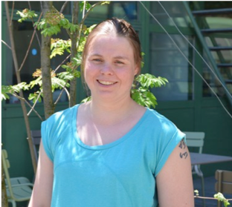
About your trainers
Astrid Rasmussen
Thor Bech Johannesen
Kirsten Ellegaard

Slide 6

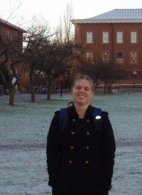

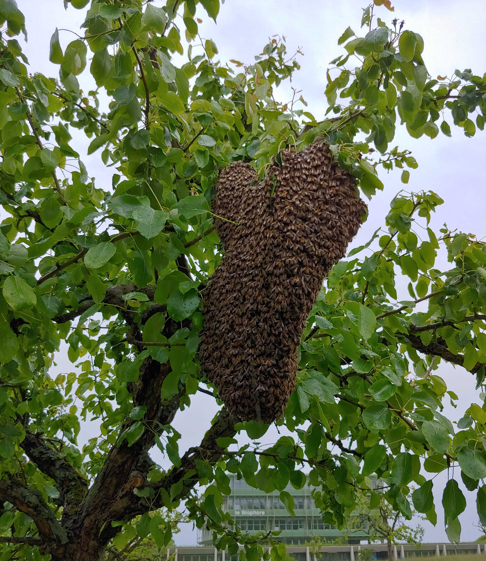
About me
MSc & PhD in evolutionary Biology
Genomics of bacterial endosymbionts
Section of ”Sequencing and Bioinformatics”
SARS-CoV-2 genome sequencing and QC
Postdoc
Honeybee gut microbiota
Metagenomics

Slide 7
POLL time!

