Slide 1
Data on this workshop
Hallgren et al. (2021): MINTyper: an outbreak-detection method for accutrate and rapid SNP typing of clonal clusters with noisy long reads. Biology Methods and Protocols, vol 6, issue 1
https://doi.org/10.1093/biomethods/bpab008
https://www.ebi.ac.uk/ena/browser/view/PRJEB38543
Illumina MiSeq (2 x 251bp)
End-trimmed with Trimmomatic: Q > 20
607.439 paired-end reads
Nanopore MinION (R9.4.1 flow-cell)
Sequencing adapters removed with Porechop
Min quality Q > 10 (NanoFilt)
20.232 reads
500.043.638 bp (500M)

Slide 2
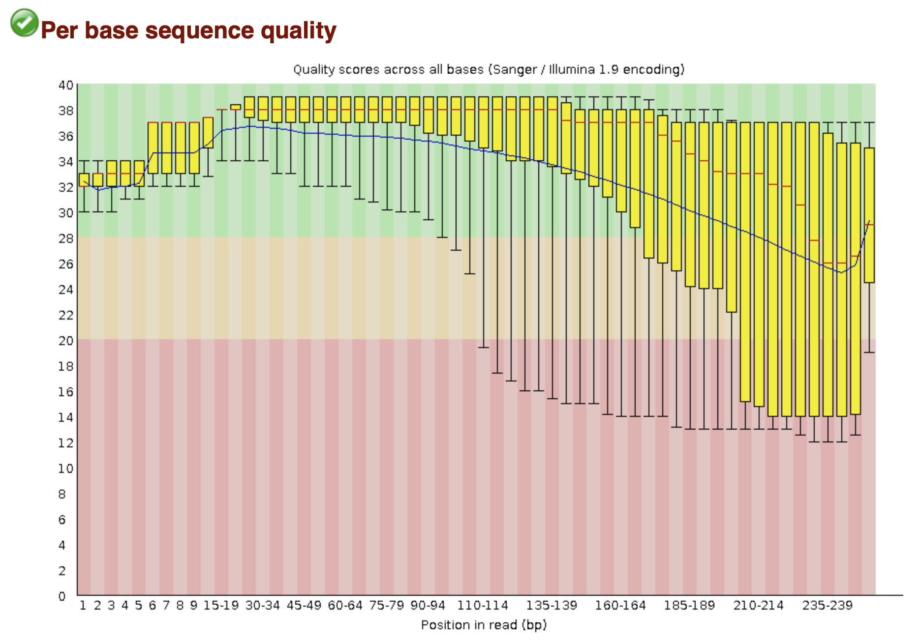
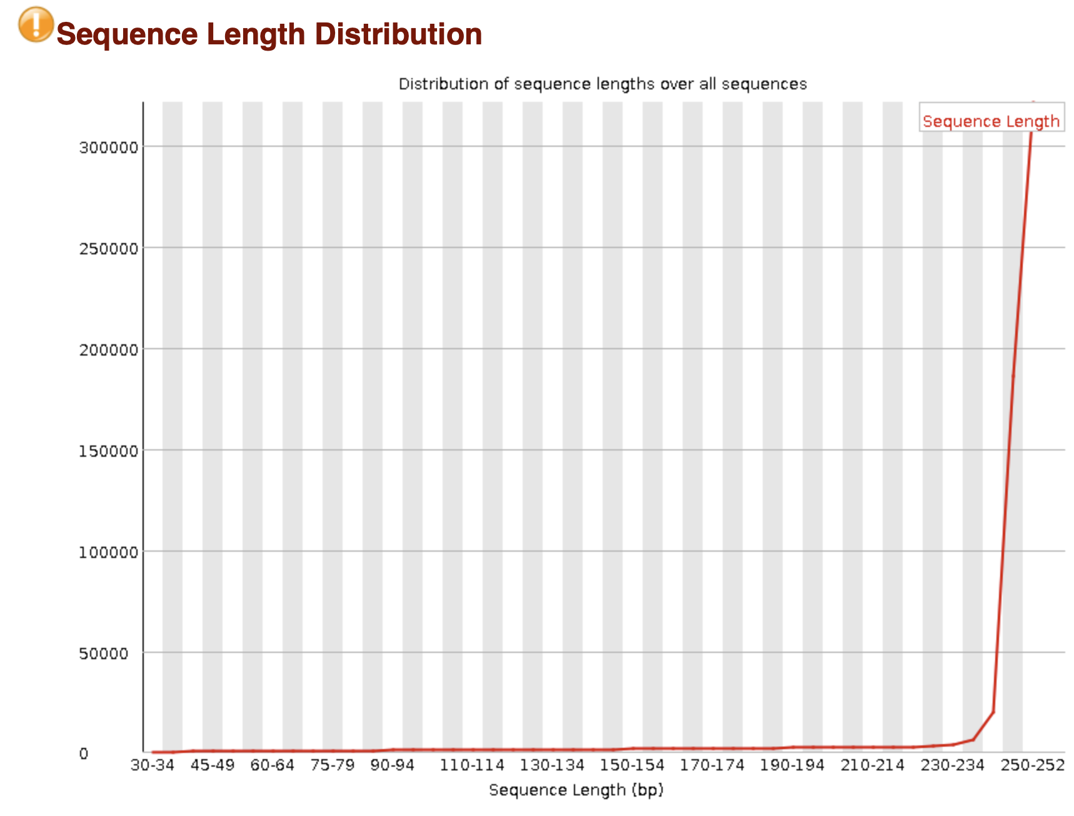
Quality of illumina data for our demo-sample
Images from FastQC report

Slide 3
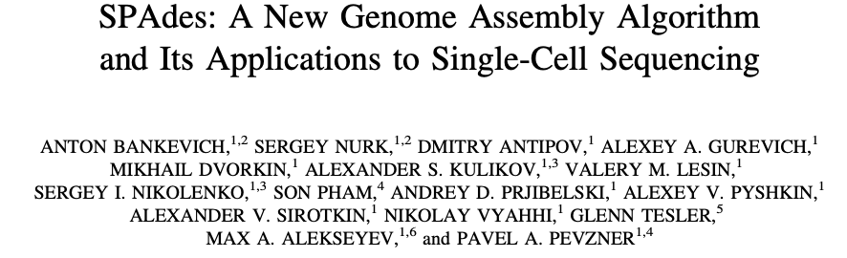
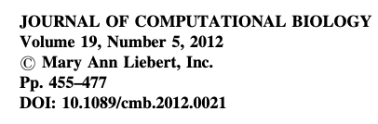
About SPAdes
First published in 2012
Continously updated
One of the most widely used genome assemblers for short-read sequencing data

Slide 4
Why did SPAdes get so popular?
Multi-sized de bruijn graph
  Variable coverage
Better use of paired-end reads
  Variable insert-size
Better read error correction
  Probabilistic (BayesHammer)
Good computational performance
Ease of installation and usage

Slide 5
Read the manual! https://github.com/ablab/spades
What kind of input data is suitable for SPAdes?
What kind of genomes can be assembled with SPAdes?

