Slide 1
Genome assembly and QC
Virtual seminar, 4th and 7th Dec 2023
Introduction to genome assembly strategies

Slide 2
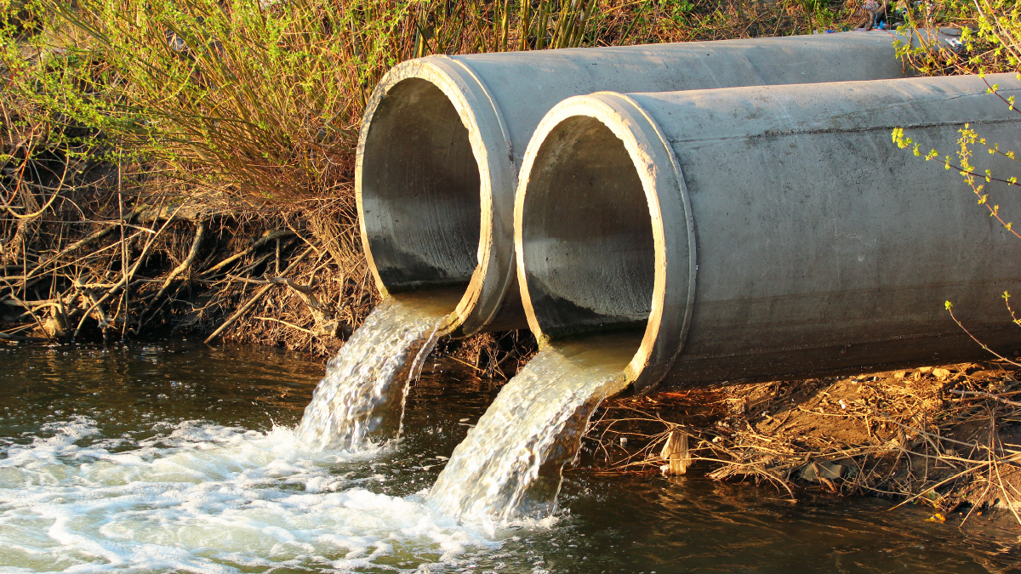
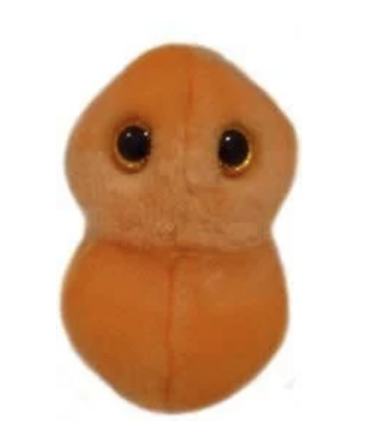
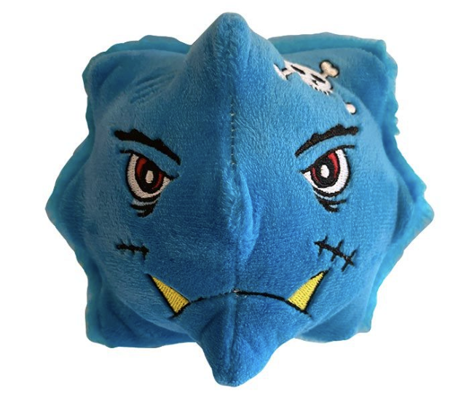
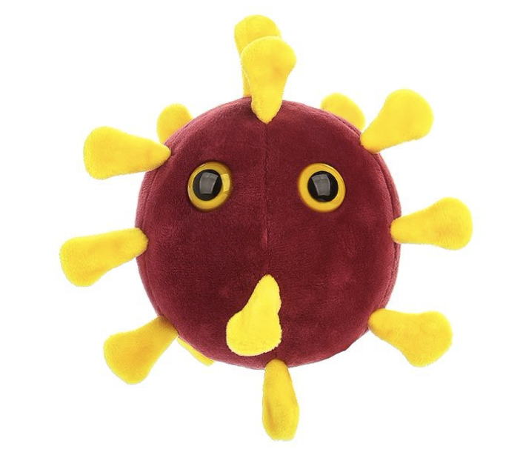
How to sequence a genome
DNA
Reads
DNA extraction
Sequencing
Genome re-construction
Images: giantmicrobes.com, https://nccid.ca/wastewater-surveillance-for-covid-19/

Slide 3
How to sequence a genome
Fragmentation
Cultivation
(bacteria)
DNA
Reads
DNA extraction
Sequencing
Genome re-construction
Images: giantmicrobes.com, https://nccid.ca/wastewater-surveillance-for-covid-19/

Slide 4
The assembly problem
TAGCC
ATGTT
AGCCG
GCCGG
GTTTA
TGTTT
TTAGC
TTTAG

Slide 5
The assembly problem
TAGCC
TTTAG
AGCCG
GCCGG
GTTTA
TTAGC
ATGTT
TGTTT

Slide 6
The assembly problem
ATGTTTAGCCGG
ATGTT
TGTTT
GTTTA
TTTAG
TTAGC
TAGCC
AGCCG
GCCGG

Slide 7
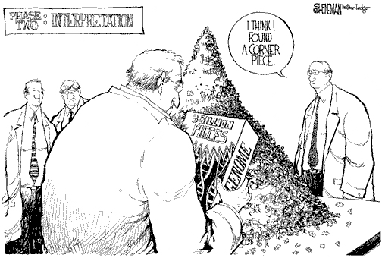

The assembly problem read-length and base-calling quality matters
?
Read-length:
Jigsaw puzzles with many small pieces are hard!
Read-accuracy:
Like a jigsaw puzzle with somewhat misshapen pieces
https://twitter.com/FLGenomics/status/520611003751735296

Slide 8
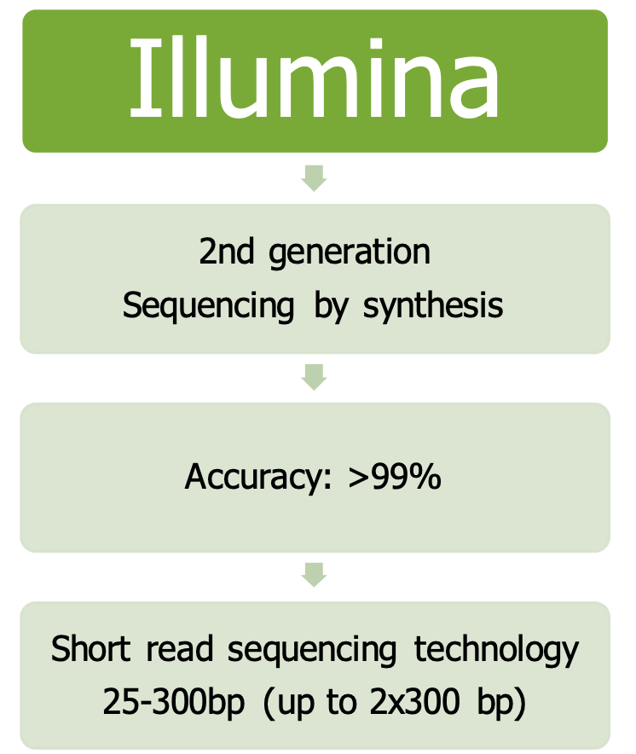
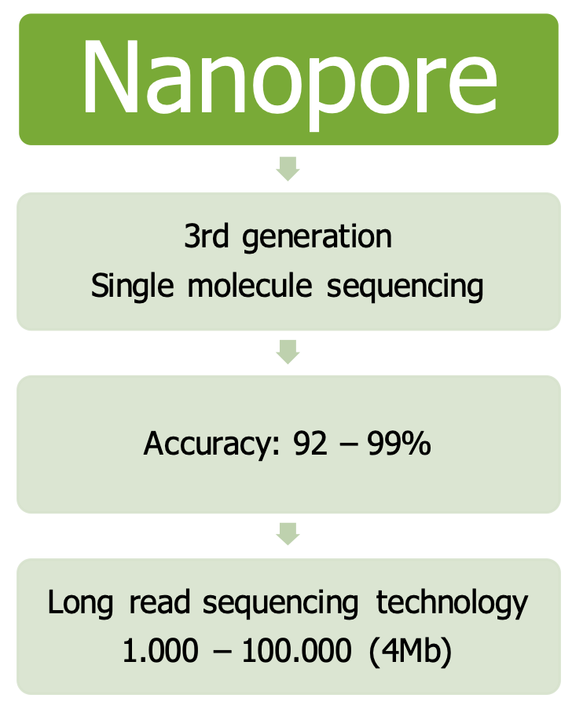
There is a trade-off between read-length and quality

Slide 9
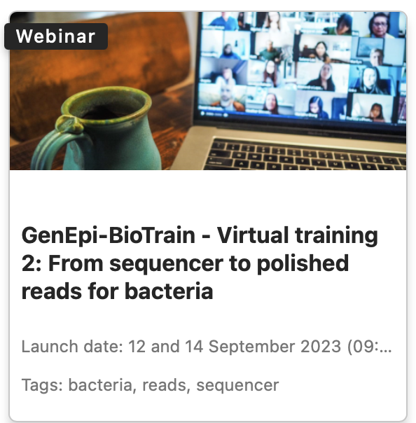
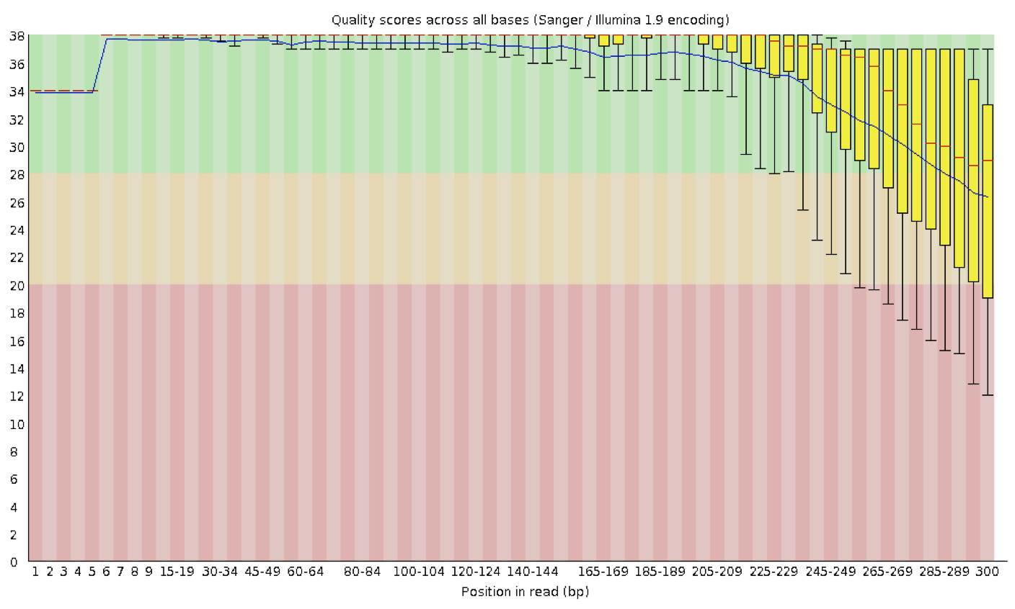
Check your raw-data and filter (if needed)
Example plot of quality scores for Illumina data (FastQC)
Quality score (Phred)
Read position
Notes:
SLIDO nb. 1

Slide 10
POLL-time

Slide 11
Assembly algorithms
two main classes
OLC: Overlap layout consensus
Assembly graph made from overlaps between reads
De-Bruijn graphs
Assembly graph made from shared k-mers of reads

Slide 12
OLC: Overlap-layout-consensus
Intuitive. First assemblers used this approach.
Looking for overlaps: if suffix of one read has significant similarity with prefix of another, the two reads are connected in the assembly graph.
GCCGGTTCAA
ATGTTTAGCCGG

Slide 13
“OLC”: Overlap-layout-consensus
Intuitive. First assemblers used this approach
Looking for overlaps: if suffix of one read has “significant similarity” with prefix of another, the two reads are connected in the assembly graph.
TTCAAGCTGGA
?
?
GCCGGTTCAA
CCGGTTTAAG
?
ATGTTTAGCCGG
CCGGTTCAAG

Slide 14
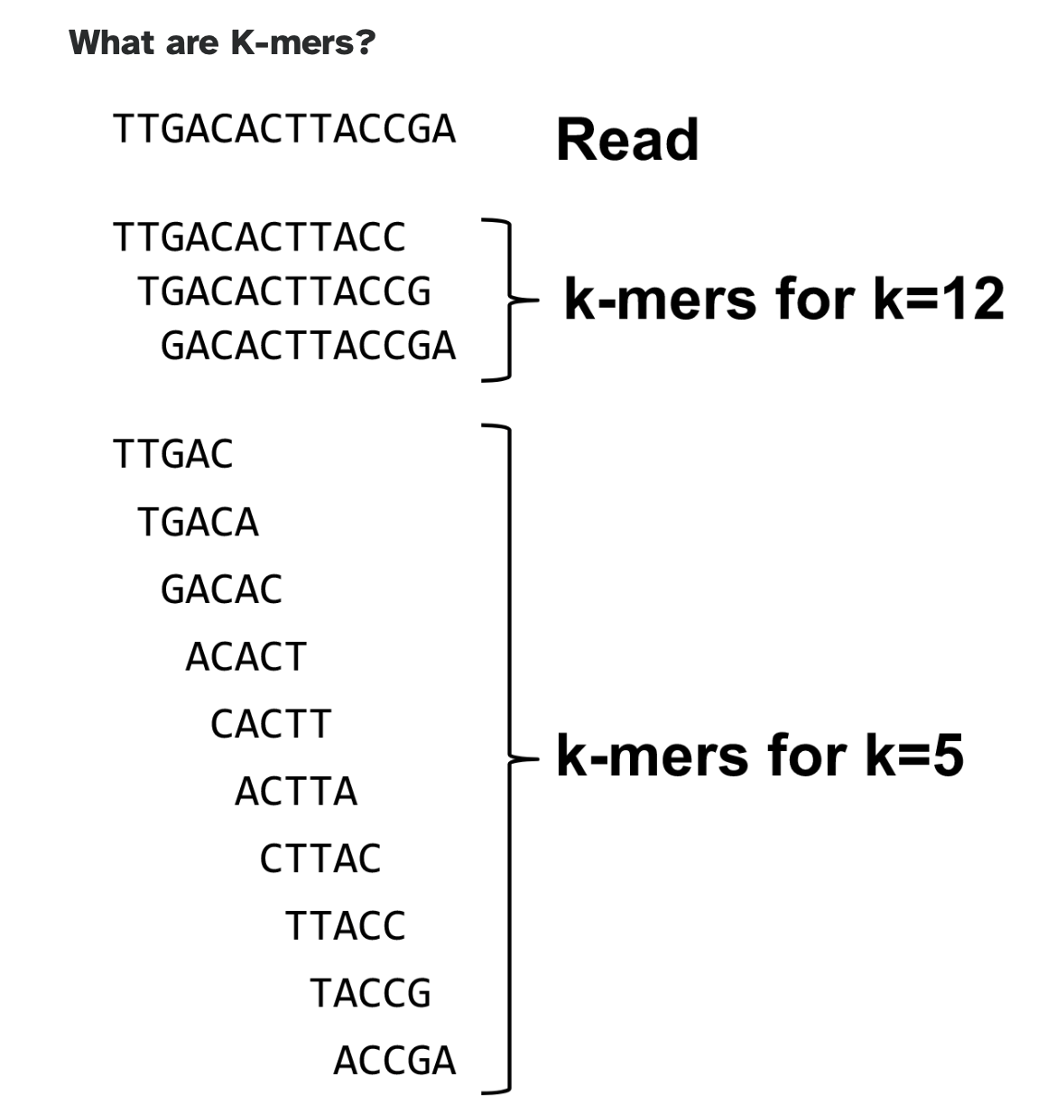
De bruijn graphs
de Bruijn graphs utilize k-mers of reads to construct the assembly graph
Once the k-mers have been constructed, reads having a k-mer in common can be found very quickly (“Hashing”)
training.galaxyproject.org, geeksforgeeks.org/what-is-hashing

Slide 15
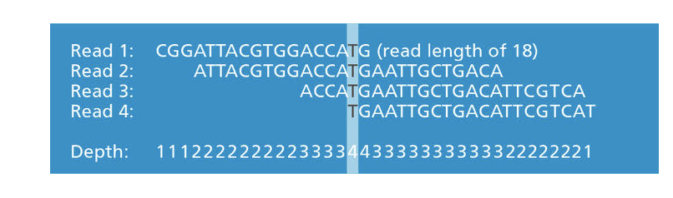
De bruijn graphs:
Coverage matters
de bruijn graphs require exact k-mer matches
More coverage => more error-free reads
The frequency of k-mers can be counted and used to annotate the graph (and to clean it up)
training.galaxyproject.org

Slide 16
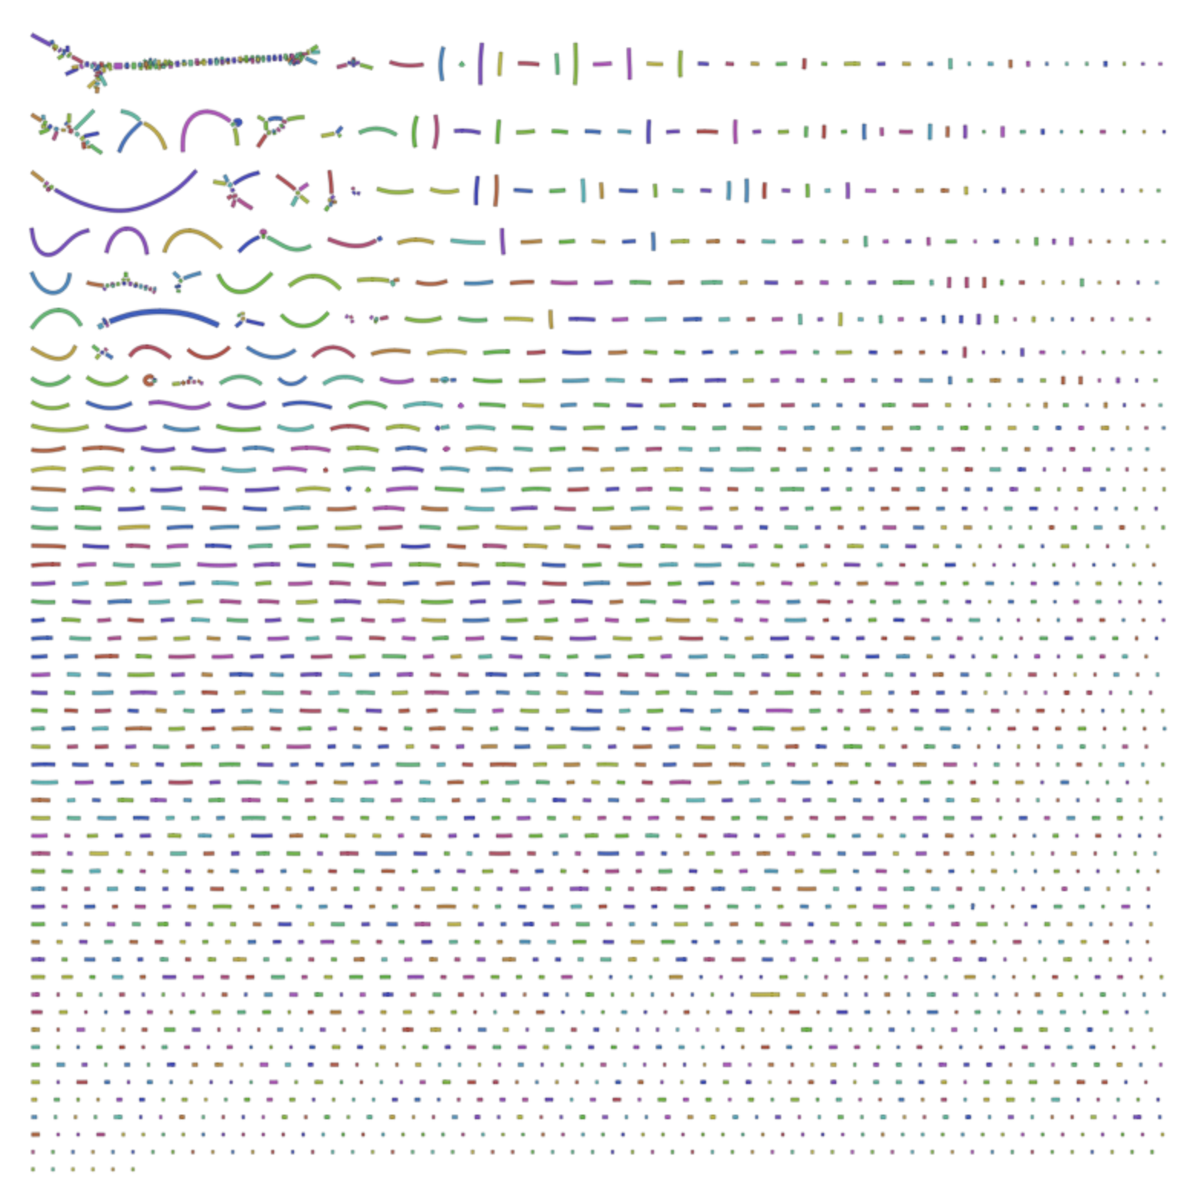
Which k-mer size to use?
Salmonella genome assembled with Illumina 100bp (single-end) reads, and kmer-size 91
If the k-mer is too large, the reads wont get connected in the graph
https://github.com/rrwick/Bandage/wiki/Effect-of-kmer-size

Slide 17
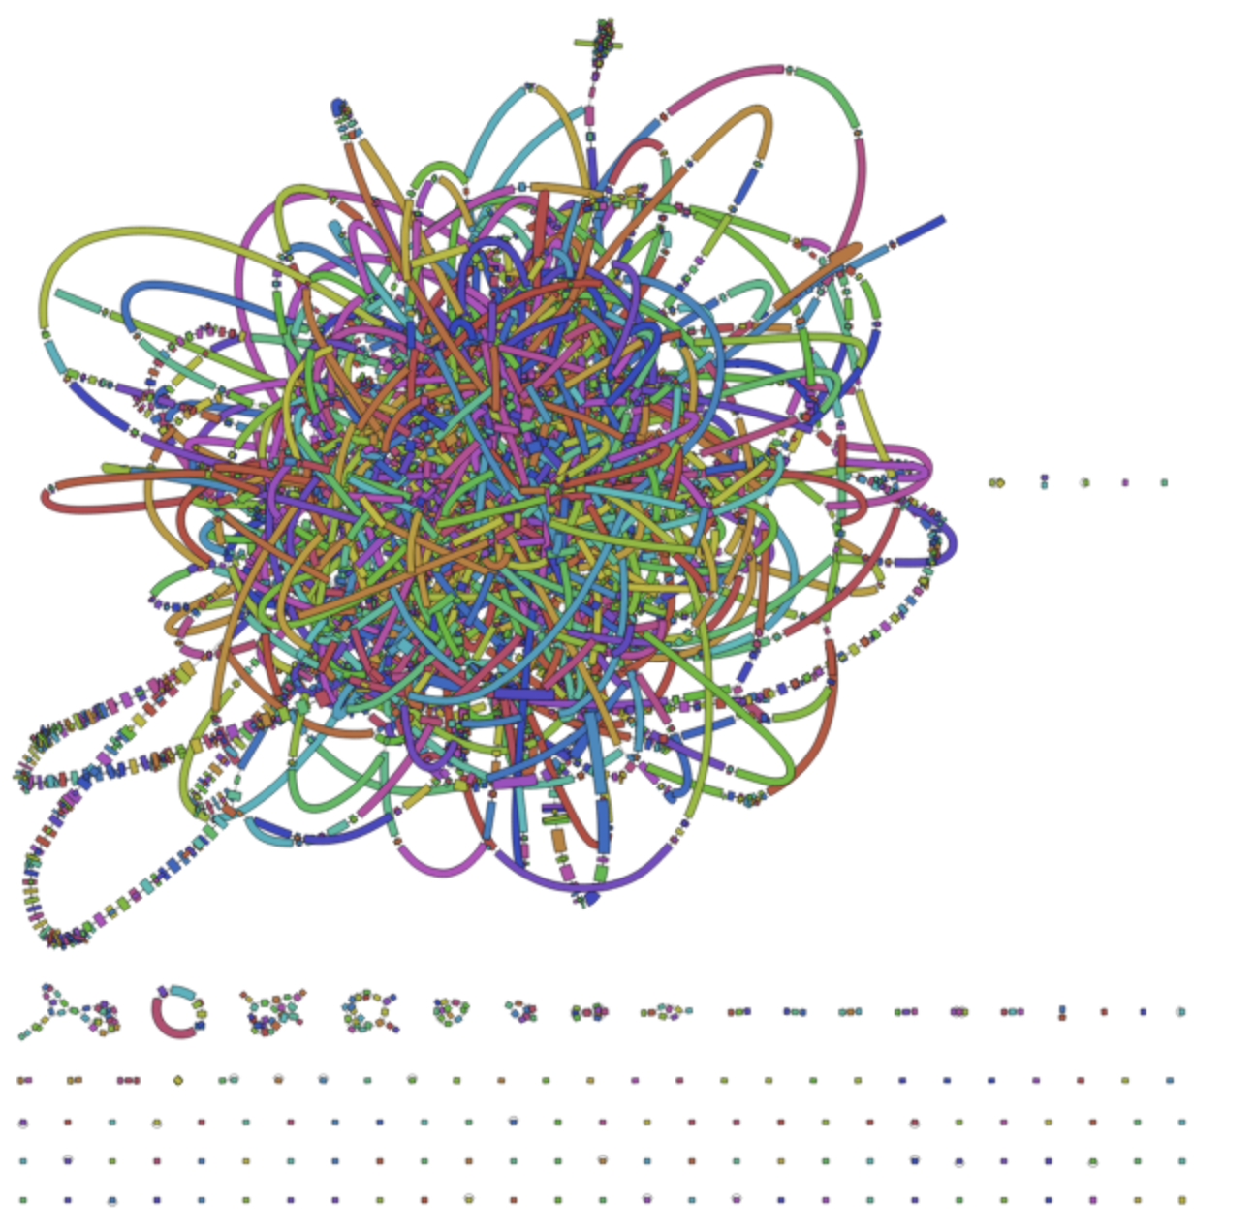
Which kmer-size to use?
Salmonella genome assembled with Illumina 100bp (single-end) reads, and kmer-size 51
If the k-mer is too small, all the reads start connecting to each other in the graph (aka “the hairball”)
https://github.com/rrwick/Bandage/wiki/Effect-of-kmer-size

Slide 18
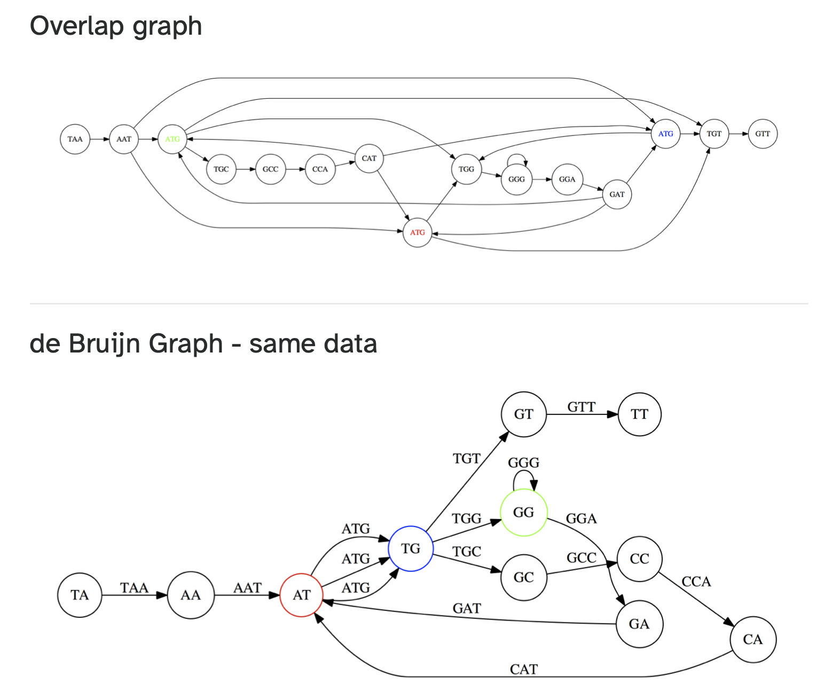
Nodes are reads, edges are overlaps between reads
Nodes are overlaps, edges are reads
training.galaxyproject.org

Slide 19
POLL-time

Slide 20
Assembly algorithm comparison
OLC: Overlap-layout-consensus
Intuitive. First assemblers used this approach
Looking for overlaps: if suffix of one read has significant similarity with prefix of another, the two reads are connected in the assembly graph.
Works well with long reads and small amounts of data.
Computationally expensive (many comparisons to make)
De Bruijn graph
Counter-intuitive. Yet, the most widely used genome assembly algorithm
Uses k-mers of reads to generate the assembly graph (“hashing”)
Works with with short reads and large amounts of data
Computationally efficient
Sensitive to low coverage and sequencing errors

Slide 21
Genome assembly outcome contig: Contiguous representation of a genomic region
The genome assembler will generate a fasta file, with the assembled sequence(s)
”Header”: a unique identifier starting with ‘>’, normally also containing some relevant info (fx. coverage or length)
The actual sequence
>contig1_etc
TGAACTGGCAGGG…
>contig2_etc
GTTCAACCTAGGG…
…

Slide 22
Genome assembly outcome contig: Contiguous representation of a genomic region
The genome assembler will generate a fasta file, with the assembled sequence(s)
”Header”: a unique identifier starting with ‘>’, normally also containing some relevant info (fx. coverage or length)
The actual sequence
>contig1_etc
TGAACTGGCAGGG…
>contig2_etc
GTTCAACCTAGGG…
…
Most assemblers will also generate several additional files, fx.:
  A record of the settings you used
  Intermediate result-files
  Other stats to help you evaluate the quality of your assembly

Slide 23
Genome assembly outcome
Desired result: 1 contig
More likely result: collection of contigs

Slide 24
Genome assembly outcome
Desired result: 1 contig
More likely result: collection of contigs
Sequencing errors can generate contig errors

Slide 25

Why not one contig?
Jigsaw puzzles with lots of blue sky are hard.
Imagine if you have identical pieces..
=> repeats!
Private photo: Kirsten Ellegaard

Slide 26
Why are repeats a problem for assembly?
Repeated sequence
Genome segment

Slide 27
Why are repeats a problem for assembly?
Repeated sequence
Genome segment
What it looks like in our contig file:

Slide 28
Why are repeats a problem for assembly?
Repeated sequence
Genome segment
What it looks like in our contig file:
What we know from the gfa files and paths files:

Slide 29
Adding long-distance information can greatly facilitate assembly
Paired-end reads
Each end of a DNA fragment is sequenced
The reads are known to come from the same DNA fragment, and the approximate fragment size is known
  Typically 300-500bp
=> Longer contigs
Read 1
Read 2

Slide 30
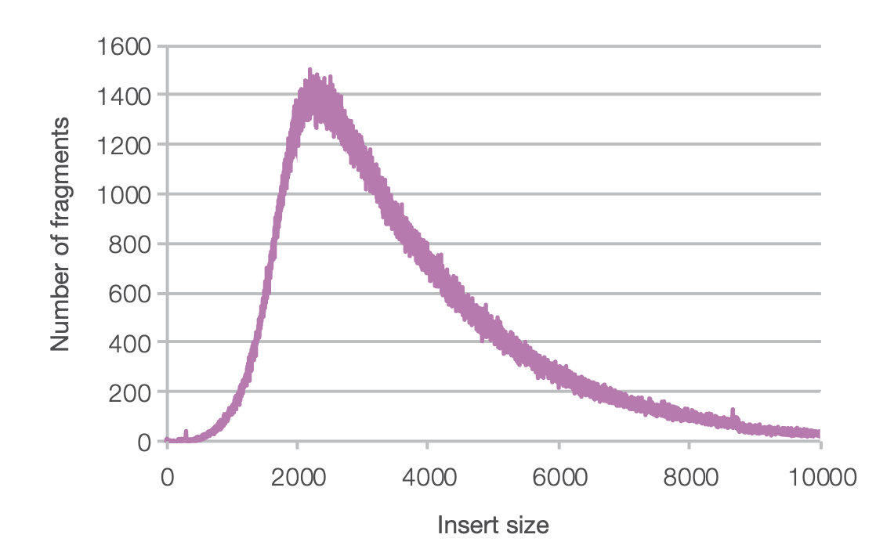
Adding long-distance information can greatly facilitate assembly
Long-insert paired end reads (mate pair)
Mate-pair sequencing can provide even longer distance information
Several other molecular tricks have been developed
  Fx. Hi-C, optical maps..
  Generally, more expensive (and more challenging wetlab procedure)
=> nanopore data
Illumina.com (technote_nextera_matepair_data_processing.pdf)

Slide 31
Adding long-distance information can greatly facilitate assembly
NNNNNN
NNNNNN
Scaffold: a set of contigs that have been ordered and oriented using long-distance information
Illumina.com (technote_nextera_matepair_data_processing.pdf)

Slide 32
Reads longer than repeats -> problem solved
Repeated sequence
Genome segment

Slide 33
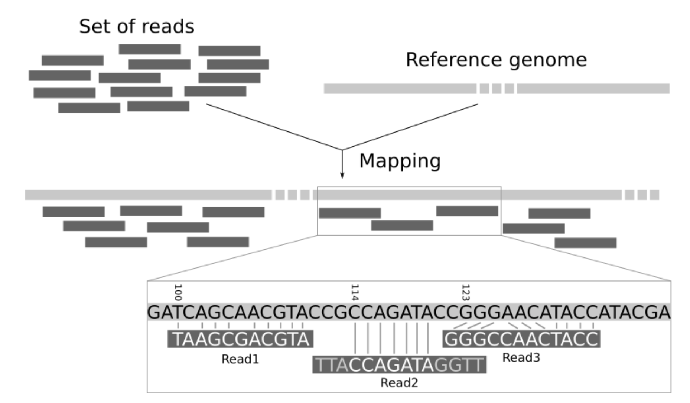
Reference-based genome assembly
If a reference genome is available, a genome can be contructed:
Map reads
Determine differences
Generate genome
Read-mapping is much easier than assembly!
training.galaxy.org

Slide 34
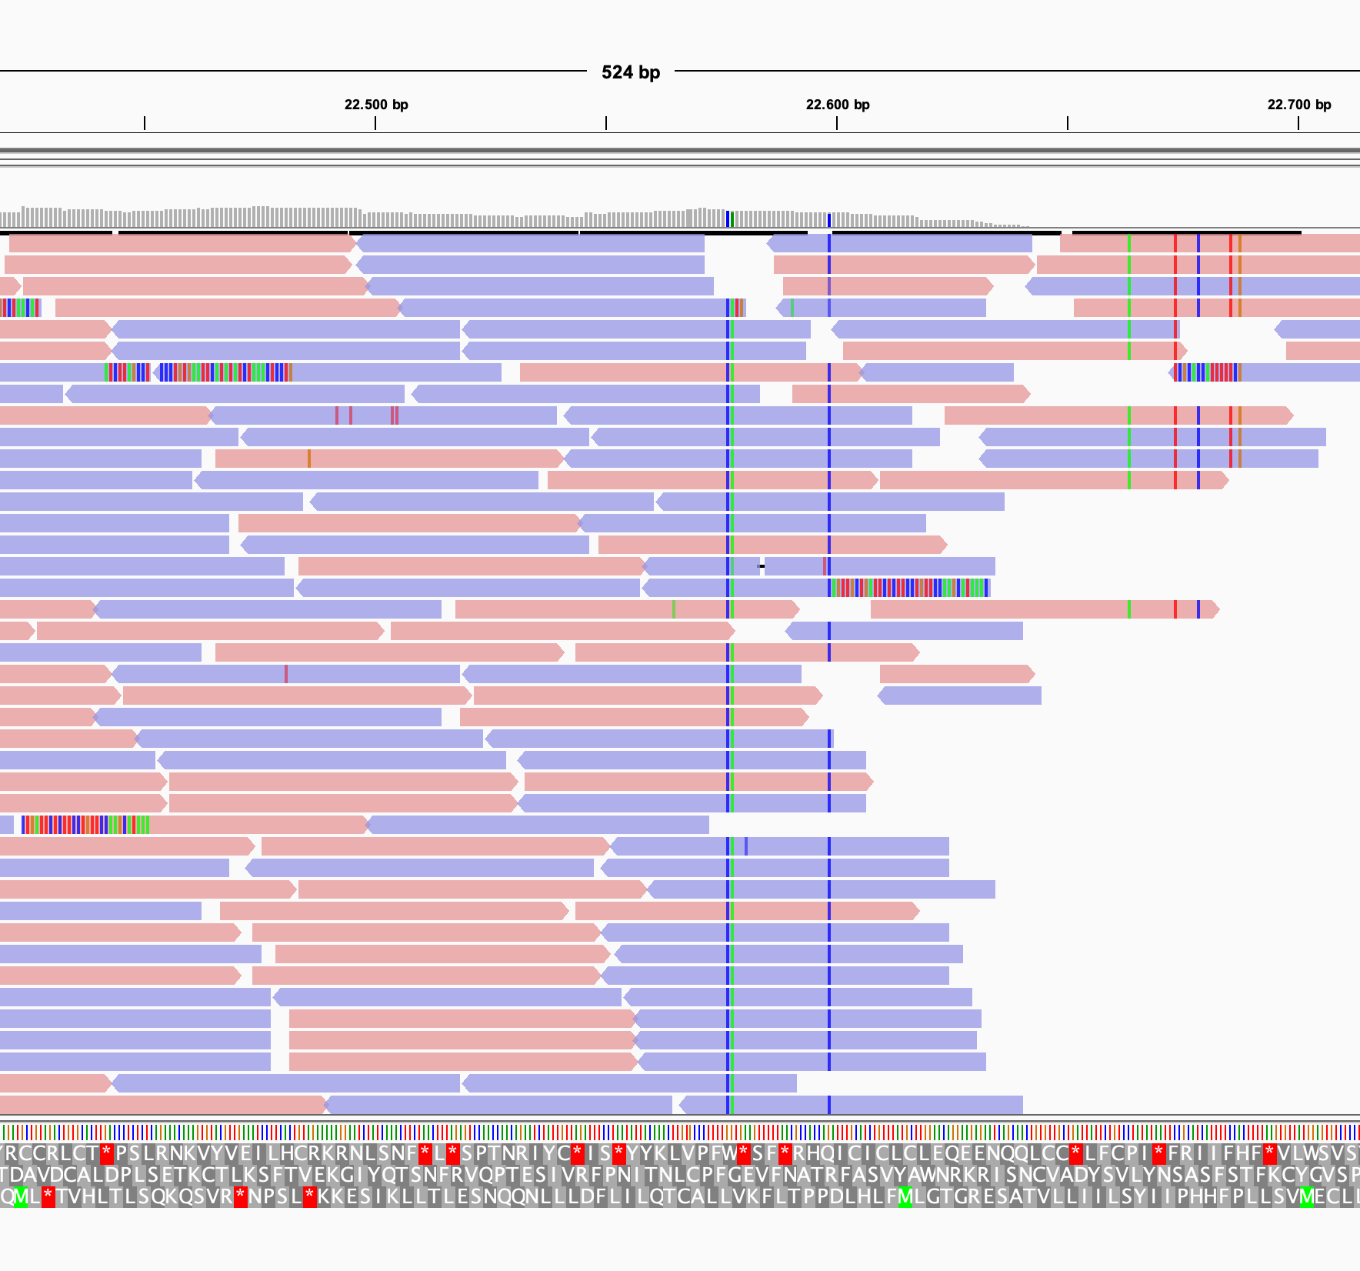
Minor variations can be reliably identified with reference-based genome assembly
SNVs (single-nucleotide variants) are straightforward
Higher sensitivity than for genome assembly
Non-clonal infections can potentially be determined
Contamination from un-related organisms is less of a problem (unless it’s a lot)
Snapshot from IGVviewer, SARS-Cov-2 data

Slide 35
Insertions/deletions are more challenging to call correctly with a reference genome
Small insertions/deletions can be called
  They must be small enough that they can be contained within the sequenced reads (alignment on both sides of variant)
  Depends on read-length (and software/thresholds)
Reference genome: GATATTCGATTAT
Read 1: TCGTTATTA
Read 2: CGTTATTAT
Read 3: GATATTCGT
Reference genome: GATATTCGTTATTAT
Read 1: TCGATTA
Read 2: CGATTAT
Read 3: GATATTCGA
Treated as SNV (A to T)
Treated as SNV (T to A)

Slide 36
Pros and cons of reference base genome assembly
Very efficient when there is a close match between your reads and your reference genome (small variations are easily called)
Tolerates low coverage better than de novo assembly
Contamination from unrelated organisms can easily be ignored

Slide 37
Pros and cons of reference base genome assembly
Very efficient when there is a close match between your reads and your reference genome (small variations are easily called)
Tolerates low coverage better than de novo assembly
Contamination from unrelated organisms can easily be ignored
Quality drops rapidly with genetic distance
Insertions/deletions will likely cause problems, due to misaligned reads
You can only assemble genes that are present in your reference genome

Slide 38
What does a good genome assembly look like?
Depends!
Adjust your expectations according to read-length and base-calling quality

Slide 39
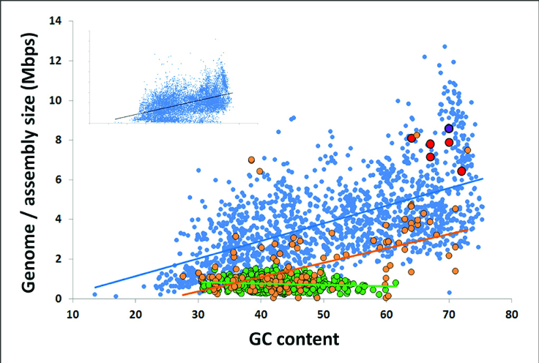
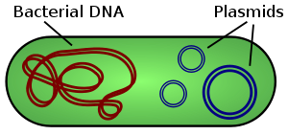
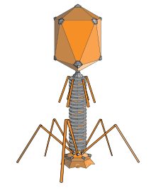
What does a good genome assembly look like?
Some pathogens are harder to sequence than others
Repeats
https://en.wikipedia.org/wiki
Origin of an alternative genetic code in the extremely small and GC-rich genome of a bacterial symbiont, McCutcheon, J. and McDonald, B., 2009, PLoS Genetics, 5(7):e1000565. CC (https://creativecommons.org/licenses/by/4.0/).

Slide 40
Some pathogens are harder to sequence than others
Wet-lab challenges
DNA extraction can be difficult for some organisms
Is the target amenable to cultivation (and thus isolation)?
Alternatively, can we enrich for our target in the sample?
  Filtering, differential centrifugation, binding of target
  For small genomes (i.e. viruses), enrichment by PCR may be possible

Slide 41
What if one cant culture or enrich?
Metagenomic sequencing
Metagenomics is an important up-and-coming method, also in public health
  Immuno-compromised patients infected with unusual pathogens
  Diseases where the aetiology is unclear (fx. meningitis)
  Emerging pathogens (The first SARS-CoV-2 genome was sequenced by meta-transcriptomic sequencing of BALF sample from patient)
Genomics is the foundation for metagenomics, many similar principles apply

Slide 42
What if one cant culture or enrich?
Metagenomic sequencing challenges
In generel, much more coverage is required
  Depletion of human DNA
  Contamination is almost unavoidable (include controls)
For de-novo metagenome assembly:
  Multiple closely related targets will cause issues (resembling sequencing errors and repeats)
  Contigs must be binned (assigned to organism bins). Not trivial.
As for genomics, using a database of reference genomes will greatly increase sensitivity
  Consider depth and breadth of coverage, and alignment identity

Slide 43
Acknowledgements
The creation of this training material was commissioned by ECDC to Statens Serum Institut (SSI) with the direct involvement of Kirsten Ellegaard

