Slide 1

Hands-on exercises with Epipulse
Bridging the gaps in Bioinformatics

Slide 2
Epipulse flow
Country A launches the event 2022-FWD-00002
ECDC organizes an on-line meeting with the affected countries; ECDC provides sequencing support to help characterizing the outbreak
Country B posts a comment
Risk Assessment update
Country C posts a comment
…
…
Country D posts a comment;
country A shares WGS data
Rapid Risk assessment
Scientific publication
ECDC publishes the situation awareness report; e-mail exchanges with country A about the event
ECDC shares WGS data analyses with the involved countries
ECDC updates the
situation awareness; phone calls with countries A and B; textbox with instructions

Slide 3
Exercise #1: scenario and objectives
You are nominated Epipulse users for an EU/EEA country. You just received an e-mail notification of a new Epipulse event in the FWD domain.
You will receive epidemiological, typing, phenotypic data from three subsequent time points
✓
Objective: add/update comments on Epipulse
Notes:
https://eur-lex.europa.eu/EN/legal-content/summary/european-centre-for-disease-prevention-and-control.html#:~:text=In%202022%2C%20the%20ECDC's%20mandate,the%20European%20Union%20(EU).

Slide 4
What we need
Five teams of two people
Credentials
Note for the facilitators: please contact ECDC staff to get the credentials and to confirm the availability of the Epipulse training environment.
epipulsetraining.europa.eu [Incognito mode]

Slide 5
Exercise #2: scenario and objectives
Countries have shared quite a lot of sequencing data related to this event. Data have been processed and the results are available in the Molecular typing tool.
You receive a list of questions from the Ministry of Health of your country.
✓
Objectives: answer the questions (see following slides)

Slide 6
What we need
Links to Microreact instances from the Molecular Typing tool
https://tinyurl.com/salm01
https://tinyurl.com/salm02

Slide 7
Exercise #2: questions
How many sequences did we share? Which are the record IDs and the collection time span?
To our knowledge two different clusters were involved in this event. Which are the clusters circulating in our country according to our data?
What are the classes of antibiotics are all isolates are potentially resistant to? What is the distribution of resistance genes / what are the resistance genes that are present in all isolates?
Is there any confirmation of the resistance profiles?
Based on the investigations, what are your recommendations?

Slide 8
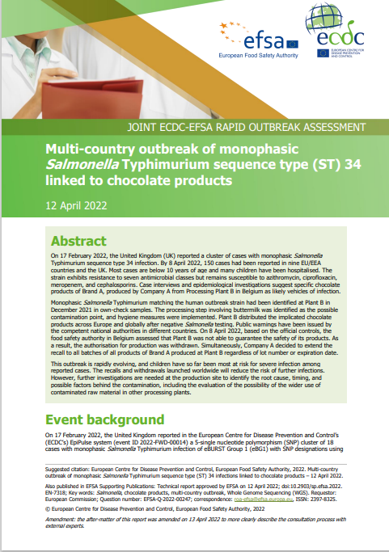
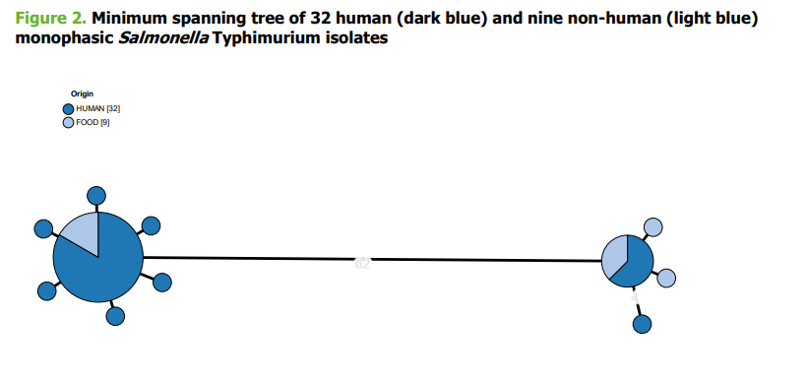
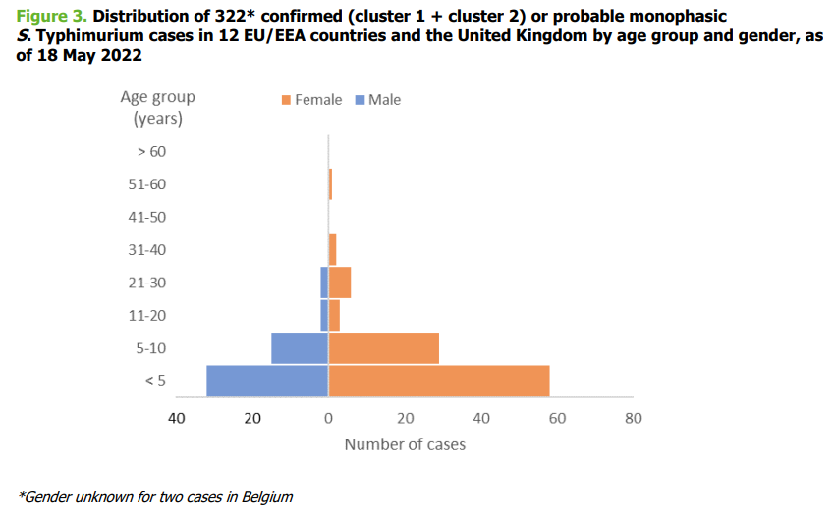
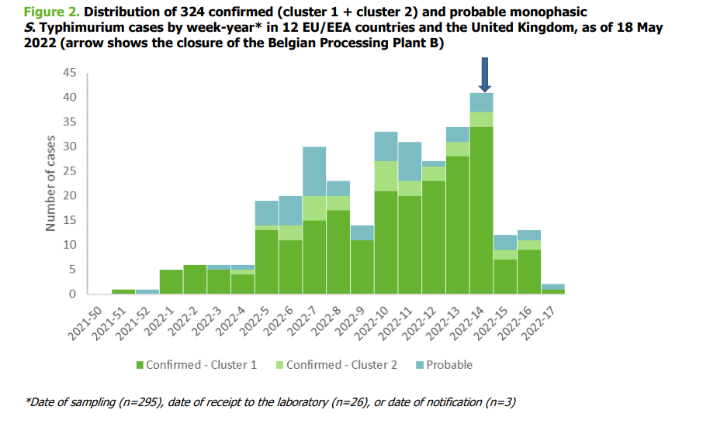
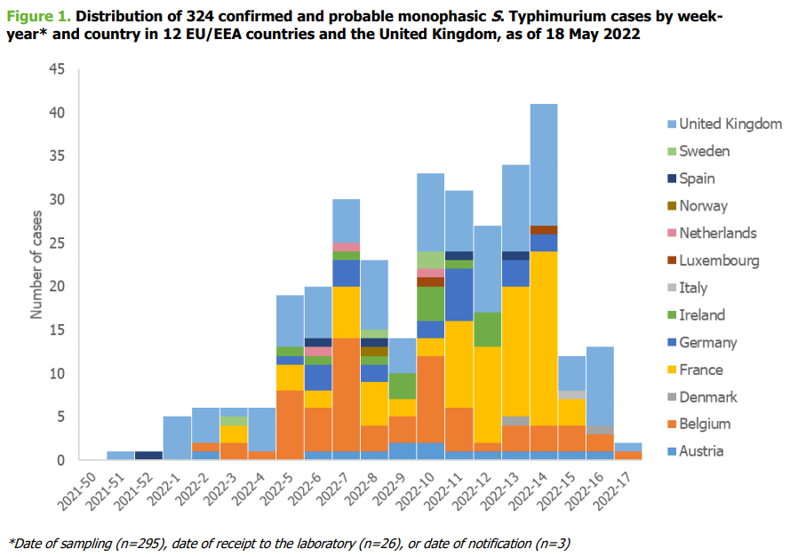
Outcome

Slide 9
Acknowledgements
This training material was created by ECDC with the direct involvement of Erik Alm, Rodrigo Felipe, Luca Freschi, Andreas Hoefer, Esther Kukielka Zunzunegui, Priyanka Nannapaneni and Maximilian Riess.

