Slide 1

A Primer of ECDC online tools
Bridging the gaps in Bioinformatics

Slide 2
ILOs
Explaining the importance and the usefulness of timely data sharing
Illustrating the purpose and basic functionalities of TESSy and EpiPulse
Illustrating the structure of an Epipulse event
Launching and updating an Epipulse event
Displaying genomic data and annotations on EpiPulse using the Molecular typing tool
Experimenting with Microreact
Reflecting on the added value of ECDC outputs

Slide 3


ECDC’s mission
identify, assess and report on current and emerging threats to human health from communicable diseases
provide recommendations for response at the EU and national levels (and at the regional level, if necessary)
In order to meet these goals ECDC has to collect, collate, evaluate and disseminate relevant scientific, epidemiological and genomic information
Notes:
Source: https://eur-lex.europa.eu/EN/legal-content/summary/european-centre-for-disease-prevention-and-control.html#:~:text=In%202022%2C%20the%20ECDC's%20mandate,the%20European%20Union%20(EU).

Slide 4
Which data do we collect?
Age | Gender | Clinical presentation
39 | M | Severe
26 | F | Mild
Epidemiological data
Erythromycin: Resistant
Tetracycline: Susceptible
[…]
Phenotypic data
>E1101_kpneumoniae
ATGCAAGCTGACTG…
Genomic data

Slide 5
What do we do with the data?
R
R
[HIGH]
S
Threat assessment Brief (TAB)
Rapid Risk assessment (RRA)
Rapid Outbreak Assessment (ROA)
Joint Notification Summary (JNS)
Epidemiological modelling
Genomic analyses and
annotations
✓
2023
Publications, datasets, trainings, …
Recommendations and guidelines
Annual epidemiological reports

Slide 6
Why all these outputs are important?
!
They are part of continuous dialogue and exchange of information between public-health institutions within Europe and beyond. This is required to face current and future threats.
✓
Long-term objective: strengthen Europe's defences against infectious diseases and contribute to make the world a safer place.

Slide 7
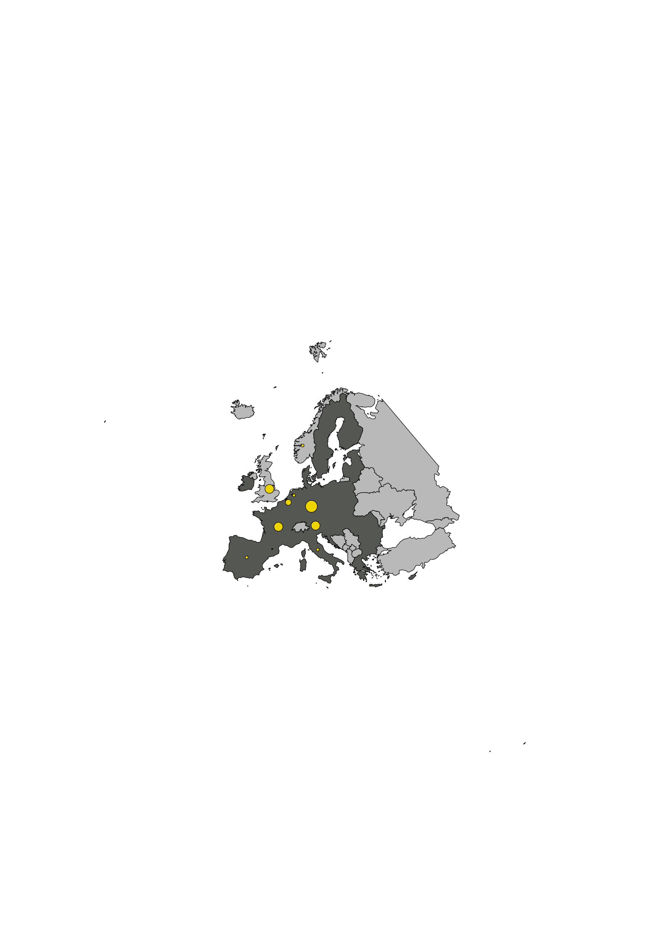
Different types of surveillance
!
Indicator-based surveillance
(e.g. sentinel surveillance)
Strategy-oriented surveillance
(e.g. structured surveys)
Event-based surveillance
(e.g. outbreaks)

Slide 8
How do we collect the data?
Designed for
TESSy
Collecting, analysing and disseminating surveillance data.
Collecting, analysing, sharing, and discussing infectious disease data for threat detection, monitoring, risk assessment and outbreak response. Data are shared on a voluntary basis.
Epipulse
Member States
EWRS
Formal notification of outbreaks, clusters and contact tracing data. Data are used for risk management.
ECDC SFTP
Genomic data upload (ad-hoc reporting, GDPR-compliant space).
ECDC upload app
Genomic and epidemiological data upload.

Slide 9
How do we collect the data?
Advantages and Challenges
TESSy
Structured data. Data submitter must fix data validation errors. Approvals needed.
Epipulse
Informal discussion, fast information turnover, low reporting threshold, cross-domain / cross-disciplinary collaboration. Complex and evolving tool.
Member States
EWRS
Direct communication channel among member states and with the EC. Formal communication channel.
ECDC SFTP
Ease-of-use, flexible access. Only for genomic data.
ECDC upload app
Genomic and epidemiological data upload. Software installation required.

Slide 10
ECDC ecosystem
ECDC bioinformatics platform
TESSy
AWS cloud
Epipulse
Epipulse
Bionumerics
Member States
EWRS
2023
SQL Databases
ECDC outputs
ECDC SFTP
ECDC upload app
!
Data access/visibility policies

Slide 11
TESSy (The European Surveillance System)
Main data source for indicator-based surveillance
Enables data standardization and harmonization
Allows the reporting of case-based or aggregated data
Policies in place to regulate data access/visibility
The format and type of data of all TESSy entries are defined by a “record type”.

Slide 12
An example of record type: RESPISURV
Record type | Variable | Description | Type | …
RESPISURV | RecordId | The record identifier is provided by the Member State[…] | TEXT | …
RESPISURV | Age | Age of patient in years as reported in the national system at the time of disease onset.[…] | NUM | …
RESPISURV | DateUsedForStatistics | […] date used by the national surveillance institute/organisation in reports and official statistics[…] | DATE | …
RESPISURV | Pathogen | […] primary pathogen identified. If multiple pathogens were identified, please use the variable Coinfection to specify the second pathogen. | CV | …
RESPISURV | IntensiveCare | Case required care in an intensive care unit or high dependency unit […] | CV | …
… | … | … | … | …
There are 171 different record types in TESSy (MetaDataSet 52, last update: 2023-04-14)
Some variables are mandatory, while others are optional
Pathogen coded values (CVs):
INFL = Influenza virus
MERS = MERS-CoV
O = Other
RSV = Respiratory syncytial virus
SARSCOV2 = SARS-CoV-2"
IntensiveCare coded values (CVs):
N = No
Unk = Unknown
Y = Yes"

Slide 13
Reporting a severe case of COVID-19 on TESSy
Step 1: choose the right record type. We will use RESPISURV
see MetaDataSet 52 for further information.
Step 2: collate the information (e.g. spreadsheet) and save in csv format
Step 3: upload to TESSy (nominated users). Notes: (1) You will go through data validation; (2) Your submission might need to be approved.

Slide 14
Further reading on TESSy
Information on TESSy available on the ECDC web site [link].
  How to access TESSy
  Detailed descriptions of all record types [link]

Slide 15
Epipulse (the European surveillance portal for infectious diseases)
ECDC platform for event-based surveillance
Also allows for continuous surveillance using WGS data (Molecular Typing tool)
allows interactions between public-health institutes and ECDC
designated officials from Member States can notify outbreaks / clusters
domains span all the infectious diseases covered by ECDC

Slide 16
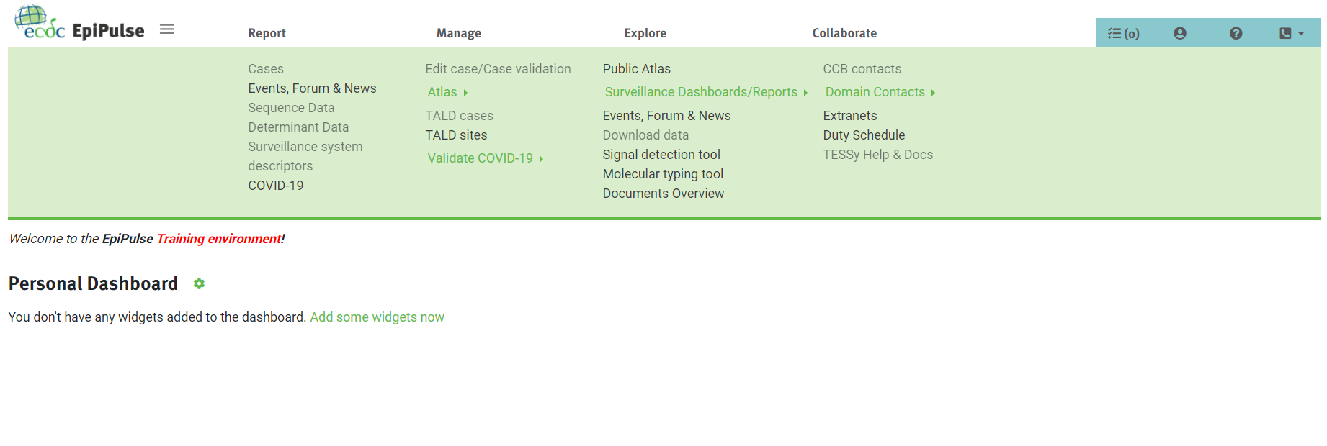
Epipulse home page

Slide 17
Epipulse home page
Epipulse menu

Slide 18

Epipulse menu
Click to show/hide the menu
Profile data and settings, Epipulse training materials, helpdesk
Today we will focus on these two tools
Four main actions

Slide 19
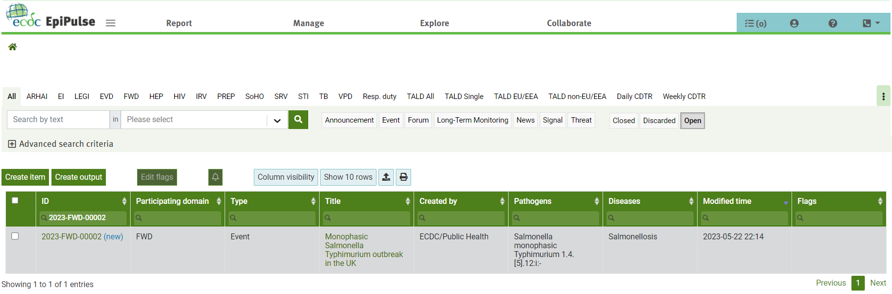
Epipulse events, forum and news page
Disease

Slide 20
Filter by domain
Filter by item type
Disease
Item ID (unique)
Event

Slide 21
Epipulse items
Signals: cases/clusters/outbreaks/incidents assessed as not posing a public health risk for the EU/EEA (originate from epidemic intelligence media monitoring or automated analyses of indicator-based surveillance data).
Events: cases/clusters/outbreaks/incidents that are assessed to pose or may pose a public health risk for the EU/EEA (Salmonella cluster reported by country X)
Threats: cases/clusters/outbreaks/incidents that are assessed to pose a public health risk for the EU/EEA and are of concern (e.g. new flu variant and high number of deaths).
Forum: questions or requests for which replies from the other users are expected (e.g. question on the specificity of a laboratory method)
News: communications or announcements (e.g. ECDC announcements, conferences and meetings)

Slide 22
Domains (explained!)
ARHAI: Antimicrobial Resistance and Healthcare-Associated Infections
EI: Epidemic Intelligence
LEGI: Legionella
EVD: Emerging Viral Diseases
FWD: Food- and Waterborne Diseases
HEP: Viral hepatitis
HIV: HIV/AIDS
IRV: Influenza and other Respiratory Viruses
PREP: Preparedness
SoHo: Substances of Human origin
SRV: General Surveillance
STI: Sexually transmitted infections
TB: Tuberculosis
VPD: Vaccine Preventable Diseases

Slide 23
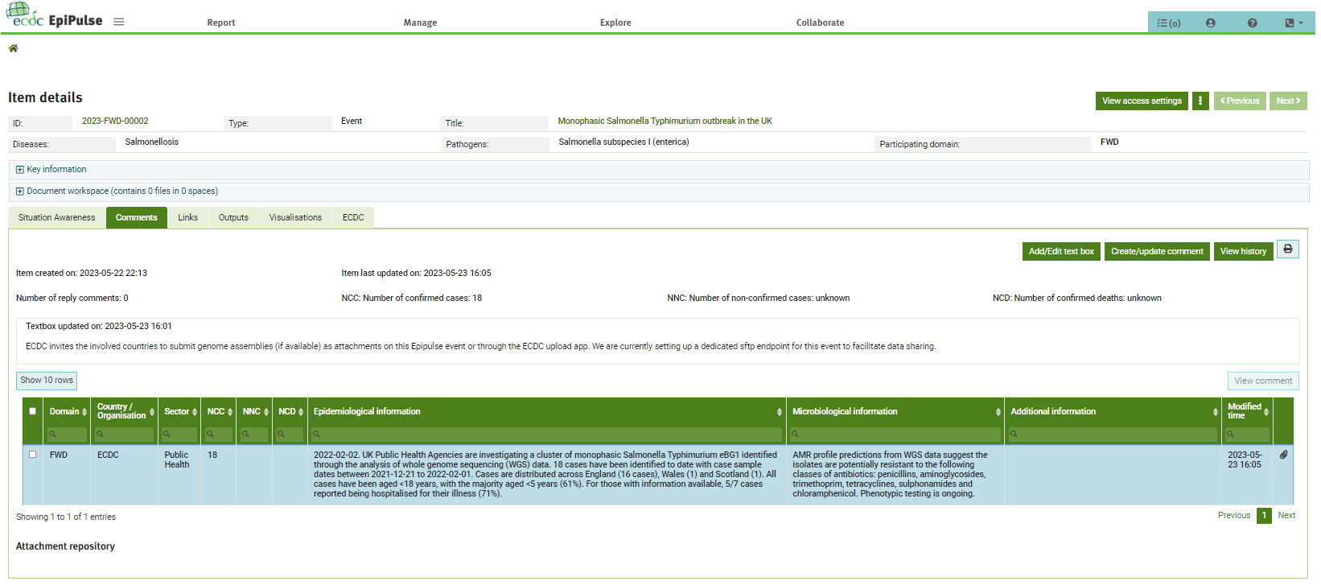
Epipulse events
ECDC event summary
Instructions
Comment #1
Attachment(s)

Slide 24
How to add a comment

Slide 25
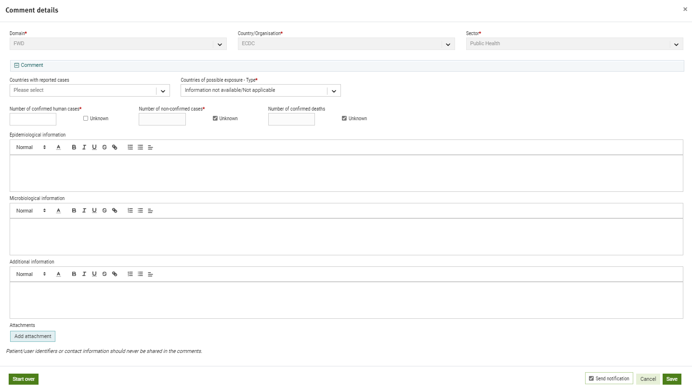
How to add a comment
Are case clusters emerging in specific groups/settings? Is there any relevant clinical information/epidemiological analysis that you feel is worth sharing?
Do you have any molecular typing data? Do you have any antimicrobial resistance profiles (phenotypic data or predictions from WGS data) for isolates involved in this event? Did you observe any issues with the diagnostics?
Which control measures are currently in place? Did you implement additional control measures?

Slide 26
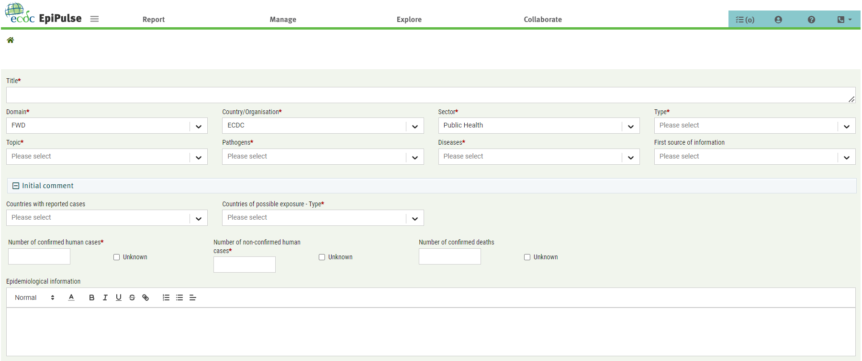
Epipulse: how to launch an event (1/2)
Path on Epipulse: > [Report tab] Events, Forum & News

Slide 27
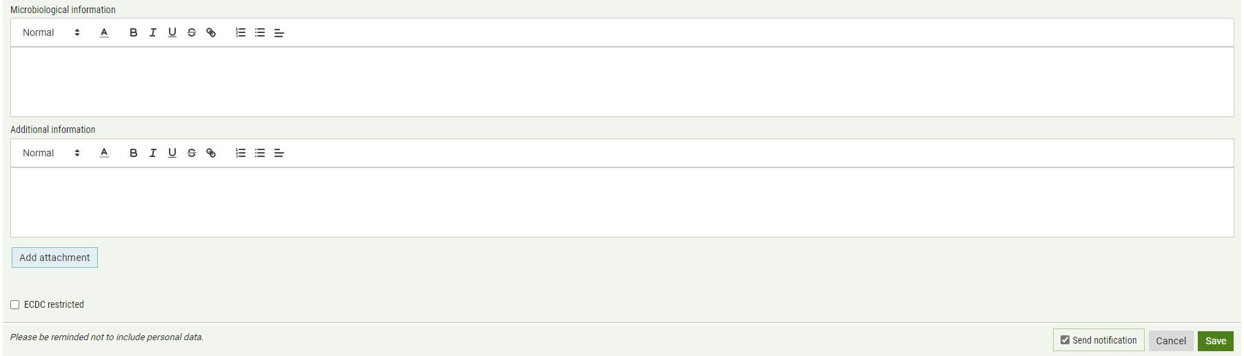
Epipulse: how to launch an event (2/2)
Path on Epipulse: > [Report tab] Events, Forum & News

Slide 28
Considerations on Epipulse events
General rule: fill the forms left to right, top to bottom. The options of drop-down lists sometimes depend on the content of previous fields.
Report relevant information in a succinct but clear way.
Remember that the aim of this tool is to encourage information sharing and informal discussions. Ask questions, share protocols and methods. Let’s organize together meetings or other activities to tackle public health threats.

Slide 29
Epipulse: the Molecular typing tool
When genomic sequences are shared with ECDC, they are automatically analysed to:
  find if they are genetically related to other known sequences (i.e. are part of a cluster) → can generate signals. Cut-offs to define clusters depend on the typing scheme used.
  generate antimicrobial resistance profile predictions
This is particularly relevant in the context of events / outbreaks.
The Molecular Typing tool is the Epipulse tool to visualize and analyse genetic clusters
It is possible to associate clusters identified by the Molecular Typing tool to Epipulse events

Slide 30
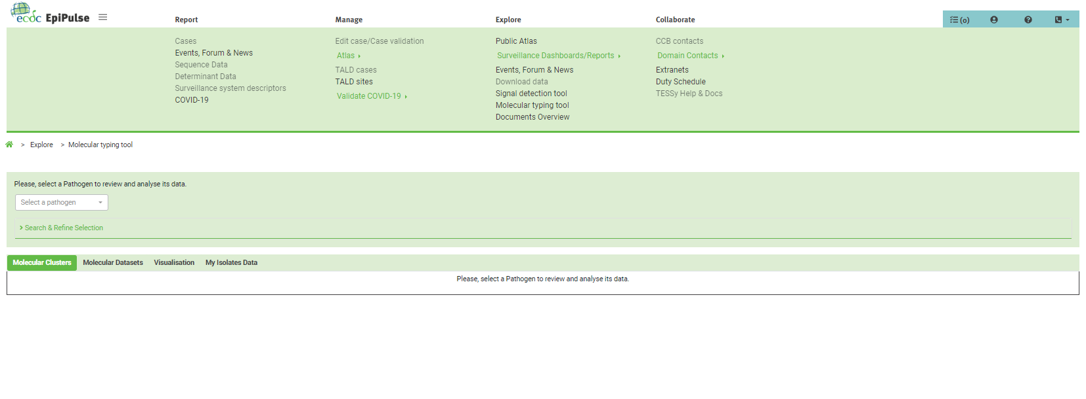
The Molecular typing tool
1.
2. Select a pathogen! In our case we select Salmonella.

Slide 31
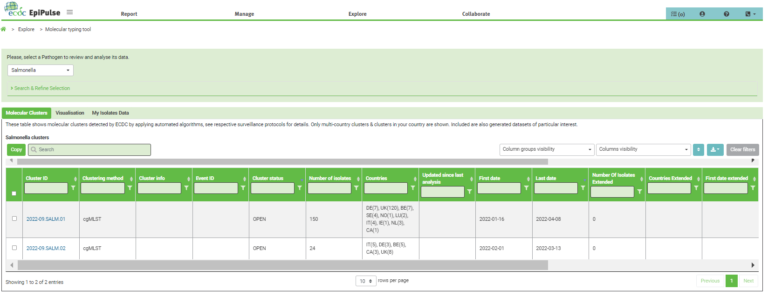
The Molecular typing tool: clusters
2023-FWD-00002
2023-FWD-00002

Slide 32
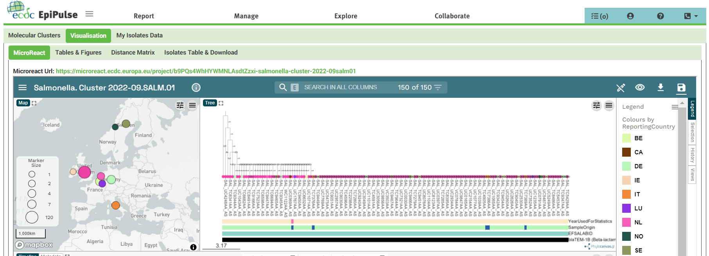
Exploring the cluster 2022-09.SALM.01
Microreact

Slide 33
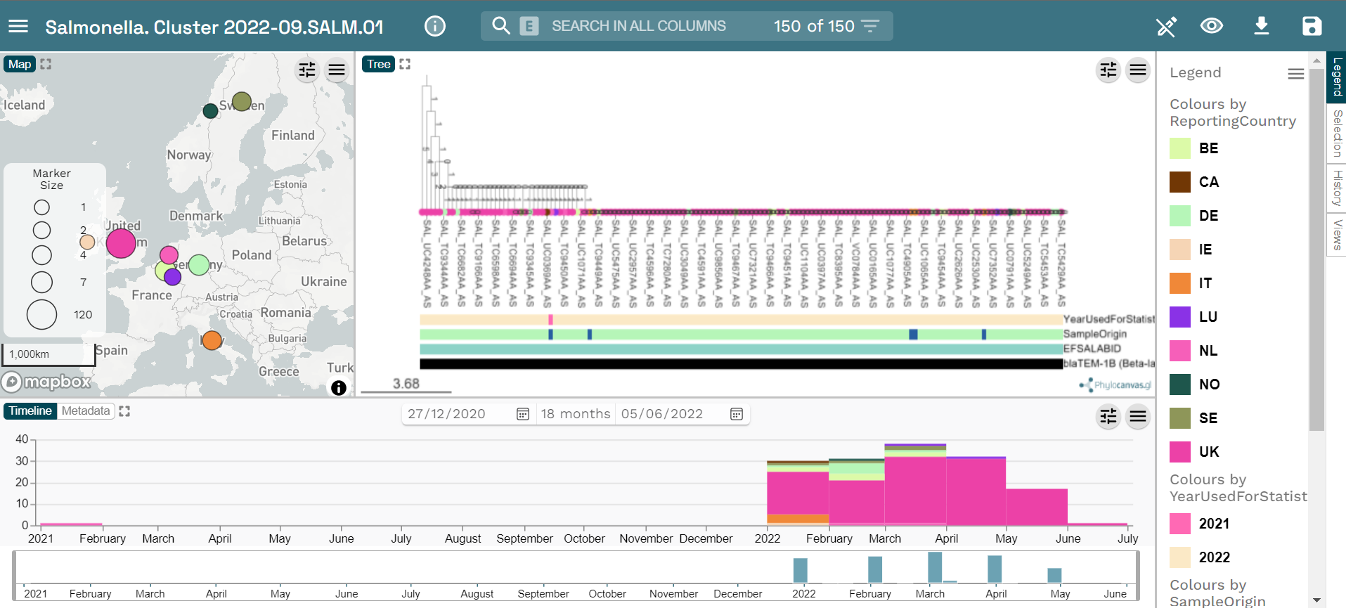
Microreact
Link: https://microreact.org/

Slide 34
Further reading on EpiPulse and Microreact
Epipulse training available on EVA
Microreact home page [link]

Slide 35
Epipulse flow
Country A launches the event 2022-FWD-00002
ECDC organizes an on-line meeting with the affected countries; ECDC provides sequencing support help characterizing the outbreak
Country B posts a comment
Risk Assessment update
Country C posts a comment
…
…
Country D posts a comment;
country A shares WGS data
Rapid Risk assessment
Scientific publication
ECDC publishes the situation awareness report; e-mail exchanges with country A about the event
ECDC shares WGS data analyses with the involved countries
ECDC updates the
situation awareness; phone calls with countries A and B; textbox with instructions
Notes:
https://eur-lex.europa.eu/EN/legal-content/summary/european-centre-for-disease-prevention-and-control.html#:~:text=In%202022%2C%20the%20ECDC's%20mandate,the%20European%20Union%20(EU).

Slide 36
How countries can benefit from using the ECDC tools
Get access to surveillance data, reports, guidelines
Participate to focused and informal discussions on public health threats
Get help to get, analyse and interpret public health data
Early signal detection
Molecular data are put in context and are enriched

Slide 37
A leap into the future
ECDC bioinformatics platform
Epipulse
Azure cloud
Epipulse
Epipulse cases
Member States
ECDC cloud genomic analysis pipelines
Epipulse events
2023
SQL Databases

Slide 38
Acknowledgements
This training material was created by ECDC with the direct involvement of Erik Alm, Rodrigo Felipe, Luca Freschi, Andreas Hoefer, Esther Kukielka Zunzunegui, Priyanka Nannapaneni and Maximilian Riess.

