Slide 1
Annotation and AMR
Day 7. Bridging the gaps in bioinformatics

Slide 2
Subjects this morning
Annotation
Full genome annotation
Functional annotation
How do we predict?
Kmer
Seed and extend
Identification of genes of interest
Database considerations
AMR
How to make your own database
Replicons
Notes:
Morning program

Slide 3
Example of workflow
DNA extraction
Sequencing
Raw data QC
Assembly
Sample selection
DNA QC
Library preparation
Sample prep
Assembly QC
Taxonomic analysis
AMR detection
Detection of VFs and MGEs
Subtyping
SNP-based phylogenetic analysis
Epidemiology
Conducted in parallel
Notes:
Brief overview of a workflow.
While we have not really dealt with the sample preparation and the sequencing steps (which I the first 7 steps here) they are of cause important for what we do subsequently with the produced read data.
So far you have taken a look at the raw data QC (both trimming and QC), assembly and SNP analysis.
Then you conduct another QC of the assembly, after which we are finally ready to conduct some annotation and analysis.
We could call these steps the preprocessing of the reads data, but some would likely include the annotation as part of the preprocessing as this is really the fundamental information we need to acquire to conduct meaningfull analysis.

Slide 4
Example of workflow
DNA extraction
Sequencing
Raw data QC
Assembly
Sample selection
DNA QC
Library preparation
Sample prep
Assembly QC
Taxonomic analysis
AMR detection
Detection of VFs and MGEs
Subtyping
SNP-based phylogenetic analysis
Epidemiology
Conducted in parallel
Covered today
Notes:
This is the subject of today,
We will type and annotate our isolates, continuing with the E. coli isolates you have been using so far.
These steps are not really a progression like the ones we have looked at before and can be conducted in parallel.
Afterwards further epidemiological studies can be conducted, but at that point we move into new territory, we are not going to deal with this today
So this work flow connects the Raw data QC to the annotation. The reason is that we do not have to wait for phylogeny or assembly to complete, we have the option to conduct some of the analysis already at thi step using the trimmed or raw reads.

Slide 5
Annotation
“The annotation process infers the structure and function of the assembled sequences. Protein-coding genes are often annotated first, but other features, such as non-coding RNAs or presence of regulatory or repetitive sequences, can also be annotated.” (Dominguez Del Angel et al, 2018)
Once we have the assembled the genome annotation is straight forward:
Conformation of species
Prediction of genes
Prediction of function
Conserved modules
Typing
Other features
If only certain features are of interest, we can use raw sequence data directly
ATGCGCGAT
EXG_123

Slide 6
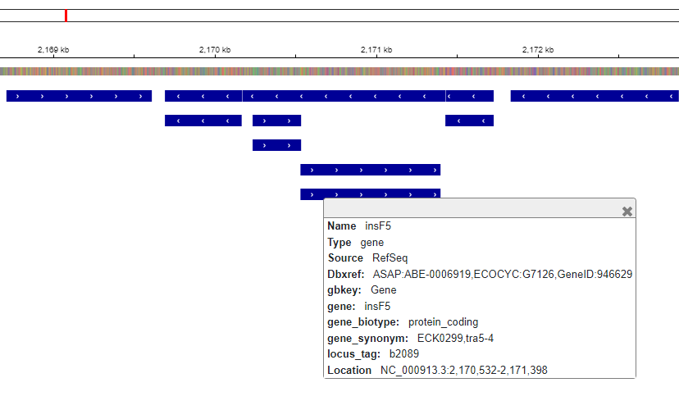
Full genome annotation
With Whole genome sequencing (WGS) we capture (almost) everything in the cell
Prokka: rapid prokaryotic genome annotation (GitHub - tseemann/prokka: Rapid prokaryotic genome annotation)
ANNOVAR: Higher organisms (ANNOVAR Documentation (openbioinformatics.org))
NCBI-PGAP: Prokaryotic annotation (NCBI Prokaryotic Genome Annotation Pipeline (nih.gov))
Predictive annotation: eggNOG-mapper (eggNOG-mapper (embl.de))
These pipelines usually generate multiple output files, which can be used for further data handling or visualization
There are multiple visualization tools, e.g. IGV, which can be installed locally or used online.
E. Coli strain K-12 from NCBI visualized with gff in IGV (IGV)

Slide 7
Data is everything
We can produce a lot of data, but is it useful?
Bioinformatics relies heavily on findings produced in the wet lab
We cannot prove biological functions purely in silico
We can make prediction based on previous findings
We can track changes down to the nucleotide level
We are limited by our databases
Some genes have no annotation information
Gene with unknown function, but recognized modules or motives
Pseudo genes
We are only interested in a small subset of information
If we are interested in a given subject, we can reduce the amount of data
In E. coli K-12 there are 4639 predicted genes of which 3 are related to AMR
Specialized databases
Simplifies analysis and clarifies message

Slide 8
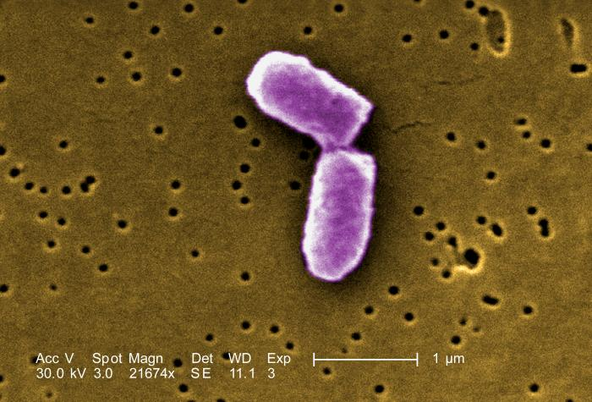
Data is everything
Translating classic biochemical methods to bioinformatics
Serotyping of E. coli is based on testing the O- and H-antigens with antisera
186 O-antigens and 53 H-flagellar antigens determines the serotype
Time consuming and sometimes inconclusive
O- and H- genes have been extracted and their associated phenotype determined
Predicting the Serotype based on genetic profile showed >98% concordance with phenotype
Analysis can be conducted in minutes rather than hours
It is still only an estimate
(Joensen et al., 2015, Fratamico et al., 2016)
E. coli in scanning electron microscopic image, CDC/ Evangeline Sowers, Janice Haney Carr, 2005, Public domain image, https://phil.cdc.gov/Details.aspx?pid=10042

Slide 9
Prediction of species
16s rRNA gene formed the basis as the first method for sequenced based taxonomy
Other approaches:
gyrB gene, rMLST, species-specific functional domain profiles
Shortcomings:
Only represents a small fraction of the entire genome
Today we have WGS data, better to ultilize the whole genome instead of just one gene for identification
16s rRNA gene

Slide 10
Prediction of species - Kmerfinder
With WGS we can use all the genetic information to predict the species
Kmerfinder works by breaking a genome into little pieces (k-mers) and identifying the species from these pieces (k-mers)

Slide 11
k-mers
A k-mer is a continuous sequence of k bases
e.g a certain length of DNA, RNA or protein
k is any positive integer
Sequences with high similarity must share k-mers
Consider the nucleotide sequence 'ACTCCGTAACG'.
We have this long sequence that we can cut into smaller pieces or k-mers
We can extract all the 4-mers (substrings of length 4) in this DNA sequence
A | C | T | C | C | G | T | A | A | C | G | T

Slide 12
k-mers
A | C | T | C | C | G | T | A | A | C | G | T
DNA sequence
A | C | T | C | C | G | T | A | A | C | G | T
A | C | T | C | C | G | T | A | A | C | G | T
A | C | T | C | C | G | T | A | A | C | G | T
A | C | T | C | C | G | T | A | A | C | G | T
4-mers
A | C | T | C | C | G | T | A | A | C | G | T
A | C | T | C | C | G | T | A | A | C | G | T
A | C | T | C | C | G | T | A | A | C | G | T
A | C | T | C | C | G | T | A | A | C | G | T

Slide 13
k-mers
We can extract all the 4-mers (substrings of length 4) in this DNA sequence.
We created a window of length 4 and slide it from left to right, shifting one character at a time.
If the length of a given DNA sequence is N, we end up with N - k+1 k-mers
Total number of k-mers = N – k + 1
In the previous slide, the DNA sequence is 11 characters long (N = 11) and k = 4, so we get eight k-mers (11- 4 + 1)

Slide 14
k-mers
A | C | T | C | C | G | T | A | A | C | G | T
DNA sequence
A | C | T | C | C | G | T | A | A | C | G | T
A | C | T | C | C | G | T | A | A | C | G | T
A | C | T | C | C | G | T | A | A | C | G | T
Eight k-mers where k=4
A | C | T | C | C | G | T | A | A | C | G | T
4-mers
A | C | T | C | C | G | T | A | A | C | G | T
A | C | T | C | C | G | T | A | A | C | G | T
A | C | T | C | C | G | T | A | A | C | G | T
A | C | T | C | C | G | T | A | A | C | G | T

Slide 15
Species prediction with k-mers
Sequences with high simlarity must share k-mers
We can break genomes up into k-mers and compare them
Genome A
Genome B

Slide 16
Species prediction with KmerFinder
Known species
Contains all known species from NCBI
Unknown species
A | C | T | G | A | A | C | G | T | G
A | C | T | G | A | A | C | G | T | A
A | C | T | G | A | A | C | G | T | G
A | C | T | G | A | A | C | G | T | G
A | C | T | G | A | A | C | G | T | G
A | C | T | G | A | A | C | G | T | G
A | C | T | G | A | A | C | G | T | G
Kmer
database
A | C | T | G | A | A | C | G | T | G
A | C | T | G | A | A | C | G | T | G
A | C | T | G | A | A | C | G | T | G
A | C | T | G | A | A | C | G | T | G
A | C | T | G | A | A | C | G | T | G
A | C | T | G | A | A | C | G | T | G
A | C | T | G | A | A | C | G | T | G
Species
A | C | T | G | A | A | C | G | T | G
A | C | T | G | A | A | C | G | T | A

Slide 17
Species prediction with KmerFinder
Genomes are spilt into 16-mers
But all these k-mers won't be in the database
Tool will take too long to compute
So redundant data is reduced
Only 16-mers with specific prefixes are kept e.g ATGAG
Reduced redundancy speeds up the tool
But how does the tool the compare k-mers?

Slide 18
k-mer alignment (KMA)
Reference db bacteria of known species (template)
Bact1
E. coli
Query bacteria of unknown species
Bact2
S. enterica
Bact3
k. pneumoniae
Bact4
S. aureus
Adapted from: Introduction to CGE tools, presentation by Pimpalas Leekitcharoenphon

Slide 19
KmerFinder webtool
https://cge.food.dtu.dk/services/KmerFinder/

Slide 20
Kmer webtool output
Source: Introduction to CGE tools, presentation by Pimpalas Leekitcharoenphon

Slide 21
Kmer webtool output
Source: Introduction to CGE tools, presentation by Pimpalas Leekitcharoenphon

Slide 22
Kmer webtool output
Source: Introduction to CGE tools, presentation by Pimpalas Leekitcharoenphon

Slide 23
Kmer webtool output
Source: Introduction to CGE tools, presentation by Pimpalas Leekitcharoenphon

Slide 24
Kmer webtool output
Source: Introduction to CGE tools, presentation by Pimpalas Leekitcharoenphon

Slide 25
Functional annotation AMR
Attaching biological, chemical or otherwise functional information to a DNA sequence
Often you are only interested in a limited set of genes, we will look further into AMR
AMR is a large threat to public health
Carried on mobile genetic elements (MGE) -> horizontal gene transfer
Estimated 1.27 million people died due to AMR in 2019 and estimated up to 10 million deaths by 2050 (Murray et al., 2019)
Development of new drugs is slow (Norrby et al., 2005)

Slide 26
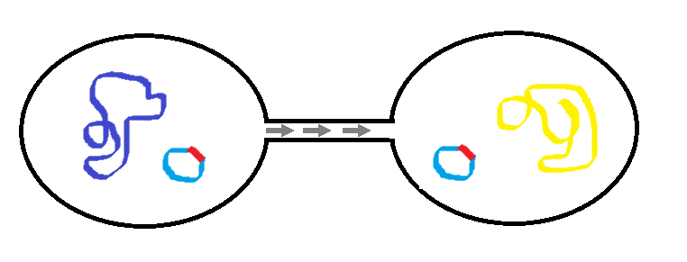
Genetic basis of AMR
AMR is conferred by different mechanisms:
Acquired resistance genes
Mutation
(Copy numbers)
MGEs can transfer resistance genes between isolates closely or distantly related
Resistance genes tend to aggregate, meaning MGEs often confer resistance to multiple classes
May integrate into host chromosome
Point mutations can confer resistance by various mechanisms:
Change the target of a drug, making the strain resistant
Upregulate the expression of a gene
Downregulate the expression of a gene
Change target specificity of protein
Usually species specific
Transfer of plasmid with resistance gene
Possible point mutation

Slide 27
Genetic basis of AMR
Note!
We also have intrinsic resistance in certain species, e.g. Mycobacterium tuberculosis inherently possess erm(37) protecting against macrolides, lincosamide and streptogramin
AMR is conferred by different mechanisms:
Acquired resistance genes
Mutation
(Copy numbers)
MGEs can transfer resistance genes between isolates closely or distantly related
Resistance genes tend to aggregate, meaning MGEs often confer resistance to multiple classes
May integrate into host chromosome
Point mutations can confer resistance by various mechanisms:
Change the target of a drug, making the strain resistant
Upregulate the expression of a gene
Downregulate the expression of a gene
Change target specificity of protein
Usually species specific
Transfer of plasmid with resistance gene
Possible point mutation

Slide 28
AMR tools and databases
There are multiple tools which all utilize their own and/or each others databases for predicting antimicrobial resistance
Resfinder (ResFinder 4.1 (dtu.dk)), AMRfinderplus (Releases · ncbi/amr (github.com)) , CARD (https://card.mcmaster.ca/home), KmerResistance, ARIBA
Differences exists due to
How the database is created and curated
How the database is maintained
How the tool conducts its search
The correct tool/database will likely depend on the type of analysis or workflow you are using
Approach results from tools with a critical mindset!

Slide 29
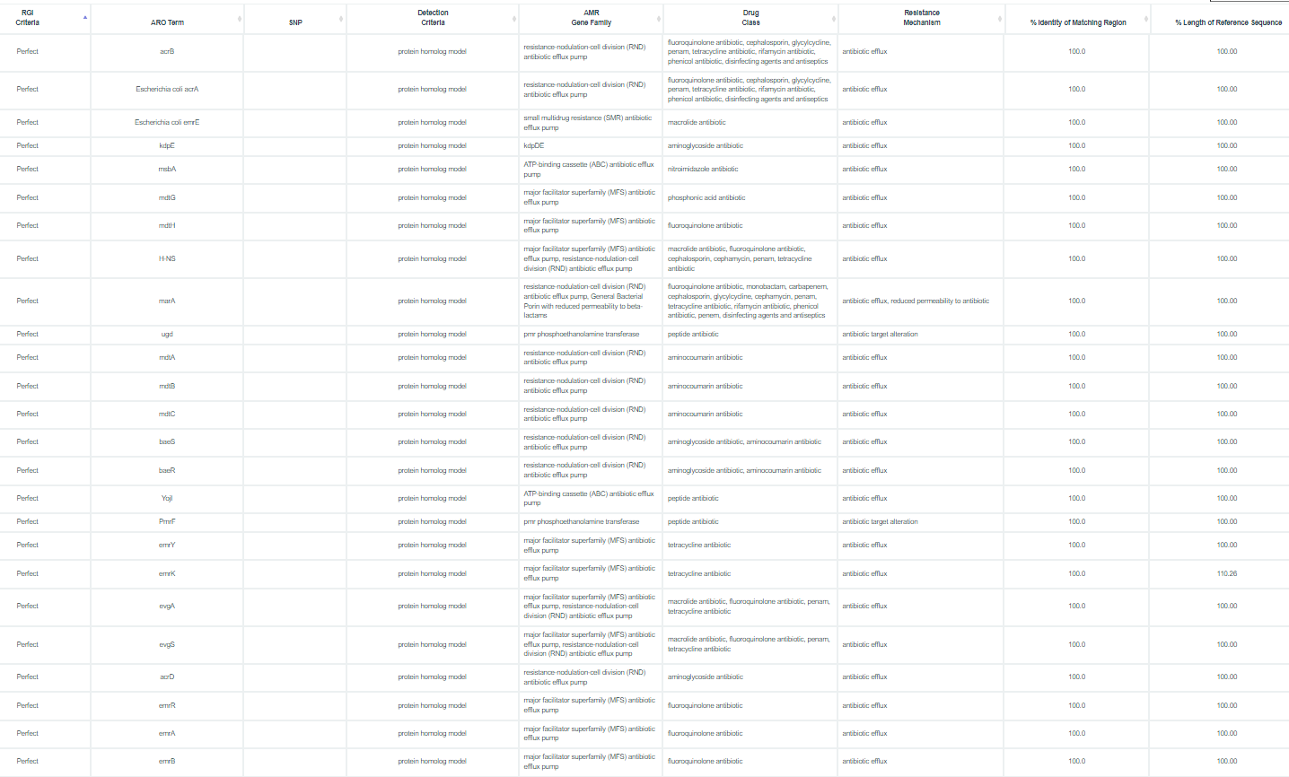
EXAMPLE
CARD output:
Data was complete genome of E. Coli strain
44 hits in total!
Let us take a closer look

Slide 30
EXAMPLE CARD output:
EmrY, emrK and emrB
Perfect hits!
Expect for emrK, ID and COV are 100%
Should we expect resistance to tetracycline and fluoroquinolones in this isolate?

Slide 31
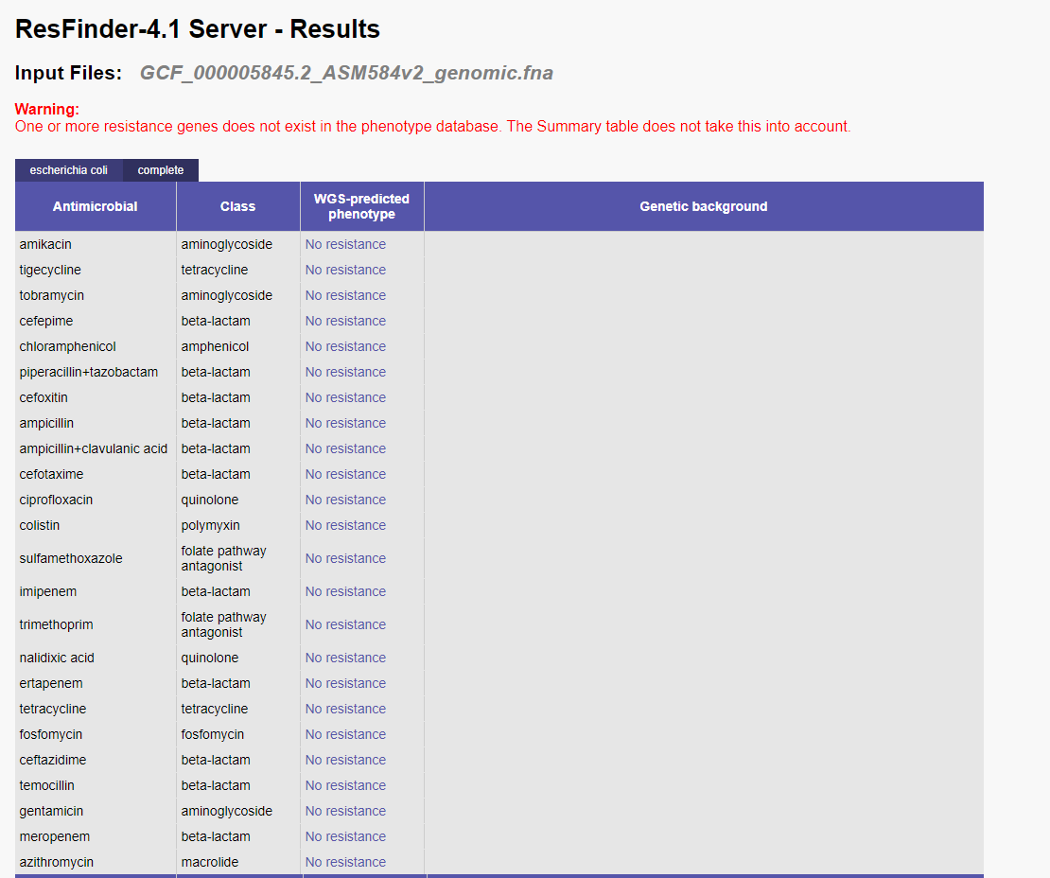
Lets try a different tool for the strain: ResFinder
No resistance at all?

Slide 32
Lets try a different tool for the strain: ResFinder
No resistance at all?
No resistance to tetracycline or quinolones?

Slide 33
Lets try a different tool for the strain: ResFinder
No resistance at all?
No resistance to tetracycline or quinolones?
One tool gives 44 hits, another gives 0 what is the truth?

Slide 34
Differences in output example
The strain run in this example is a standard laboratory strain E. coli K-12 substrain MG1655
It is not expected to have any phenotypic resistance to tetracycline (Zhang et al., 2022)
Not actually expected to have any particular phenotypic resistance different from wild-type e. coli
If run on AMRfinderplus, no resistance genes are found either.
Approach databases with care and select based on your scope
How does results translate to the laboratory, genotypic =/= phenotypic
How much expertise is demanded to utilize findings
What is the aim of your analysis

Slide 35
Resfinder
Refinder is a tool and database for detection of genes and point mutations conferring AMR.
The tool has (3) databases:
Poinfinder_db
Resfinder_db
(DesinFinder_db)
Source: Genotypic detection of AMR in Salmonella, presentation by Ana Rita Rebelo

Slide 36
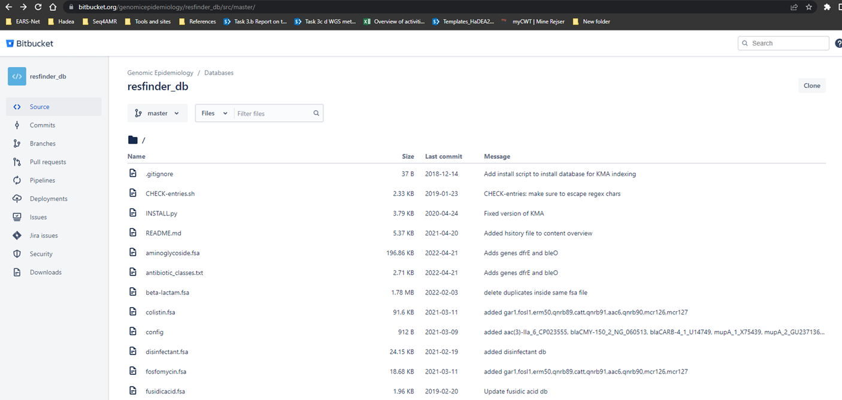
Resfinder
The tool and databases are freely available on github
The main page contains instructions for installation of the tool and how to download and install the associated databases
We will be using this tool today
Source: Genotypic detection of AMR in Salmonella, presentation by Ana Rita Rebelo

Slide 37
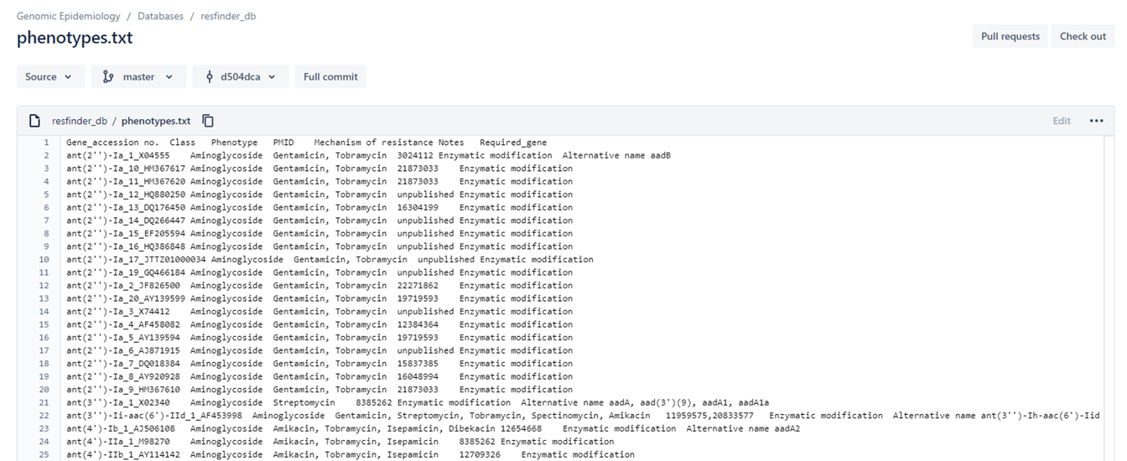
Resfinder
The databases contain:
Nucleotide references for AMR elements
Curation for each genes
Phenotypes associated with specific species
We can get:
Class of AMR gene
Specific phenotypes
Supporting sources
Mechanism
Other notes
Source: Genotypic detection of AMR in Salmonella, presentation by Ana Rita Rebelo

Slide 38
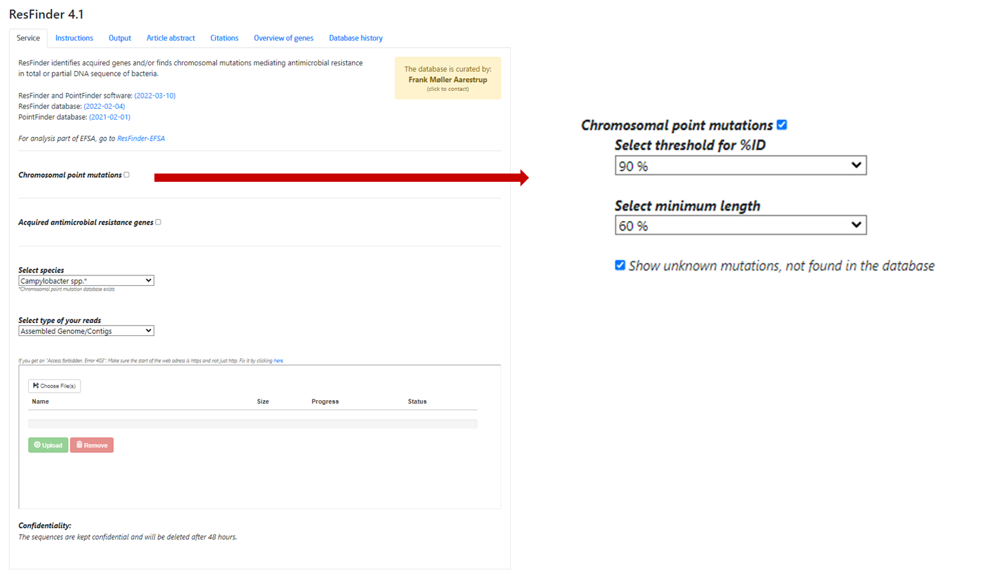
Resfinder
The tool is also available online, where isolates can be uploaded
The stand-alone tool utilize the same inputs, as we will find out in the exercises
Select the databases to use
Choose thresholds for ID and COV
Provide species
Specify input format
Give input files
Source: Genotypic detection of AMR in Salmonella, presentation by Ana Rita Rebelo

Slide 39
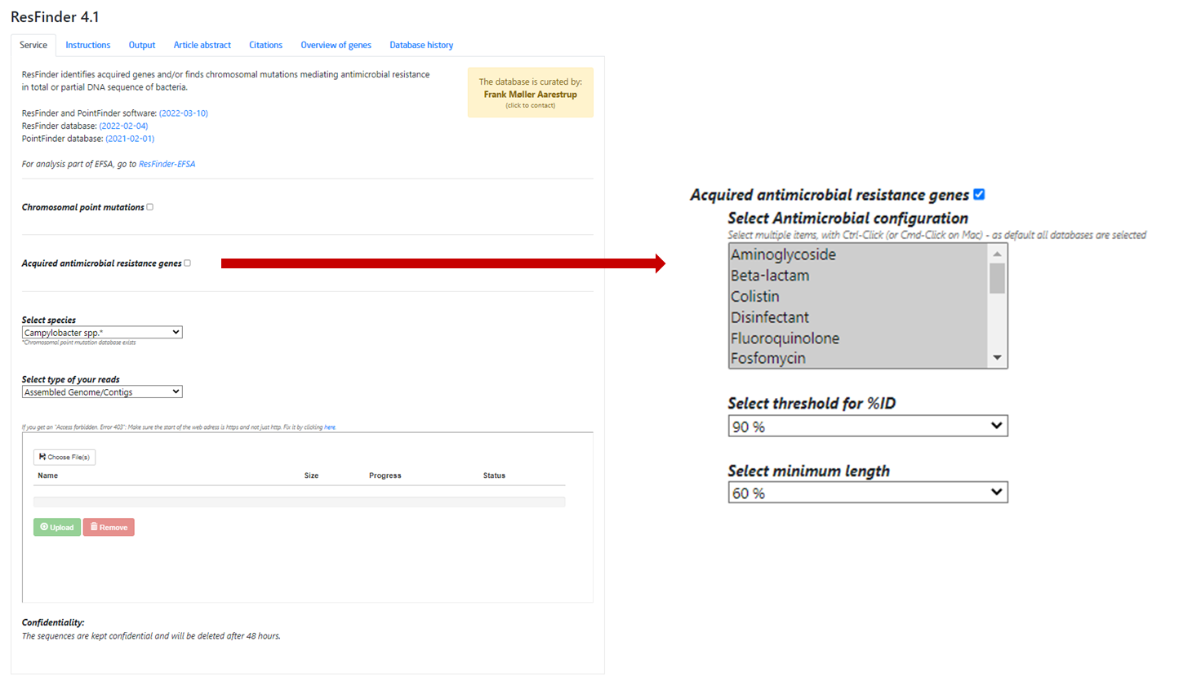
Resfinder
The tool is also available online, where isolates can be uploaded
The stand-alone tool utilize the same inputs, as we will find out in the exercises
Select the databases to use
Choose thresholds for ID and COV
Provide species
Specify input format
Give input files
For AMR genes, specific class can be chosen
Source: Genotypic detection of AMR in Salmonella, presentation by Ana Rita Rebelo

Slide 40
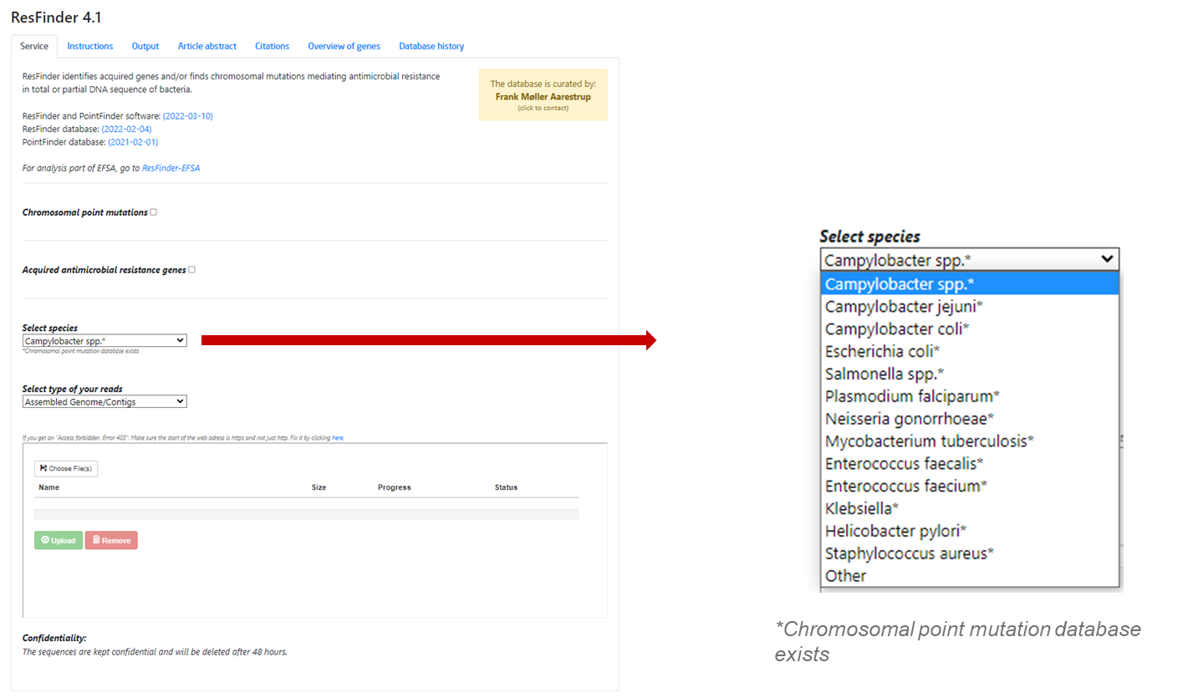
Resfinder
Species are neccesary for point mutations
Not all species are present
"Other" allows us to search for AMR genes
Source: Genotypic detection of AMR in Salmonella, presentation by Ana Rita Rebelo

Slide 41
ID and COV
What is identity (ID)?
Proportion of matching nucleotides:
What is coverage/length (COV)?
Proportion of nucleotides covered:
Ref
Iso
9/10 bp align = 90% ID
Ref
Iso
7/10 bp covered = 70% COV, 6/10 bp align = 60% ID

Slide 42
Note on databases
Make your own database!
MyDBFinder (https://cge.food.dtu.dk/services/MyKMAfinder/)
MyKMAFinder (https://cge.food.dtu.dk/services/MyDbFinder/)
NCBI-Blast (BLAST+ executables — BLASTHelp documentation (nih.gov))
Organize genes of interest into a fasta file
Upload to online solution
Make blast database with makeblastdb (part of standalone blast tools)
Large range of customization
Better options likely exist for larger datasets

Slide 43
Acknowledgements
The creation of this training material was commissioned by ECDC to Statens Serum Institut (SSI) and produced by The National Food Institute at the Technical University of Denmark (DTU) with the direct involvement of Lauge Holm Sørensen and Niamh Lacy-Roberts

Slide 44
References
Dominguez Del Angel V, Hjerde E, Sterck L et al. Ten steps to get started in Genome Assembly and Annotation [version 1; peer review: 2 approved]. F1000Research 2018, 7(ELIXIR):148 (https://doi.org/10.12688/f1000research.13598.1)
Murray, Christopher J. L., et al. “Global Burden of Bacterial Antimicrobial Resistance in 2019: a Systematic Analysis.” Lancet, vol. 399, no. 10325, Elsevier B.V., 2022, pp. 629–55, doi:10.1016/S0140-6736(21)02724-0.
Norrby, S. Ragnar, et al. “Lack of Development of New Antimicrobial Drugs: A Potential Serious Threat to Public Health.” Lancet Infectious Diseases, vol. 5, no. 2, Lancet Publishing Group, 2005, pp. 115–19, doi:10.1016/S1473-3099(05)70086-4.
Zhang, P., Mao, D., Gao, H. et al. Colonization of gut microbiota by plasmid-carrying bacteria is facilitated by evolutionary adaptation to antibiotic treatment. ISME J 16, 1284–1293 (2022). https://doi.org/10.1038/s41396-021-01171-x
Fratamico PM, DebRoy C, Liu Y, Needleman DS, Baranzoni GM, Feng P. Advances in Molecular Serotyping and Subtyping of Escherichia coli. Front Microbiol. 2016 May 3;7:644. doi: 10.3389/fmicb.2016.00644. PMID: 27199968; PMCID: PMC4853403.
Joensen, Katrine Grimstrup, et al. “Rapid and Easy In Silico Serotyping of Escherichia Coli Isolates by Use of Whole-Genome Sequencing Data.” Journal of Clinical Microbiology, edited by K. C. Carroll, vol. 53, no. 8, American Society for Microbiology, 2015, pp. 2410–26, doi:10.1128/JCM.00008-15.

