Slide 1
GenEpi-BioTrain – Virtual Training 7
Sequence alignment in theory and practice
Thor Bech Johannesen
Sequencing and Bioinformatics
Department of Bacteria, Parasites and Fungi
Statens Serum Institut, Copenhagen, Denmark

Slide 2
ILOs
Understand the purpose of sequence alignment and what we use alignments for
Understand how alignments are calculated, substitution matrices and gap penalties
Understand how global alignments are created in practice; the Needleman-Wunsch algorithm
Use two common command line alignment tools, Muscle and Mafft to create multiple sequence alignments
Use Snippy to generate a core genome alignment from assemblies

Slide 3
Intended learning outcomes
Understand when and why we need to perform sequence alignments
Describe the different uses of global sequence alignment, local sequence alignment, and multiple sequence alignment (MSA)
Understand how alignments are calculated and the meaning of substitution matrices and gap penalties
Understand how a pairwise sequence alignment is generated in practice; the Needleman-Wunsch algorithm
Use two common command line alignment tools, Muscle and Mafft to create multiple sequence alignments
Use Basic Local Alignment Tool (Blast) on command line
Use Snippy to generate a core genome alignment from reads and assemblies

Slide 4
The format of todays session
A short introduction to sequence alignment

Slide 5
Data used in this Virtual Training
The data used for the exercises in these training sessions can be downloaded from EVA or github
How to acquire it is detailed
A fasta file containing the v3-v4 region of the 16s rRNA gene extracted from 14 isolates from various species
Paired-end Illumina reads from 22 Listeria monocytogenes isolates from an outbreak investigation
Genome assemblies generated from those read data
Various metadata for the Listeria monocytogenes 22 isolates

Slide 6
A quick note on kmers
Q: Why are we so fond of using kmers in bioinformatics?
A: Because they are incredibly computationally efficient
Consider this particular 5mer AGCAT
How many 5mers exist that are exactly identical to this 5mer?
What if we allow one (1) mismatch? How many 5mers exist that have at most one mismatch relative to AGCAT?

Slide 7
Why do we do sequence alignment?
To investigate evolutionary relationships
- By looking for conserved patterns
To find common motifs between sequences
- Identify the same gene in different isolates or species
- Identify similar structures that appear in different genes
To identify genes in an isolate by matching them to a database

Slide 8
Why do we do sequence alignment?
Global sequence alignment
Align the full length of two similar sequences
Multiple sequence alignment (MSA)
Align the full length of multiple sequences
Local sequence alignment (f.x BLAST)
Identify similar regions in sequences, and align those regions

Slide 9
Sequence alignment, how?
Have a look at the letters and composition of these names
Would you say any of them are similar?
KARSTEN
THOR
ASTRID
KIRSTEN
TORSTEN
KASPER
KIRSTINE

Slide 10
Global sequence alignment
Aim: to find the best alignment over the entire length of two sequences
How do we quantify the “goodness” of an alignment?
KIRSTEN
| |||||
KARSTEN
KIRSTEN
|||||
TORSTEN

Slide 11
Global sequence alignment
Aim: to find the best alignment over the entire length of two sequences
How do we quantify the “goodness” of an alignment?
By a pre-defined
Scoring scheme:
F. ex.:
Match = +1
Mismatch = -1
KIRSTEN
| |||||
KARSTEN
KIRSTEN
|||||
TORSTEN
6 match
1 mismatch
5 match
2 mismatch
Score = 6-1 = 5
Score = 5-2 = 3

Slide 12
Global sequence alignment
If all we had to do was count matches and mismatches, this would be trivial
But we also have to account for insertions and deletions
Scoring scheme:
Match = +1
Mismatch = -1
Gap = -1
KARSTEN
||
KASPER-
KARSTEN
|| | |
KA-SPER
2 match
4 mismatch
1 gap
3 match
3 mismatch
1 gap
Score = 2-4-1 = -3
Score = 3-3-1 = -1

Slide 13
Global sequence alignment of DNA
We can further optimize our scoring system by using a substitution matrix instead of simply looking at match/mismatch
Substitution matrix with even weights
(Match = +1, mismatch = -1, just as before)
Weighted substitution matrix were purine <-> pyrimidine mutations are penalized more than purine <-> purine and pyrimidine <-> pyrimidine
 | C | T | A | G
C | 1 | -1 | -1 | -1
T | -1 | 1 | -1 | -1
A | -1 | -1 | 1 | -1
G | -1 | -1 | -1 | 1
 | C | T | A | G
C | 2 | 1 | -1 | -1
T | 1 | 2 | -1 | -1
A | -1 | -1 | 2 | 1
G | -1 | -1 | 1 | 2

Slide 14
Sequence alignment?
Score this alignment using the weighted matrix
(and a gap penalty of -2)
AT-CTTG
ATGCTGG
 | C | T | A | G
C | 2 | 1 | -1 | -1
T | 1 | 2 | -1 | -1
A | -1 | -1 | 2 | 1
G | -1 | -1 | 1 | 2

Slide 15
Sequence alignment?
Score this alignment using the weighted matrix
(and a gap penalty of -2)
AT-CTTG
ATGCTGG
 | C | T | A | G
C | 2 | 1 | -1 | -1
T | 1 | 2 | -1 | -1
A | -1 | -1 | 2 | 1
G | -1 | -1 | 1 | 2
2+2-2+2+2-1+2 = +7

Slide 16
The Needleman-Wunsch algorithm
ATGCTCG
ATCTTG
 | C | T | A | G
C | 2 | 1 | -1 | -1
T | 1 | 2 | -1 | -1
A | -1 | -1 | 2 | 1
G | -1 | -1 | 1 | 2
Start in the top left corner
For each field (M_{i,j}), calculate three scores (C)
Deletion score:
C_{del}(M_{i,j}) = C(M_{i,j-1}) + GapPenalty
Insertion score:
C_{ins}(M_{i,j}) = C(M_{i-1,j}) + GapPenalty
Match score:
C_{match}(M_{i,j}) = C(M_{i-1,j-1}) + SubstitutionPenalty
Then fill out the field with whichever score is the best:
C = max(C_{del},C_{ins},C_{match})
Gap penalty = -2
 |  | A | T | G | C | T | C | G
 | 0
A
T
C
T
T
G

Slide 17
The Needleman-Wunsch algorithm
ATGCTCG
ATCTTG
 |  | A | T | G | C | T | C | G
 | 0 | -2 | -4 | -6 | -8 | -10 | -12 | -14
A | -2 | ?
T | -4
C | -6
T | -8
T | -10
G | -12
 | C | T | A | G
C | 2 | 1 | -1 | -1
T | 1 | 2 | -1 | -1
A | -1 | -1 | 2 | 1
G | -1 | -1 | 1 | 2
Gap penalty = -2
C_{del}=
C(M_{i,j-1}) + GapPenalty =
-2-2 = -4
C_{ins}=
C(M_{i-1,j}) + GapPenalty =
-2-2 = -4
C_{match}=
C(M_{i-1,j-1}) + SubstitutionPenalty =
0 + 2 = 2
Left score
Top score
Diagonal score

Slide 18
The Needleman-Wunsch algorithm
ATGCTCG
ATCTTG
 |  | A | T | G | C | T | C | G
 | 0 | -2 | -4 | -6 | -8 | -10 | -12 | -14
A | -2 | 2
T | -4
C | -6
T | -8
T | -10
G | -12
 | C | T | A | G
C | 2 | 1 | -1 | -1
T | 1 | 2 | -1 | -1
A | -1 | -1 | 2 | 1
G | -1 | -1 | 1 | 2
Gap penalty = -2

Slide 19
The Needleman-Wunsch algorithm
ATGCTCG
ATCTTG
 |  | A | T | G | C | T | C | G
 | 0 | -2 | -4 | -6 | -8 | -10 | -12 | -14
A | -2 | 2
T | -4
C | -6
T | -8
T | -10
G | -12
 | C | T | A | G
C | 2 | 1 | -1 | -1
T | 1 | 2 | -1 | -1
A | -1 | -1 | 2 | 1
G | -1 | -1 | 1 | 2
Gap penalty = -2

Slide 20
The Needleman-Wunsch algorithm
ATGCTCG
ATCTTG
 |  | A | T | G | C | T | C | G
 | 0 | -2 | -4 | -6 | -8 | -10 | -12 | -14
A | -2 | 2 | ?
T | -4
C | -6
T | -8
T | -10
G | -12
 | C | T | A | G
C | 2 | 1 | -1 | -1
T | 1 | 2 | -1 | -1
A | -1 | -1 | 2 | 1
G | -1 | -1 | 1 | 2
Gap penalty = -2
C_{del}=
C(M_{i,j-1}) + GapPenalty =
2 - 2 = 0
C_{ins}=
C(M_{i,j-1}) + GapPenalty =
-4 - 2 = -6
C_{match}=
C(M_{i-1,j-1}) + SubstitutionPenalty =
-2 - 1 = -3

Slide 21
Exercise: Needleman-Wunsch algorithm
ATGCTCG
ATCTTG
 |  | A | T | G | C | T | C | G
 | 0 | -2 | -4 | -6 | -8 | -10 | -12 | -14
A | -2 | 2 | 0
T | -4
C | -6
T | -8
T | -10
G | -12
 | C | T | A | G
C | 2 | 1 | -1 | -1
T | 1 | 2 | -1 | -1
A | -1 | -1 | 2 | 1
G | -1 | -1 | 1 | 2
Gap penalty = -2

Slide 22
Exercise: Needleman-Wunsch algorithm
ATGCTCG
ATCTTG
 |  | A | T | G | C | T | C | G
 | 0 | -2 | -4 | -6 | -8 | -10 | -12 | -14
A | -2 | 2 | 0 | -2
T | -4 | 0 | 4
C | -6 | -2
T | -8
T | -10
G | -12
 | C | T | A | G
C | 2 | 1 | -1 | -1
T | 1 | 2 | -1 | -1
A | -1 | -1 | 2 | 1
G | -1 | -1 | 1 | 2
Gap penalty = -2
Now try for yourself!

Slide 23
Exercise: Needleman-Wunsch algorithm
ATGCTCG
ATCTTG
 |  | A | T | G | C | T | C | G
 | 0 | -2 | -4 | -6 | -8 | -10 | -12 | -14
A | -2 | 2 | 0 | -2
T | -4 | 0 | 4
C | -6 | -2 | ?
T | -8
T | -10
G | -12
 | C | T | A | G
C | 2 | 1 | -1 | -1
T | 1 | 2 | -1 | -1
A | -1 | -1 | 2 | 1
G | -1 | -1 | 1 | 2
Gap penalty = -2
C_{del}=
C(M_{i,j-1}) + GapPenalty =
C_{ins}=
C(M_{i,j-1}) + GapPenalty =
C_{match}=
C(M_{i-1,j-1}) + SubstitutionPenalty =
-2 - 2 = -4
4 - 2 = 2
0 + 1 = 1

Slide 24
Exercise: Needleman-Wunsch algorithm
ATGCTCG
AT-CTTG
 |  | A | T | G | C | T | C | G
 | 0 | -2 | -4 | -6 | -8 | -10 | -12 | -14
A | -2 | 2 | 0 | -2 | -4 | -6 | -8 | -10
T | -4 | 0 | 4 | 2 | 0 | -2 | -4 | -6
C | -6 | -2 | 2 | 3 | 4 | 2 | 0 | -2
T | -8 | -4 | 0 | 1 | 4 | 6 | 4 | 2
T | -10 | -6 | -2 | -1 | 2 | 6 | 7 | 5
G | -12 | -8 | -4 | 0 | 0 | 4 | 5 | 9
 | C | T | A | G
C | 2 | 1 | -1 | -1
T | 1 | 2 | -1 | -1
A | -1 | -1 | 2 | 1
G | -1 | -1 | 1 | 2
Gap penalty = -2

Slide 25
Needleman-Wunsh: The traceback
A
|
A
T
|
T
G
-
C
|
C
T
|
T
C
T
G
|
G
 |  | A | T | G | C | T | C | G
 | done | left | left | left | left | left | left | left
A | up | diag | left | left | left | left | left | left
T | up | up | diag | left | left | diag | left | left
C | up | up | up | diag | diag | left | diag | left
T | up | up | diag | diag | diag | diag | left | left
T | up | up | diag | diag | diag | diag | diag | left
G | up | up | up | diag | up | up | diag | diag

Slide 26
Multiple sequence alignments
Multiple sequence alignment is considerably more complex
than pairwise alignment
We will focus on the practical use rather than another hour of theory
KIRSTEN
KARSTEN
TORSTEN
KASPER
THOR
KIRSTINE
ASTRID
K-IRSTEN-
K-ARSTEN-
T-ORSTEN-
K-A-SPER-
THOR-----
KIR-STINE
--A-STRID

Slide 27
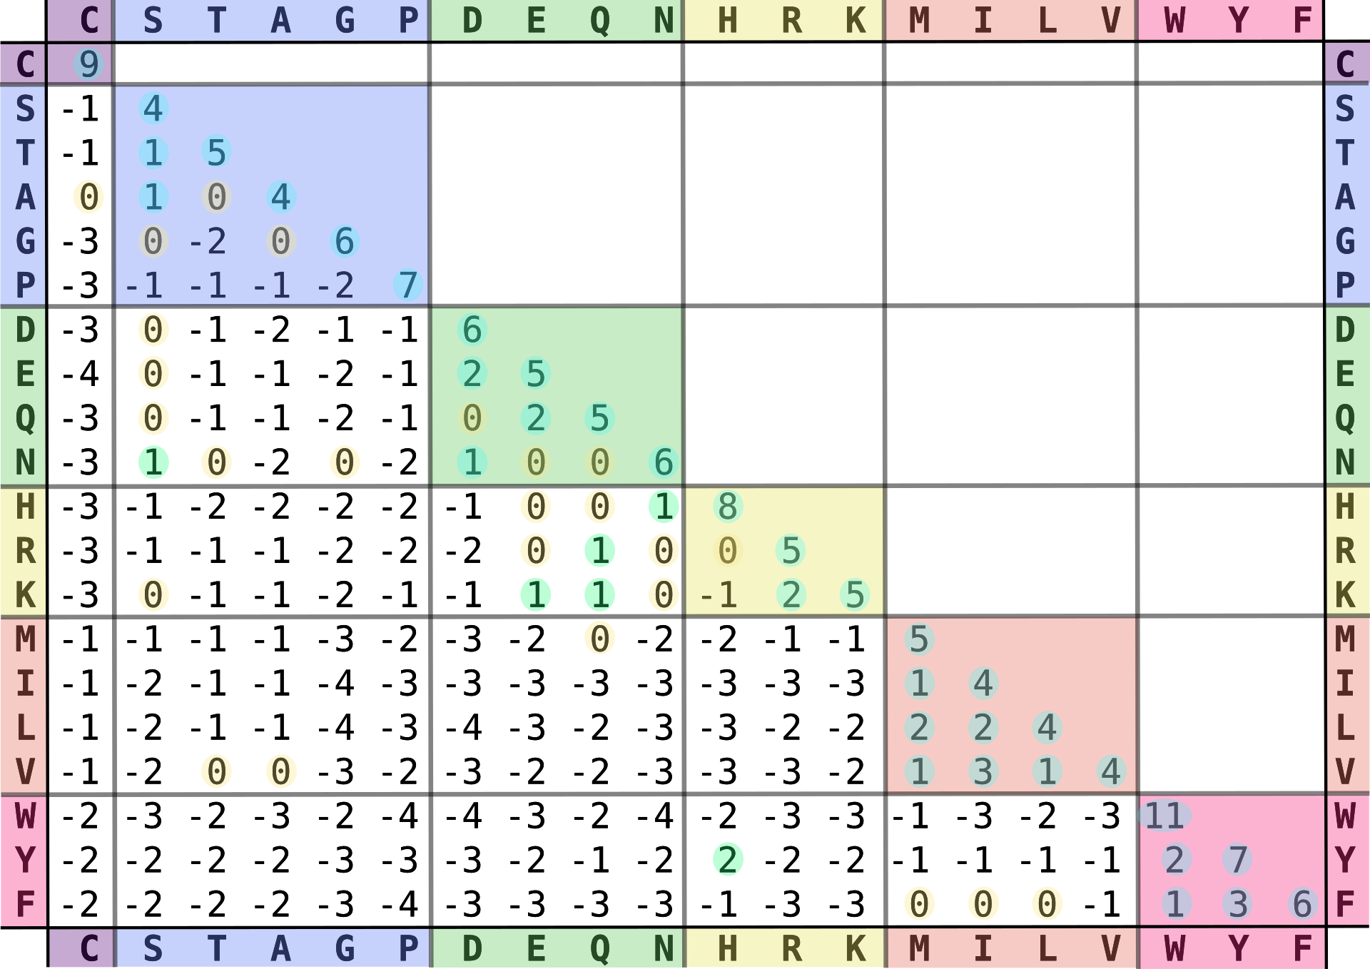
Protein sequence alignment?
We will be focusing on DNA sequence alignment today, but protein alignments work just the same, only with a more complex substitution matrix because there are 20 standard amino acids and only 4 types of nucleotides in DNA
Blosum62 substitution matrix

Slide 28
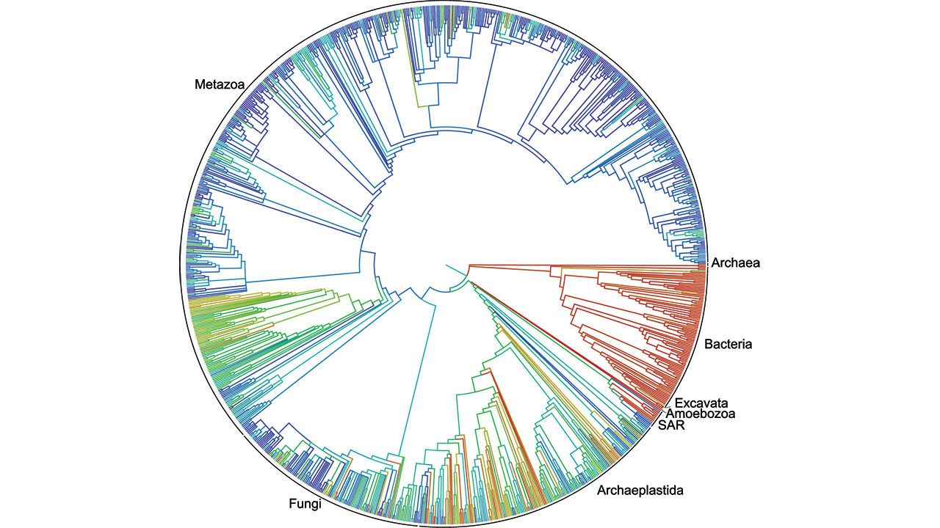
Phylogenetics
Investigating the evolutionary relationship between organisms
We have to align our sequences before we can infer a phylogenetic relationship
https://www.science.org/content/article/first-comprehensive-tree-life-shows-how-related-you-are-millions-species

Slide 29
Exercise: Inferring the evolutionary relationship between bacteria from the 16s rRNA gene
Look at the file in /home/gebt/BTG_2024/data/16S/16s_sequences.fasta
The file contains part of the 16s rRNA gene from 14 isolates, the v3-v4 region widely used for microbiome analysis
We can use these sequences to infer the evolutionary relationship between these species!
But first we have to align the sequences.

Slide 30
Exercise: MAFFT, Multiple Alignment using Fast Fourier transform
First, lets have a look at what the helper file can tell us
mafft -h
Now make an alignment for the 16s_sequences.fasta
mafft 16s_sequences.fasta > 16s_sequences_mafft_alignment.fasta

Slide 31
Exercise: MUSCLE, MUltiple Sequence Comparison by Log-Expectation
Again, lets have a look at what the helper file can tell us
muscle -h
Now make an alignment for the 16s_sequences.fasta
muscle -align 16s_sequences.fasta -output 16s_sequences_muscle_alignment.fasta

Slide 32
Exercise: MAAFT and MUSCLE
Have a look at the two alignments you generated
less 16s_sequences_mafft_alignment.fasta
less 16s_sequences_muscle_alignment.fasta
Tomorrow we will use these alignments to infer phylogenies and investigate the evolutionary relationship between these species Before then we have a few more topics of sequence alignment we need to go over

Slide 33
Core genome SNP analysis
Earlier we created the alignments necessary to infer the evolutionary relationship between isolates based on the 16s rRNA gene.
Using only a region of ~500 nucleotides naturally provides very low discriminatory power. Often different species will be identical in the specific region.
With whole-genome sequencing we have the option to not just look at a single gene (or a few genes as is the case for Multilocus Sequence Typing), but instead compare the full genomes

Slide 34
Exercise: Snippy
Snippy is a tool for Core genome SNP analysis
It works on both assemblies and raw reads, we’ll use assemblies today because it it significantly faster
It maps reads or assemblies against a reference and outputs differences between isolate and reference in various formats, including tsv and fasta
Very convenient when you want to do a phylogenetic analysis of a set of samples
A nice but slightly more complex tool for generating core SNP alignments that we use in our lab is the Northern Arizona SNP Pipeline (NASP)

Slide 35
Acknowledgements
The creation of this training material was commissioned by ECDC to Statens Serum Institut (SSI) with the direct involvement of Thor Bech Johannesen

