Slide 1
Assembling influenza genomes with IRMA
Bridging the gaps in bioinformatics/Genome assembly​
Marta Maria Ciucani, MSc, PhD
Bioinformatician
Influenza group
Statens Serum Institut
18/05/2023

Slide 2
Intended Learning Outcomes (ILOs)
Summarize key challenges related to sequencing influenza genomes
02
Use a published pipeline (IRMA) for generating a viral genome: intro and usage
03
Understand the result of the assembly (I.e. the output-files generated by the pipeline)
04
Know how to modify parameters to adapt the analysis to user-specific needs
05
Understanding the genomic structure of influenza virus
01

Slide 3
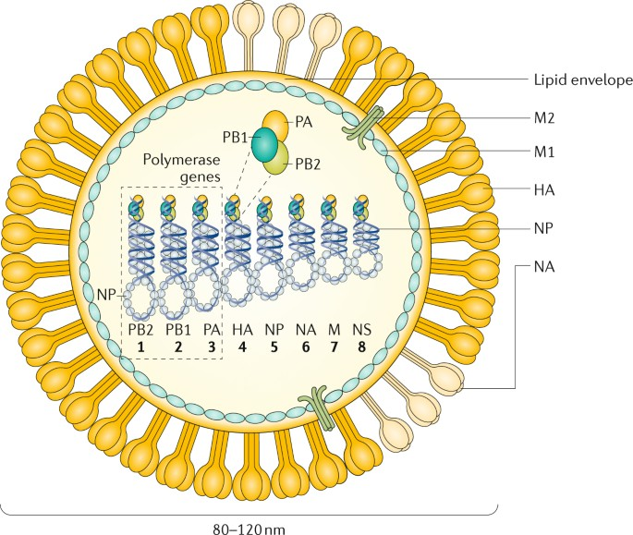
Influenza genomes
The influenza virus is an RNA virus with a segmented genome consisting of eight negative-sense single-stranded RNA segments.
Each RNA segment codes for at least one protein, with some segments encoding multiple proteins through alternative splicing.
The genome segments are enclosed within a protein shell, or nucleocapsid, and surrounded by a lipid envelope containing two major surface glycoproteins, hemagglutinin (HA) and neuraminidase (NA), which are responsible for the virus's antigenicity and host specificity.
source: https://www.nature.com/articles/s41572-018-0002-y

Slide 4
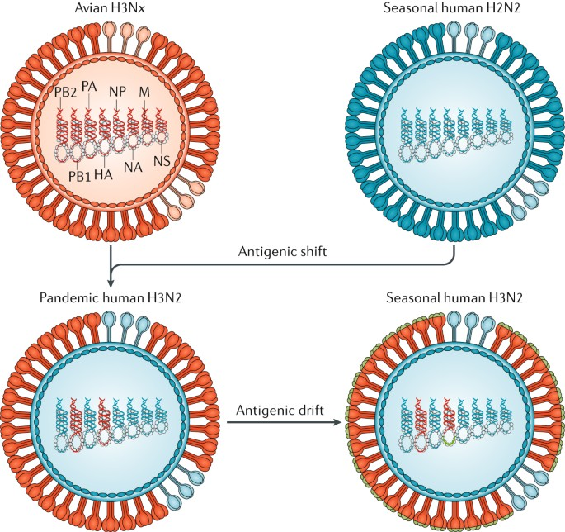
Influenza genomes
Influenza viruses undergo frequent genetic changes, both through antigenic drift and antigenic shift.
source: https://www.nature.com/articles/s41572-018-0002-y

Slide 5
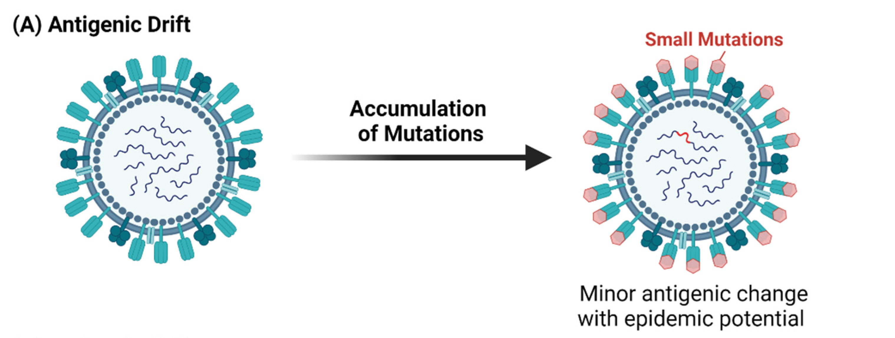
Antigenic drift
Gradual accumulation of point mutations in the genes encoding the HA and NA proteins, which results in minor changes to the virus's surface antigens (HA and NA).
HA and NA are recognized by the immune system and can trigger an immune response (including producing antibodies to fight infection).
The small genetic changes usually produce viruses that are closely related to one another, which can be illustrated by their location close together on a phylogenetic tree.
sources: https://www.mdpi.com/1999-4915/13/11/2276#
https://www.nature.com/articles/s41572-018-0002-y

Slide 6
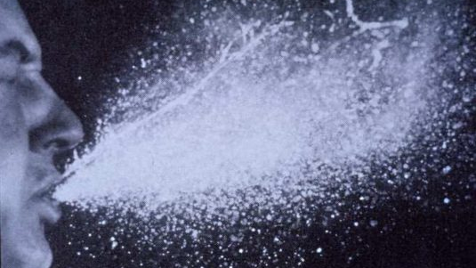
Antigenic drift
Over time mutations lead to viruses that are antigenically different, meaning a person’s antibodies bind differently or not at all to the virus, resulting in a loss or reduction in protection against that particular flu virus.
Can cause multiple flu infection over our life time
It’s the reason why we annually change the flu vaccine composition.

Slide 7
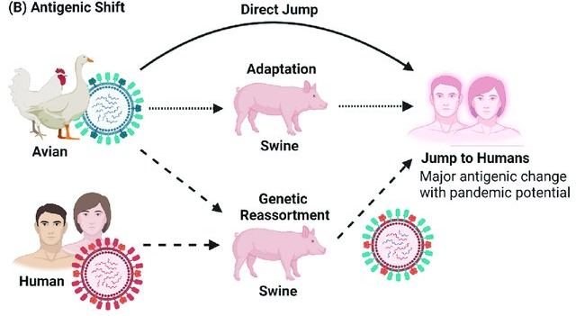
Antigenic shift
Occurs when two different influenza viruses infect the same host cell and exchange genome segments, resulting in a novel virus with new surface antigens.
source: https://www.mdpi.com/1999-4915/13/11/2276

Slide 8
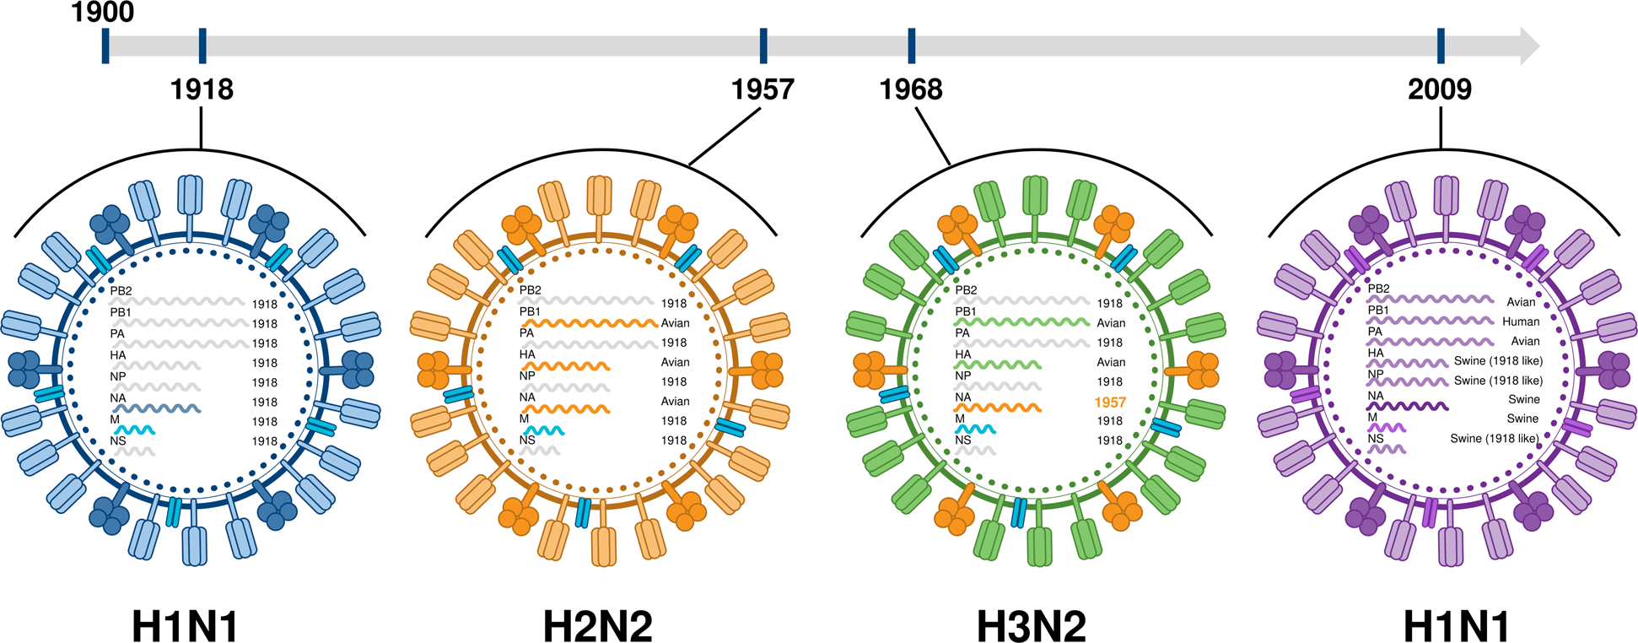
Antigenic shift
Results in major antigenic change via direct jump, adaptation and genetic reassortment.
Antigenic shift is responsible for the emergence of pandemic influenza strains, such as the H1N1 strain that caused the 1918 Spanish flu pandemic and the H5N1 strain that has caused outbreaks in birds and humans in recent years.
source: https://www.mdpi.com/1999-4915/13/11/2276
source: https://doi.org/10.1038/s12276-021-00603-0

Slide 9
Sars-Cov2
VS
Influenza
Genome size and structure: The genome of SARS-CoV-2 is a single-stranded RNA molecule, about 30,000 nucleotides long, which encodes for 29 proteins. In contrast, the influenza virus genome is composed of eight segments of single-stranded RNA, encoding for a total of 11 proteins.
Mutation rate: RNA viruses like SARS-CoV-2 and influenza viruses are known for their high mutation rates, which allow them to adapt quickly to changing environments. However, the mutation rate of SARS-CoV-2 is lower than that of influenza viruses.
Antigenic variation: Influenza viruses are notorious for their ability to undergo rapid antigenic drift, which allows them to evade the host immune system and cause seasonal epidemics. SARS-CoV-2 also exhibits some degree of antigenic variation, but it appears to be less pronounced than that of influenza viruses.

Slide 10
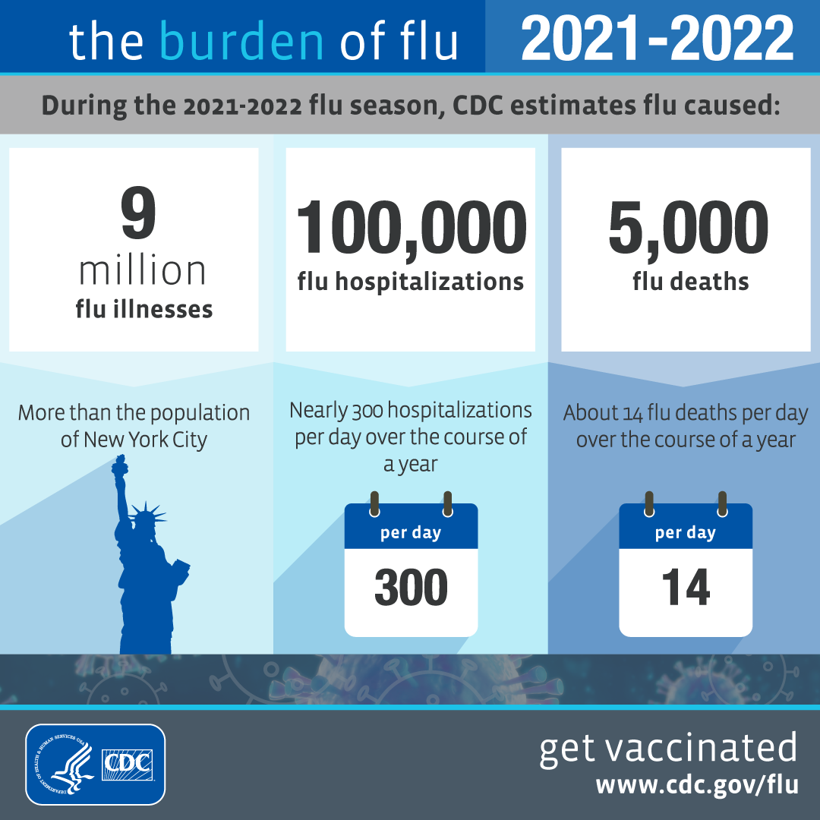
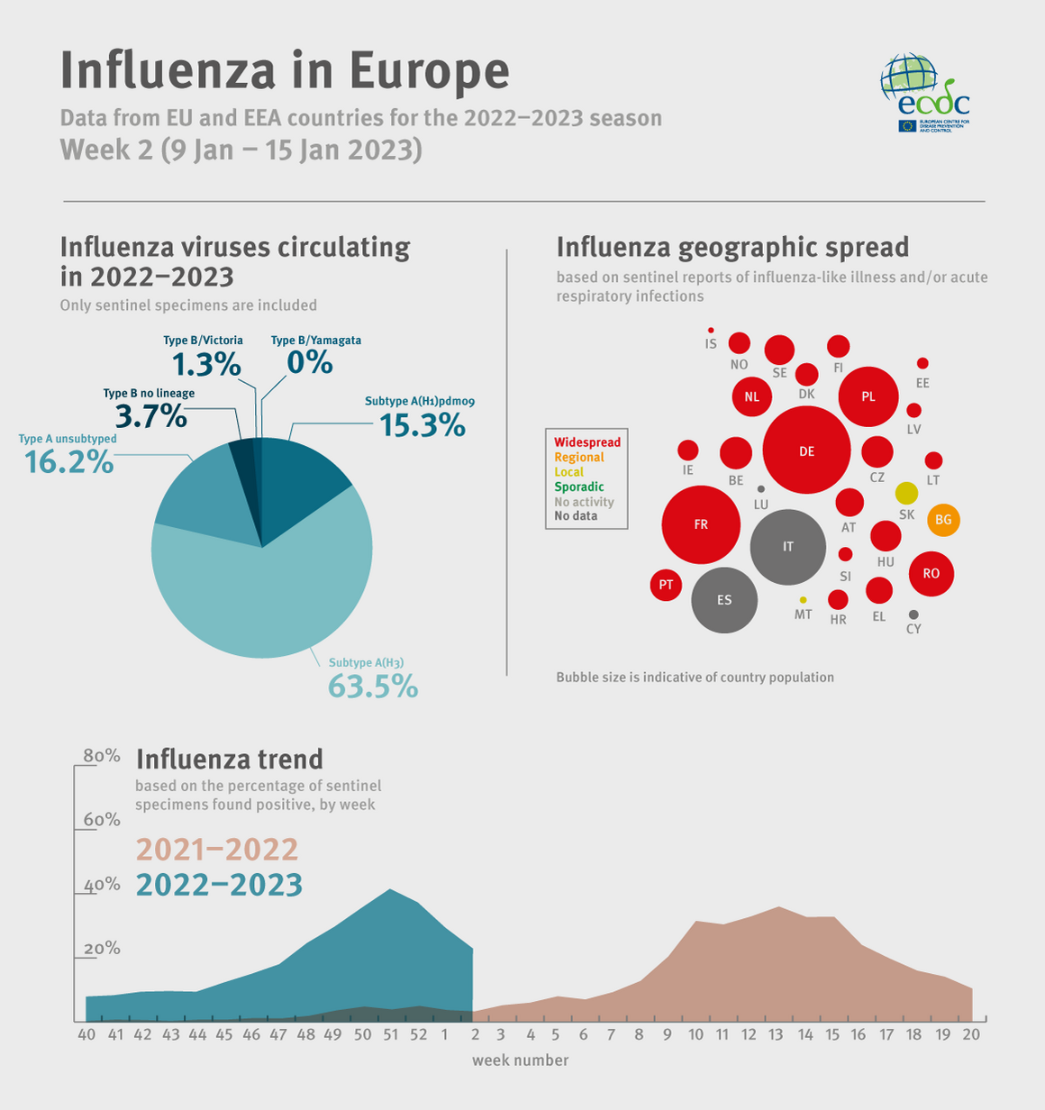
Background
Influenza viruses cause a significant disease burden as a result of seasonal activity and outbreaks
Disease severity and fast mutation rate -> large global surveillance network is required
The high level of mutation inherent in influenza virus reproduction leads to antigenic drift within gene segments while reassortment of segments causes antigenic shift which can cause outbreaks of infection
sources: ECDC - https://www.ecdc.europa.eu/en/publications-data/weekly-influenza-update-week-2-january-2023
and CDC - https://www.cdc.gov/flu/resource-center/freeresources/graphics/flu-burden-2022-2023.htm

Slide 11
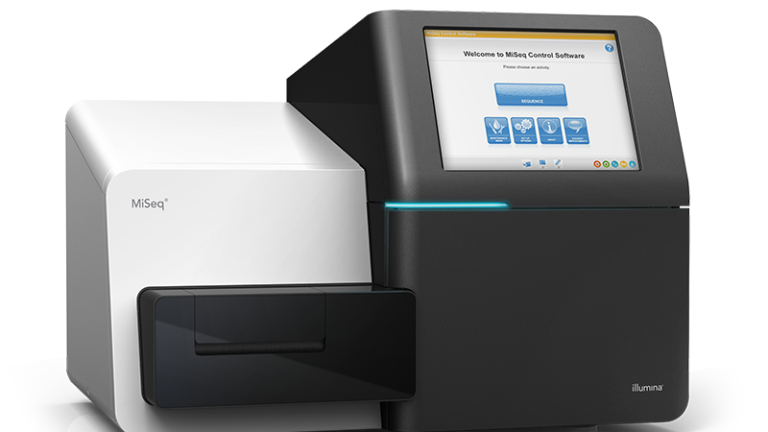
Background
Rapid expansion in surveillance efforts for zoonotic viruses and use of NGS technologies.
NGS offers advantages for surveillance and outbreak investigation in terms of speed and resolution of sequence differences

Slide 12
Background
Reference based NGS assembly programs do not perform well with the influenza segmented
genome.
These programs discard read sequences from assembly that have too many mismatches or insertions/deletions (indels)
These approaches minimise coverage and prevent complete assembly
source: https://www.nature.com/articles/s41572-018-0002-y

Slide 13


1- Influenza Division, Centers for Disease Control and Prevention, 1600 Clifton Road, Atlanta, GA 30329, USA.
2-Center for Infectious Diseases, The University of Texas School of Public Health, Houston, TX, USA.
3-Battelle Memorial Research Institute, 1600 Clifton Road, Atlanta, GA 30329, USA.

Slide 14
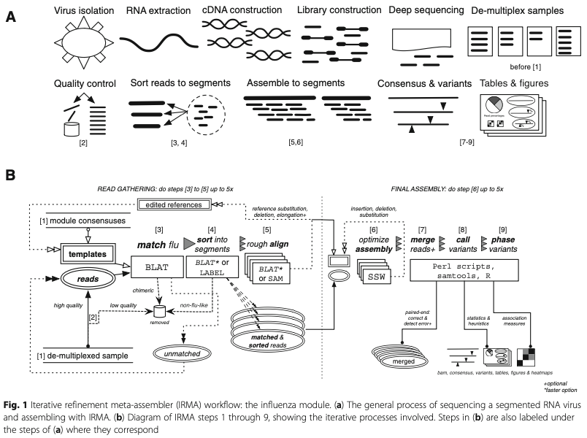
IRMA: the iterative refinement meta- assembler
source: https://bmcgenomics.biomedcentral.com/articles/10.1186/s12864-016-3030-6

Slide 15
General sequencing process
source: https://bmcgenomics.biomedcentral.com/articles/10.1186/s12864-016-3030-6

Slide 16
Diagram of IRMA workflow
source: https://bmcgenomics.biomedcentral.com/articles/10.1186/s12864-016-3030-6

Slide 17
IRMA: the iterative refinement meta- assembler
Developed as a flexible approach that more thoroughly addresses viral diversity
Provides a comprehensive solution to address each aspect of NGS assembly, as it applies to RNA virus evolution, in a flexible and robust manner
Used to process genome sequence data derived from the large volume of surveillance specimens characterized at CDC
source: https://bmcgenomics.biomedcentral.com/articles/10.1186/s12864-016-3030-6

Slide 18
IRMA: the iterative refinement meta- assembler
Used successfully to identify low frequency variants
IRMA applies an iterative refinement process that improves assembly accuracy
Uses a hierarchical approach that can efficiently assemble reads across a range of coverage depths and phased minor variants
Provides a comprehensive set of analysis outputs.
source: https://bmcgenomics.biomedcentral.com/articles/10.1186/s12864-016-3030-6

Slide 19
Install IRMA
Warning!! IRMA was designed for use with Linux and Mac OS, not Windows.
IRMA requires at least Perl version 5 and BASH version 3, which is standard on most Linux & Mac OS X systems.
R must be available on any computer which runs IRMA processes.
Download: get the latest version of IRMA & LABEL and unzip the archive in the desired <install_path>.
More instruction at this link: https://wonder.cdc.gov/amd/flu/irma/install.html

Slide 20
Dependencies
BLAT for the matching step of the flu reads
LABEL (for sorting reads into segments), which also packages certain resources used by IRMA:
  Sequence Alignment and Modeling System (SAM) for both the rough align and sort steps
  Shogun Toolbox, which is an essential part of LABEL, is used in the sort step
SSW (modification of Smith-Waterman algorithm) for the final assembly step
samtools for BAM-SAM conversion as well as BAM sorting and indexing

Slide 21
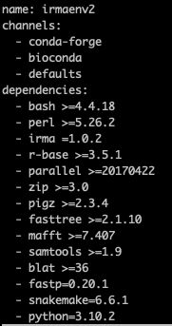
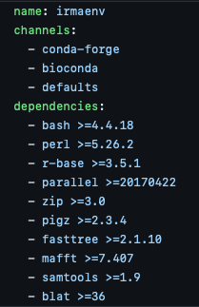
How to install IRMA
Or, you can simply use a conda environment!
So make sure you install conda or miniconda
# Install Conda
wget https://repo.continuum.io/miniconda/Miniconda3-latest-Linux-x86_64.sh -O miniconda.sh
bash miniconda.sh -b -p $HOME/miniconda
And then:
# Download repo
git clone https://github.com/peterk87/irma.git
cd irma
# create IRMA conda env
conda env create --file=conda_env.yaml
# activate IRMA conda env
conda activate irmaenv
More instruction at this link: https://wonder.cdc.gov/amd/flu/irma/install.html

Slide 22
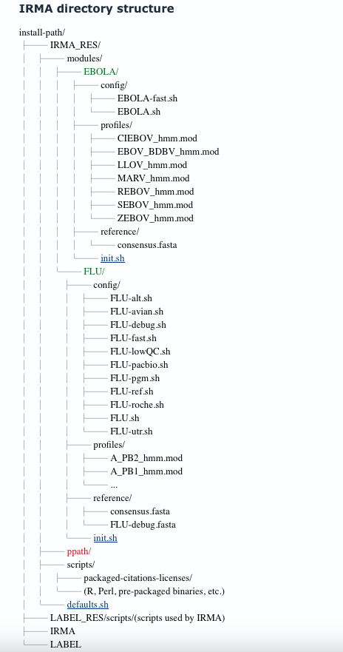
Irma directory
Global conf file. Variables should not be deleted from this file
More info here: https://wonder.cdc.gov/amd/flu/irma/modules.html

Slide 23
Irma directory
run-specific named configuration files can be applied to specialize the assembly for different situations.
Module-specific configurations are applied that may override any global arguments. These configurations help adjust the assembly to the organism of interest.
More info here: https://wonder.cdc.gov/amd/flu/irma/modules.html

Slide 24
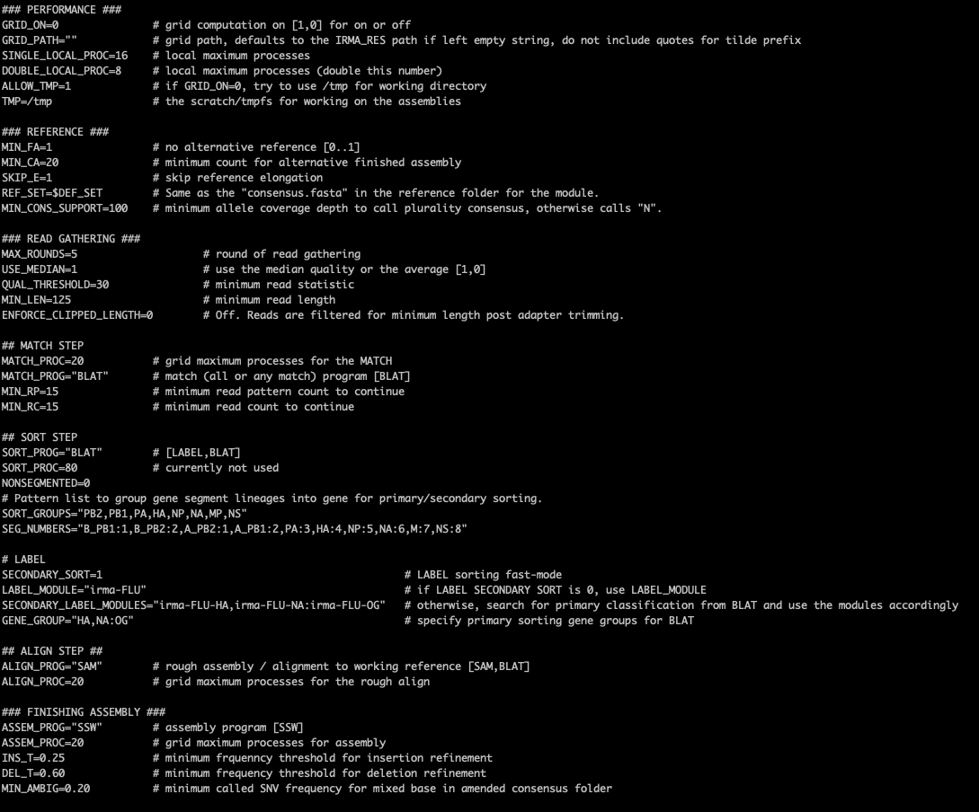
init.sh file
keep an eye on the parameters that you would like to change and adapt to your needs!
More info here: https://wonder.cdc.gov/amd/flu/irma/configuration.html

Slide 25
How to run IRMA
Easy peasy!
Calling IRMA requires three components:
a module argument specifying the organism and an optional run-specific configuration,
the input fastq data, and
the output name for the sample.
Note: If more than one fastq are needed per sample, then one needs to concatenate the appropriate read files.

Slide 26
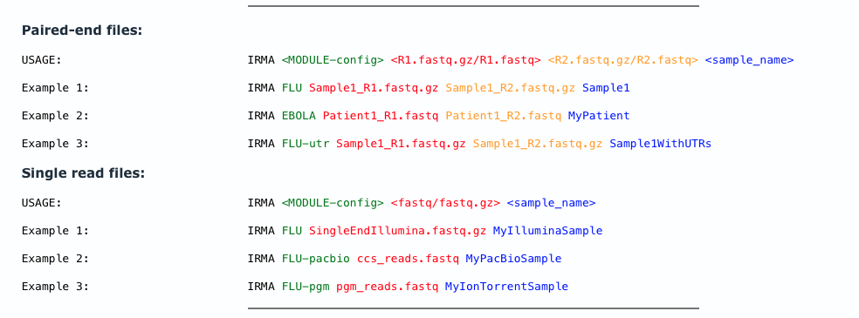
How to run IRMA
source: https://wonder.cdc.gov/amd/flu/irma/run.html

Slide 27
IRMA outputs
Amended consensus
Figures
Intermediate
Logs
Matrices
Secondary
Tables
Main data folder

Slide 28
IRMA outputs
Amended consensus
Figures
Intermediate
Logs
Matrices
Secondary
Tables
Main data folder

Slide 29
Irma outputs – Main Data Folder
bam
Plurality consensus sequences
They are named after the virus genome or gene segment class label that was matched to.
Useful when used with the BAM file to look at minor variants
A plurality rule was chosen over majority consensus because it is more inclusive for pattern matching purposes and does not assign strict thresholds for the dominant virus phase in the sample.
Other parameters are available to restrict the quality of the consensus alleles as part of the amended consensus.
fasta
vcf

Slide 30
IRMA outputs
Amended consensus
Figures
Intermediate
Logs
Matrices
Secondary
Tables
Main data folder

Slide 31
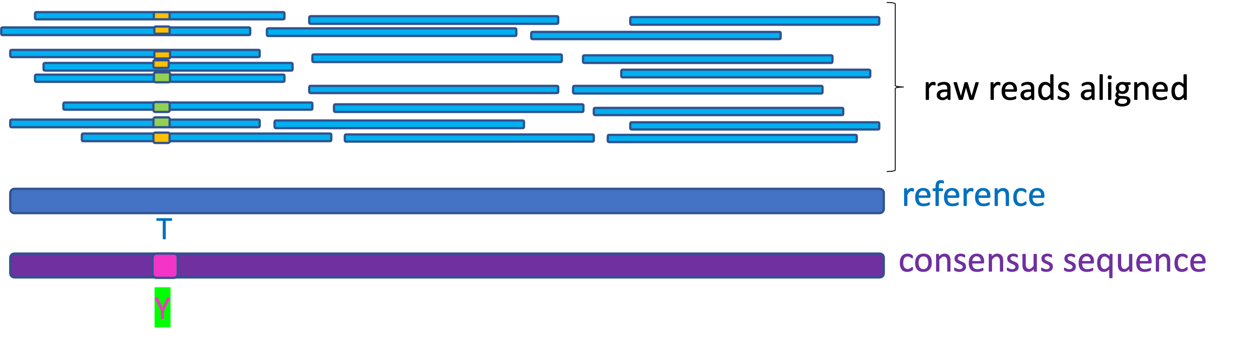
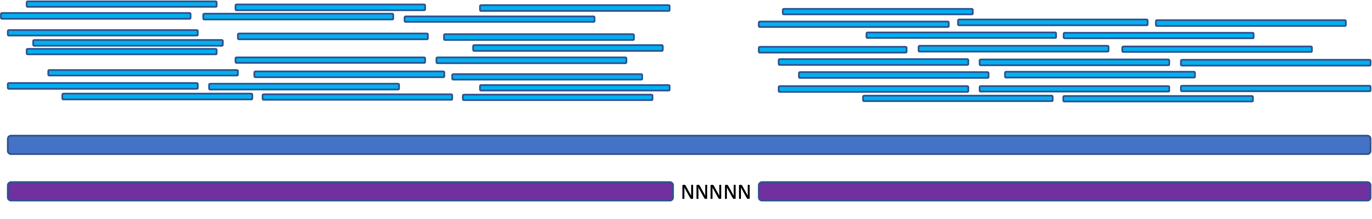
Amended consensus
These sequences are modifications to the plurality consensus.
The first type of amendment is base ambiguation for mixed alleles.
The second type of base amendment is for consensus allele quality control.
reads
reference
consensus

Slide 32
IRMA outputs
Amended consensus
Figures
Intermediate
Logs
Matrices
Secondary
Tables
Main data folder

Slide 33
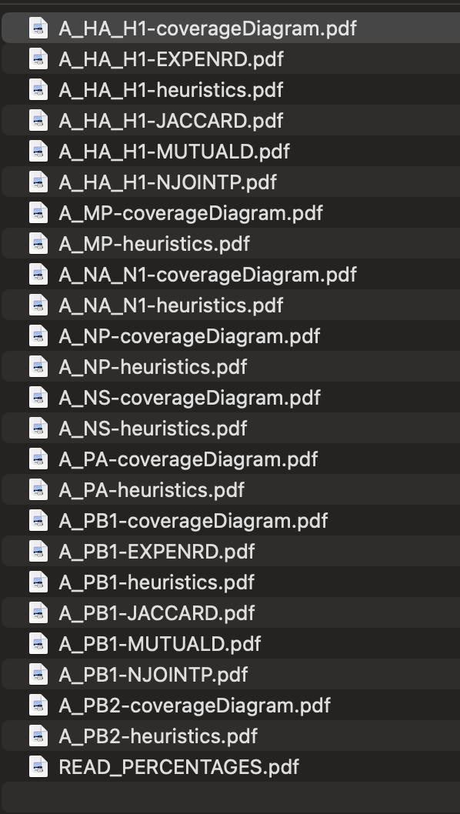
Figures

Slide 34
IRMA outputs
Amended consensus
Figures
Intermediate
Logs
Matrices
Secondary
Tables
Main data folder

Slide 35
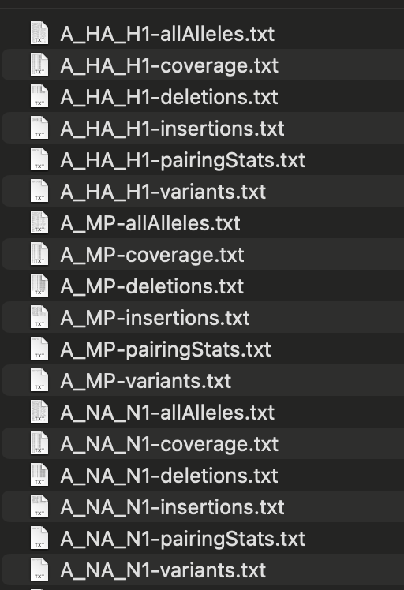
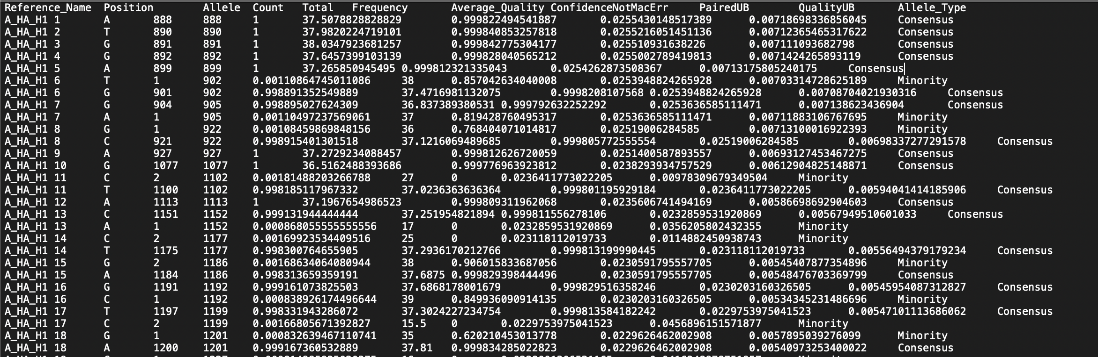
Tables
A_HA_H1-allAlleles.txt

Slide 36
Conclusions
IRMA addresses viral diversity, which is critical for surveillance of rapidly evolving RNA viruses
IRMA can efficiently assemble reads across a range of coverage depths and phased minor variants
IRMA is customizable for different applications and organisms and provides a comprehensive set of analysis outputs
IRMA provides a comprehensive solution that addresses each aspect of NGS assembly, as it applies to RNA virus evolution, in a flexible and robust manner
IRMA has been used successfully to identify low frequency variants.

Slide 37
Acknowledgements
The creation of this training material was commissioned by ECDC to Statens Serum Institut (SSI) with the direct involvement of Marta Maria Ciucani

