Slide 1
Sequencing quality scores
Bridging the gaps in Bioinformatics/Sequencing and raw-data QC

Slide 2
ILOs
Describe the FASTQ format
Explain what a phred quality score is
Explain how phred quality scores are used to assess sequencing accuracy
Describe the output from a Nanopore sequencing run
Name and execute QC software for Nanopore data

Slide 3
Outline
This session consists of the following elements
Brief introduction to the FASTQ file format
Brief introduction to phred quality scores
FASTQ and phred quality score exercise + coffee break
Output from a Nanopore sequencer
What you can see while sequencing
What you can see after sequencing
5. Lunch break
6. Nanopore QC exercise

Slide 4
Quality control of sequencing data
Base calling errors
Adapter contamination
GC content
Sequence length distribution
Contamination

Slide 5
Quality control of sequencing data
Base calling errors
Adapter contamination
GC content
Sequence length distribution
Contamination

Slide 6
Quality control of sequencing data
@SEQ_ID
GATTTGGGGTTCAAAGCAGTATCGATCAAATAGTAAATCCATTTGTTCAACTCACAGTTT
+
!''*((((***+))%%%++)(%%%%).1***-+*''))**55CCF>>>>>>CCCCCCC65
Base calling error probabilities are encoded in the FASTQ format

Slide 7
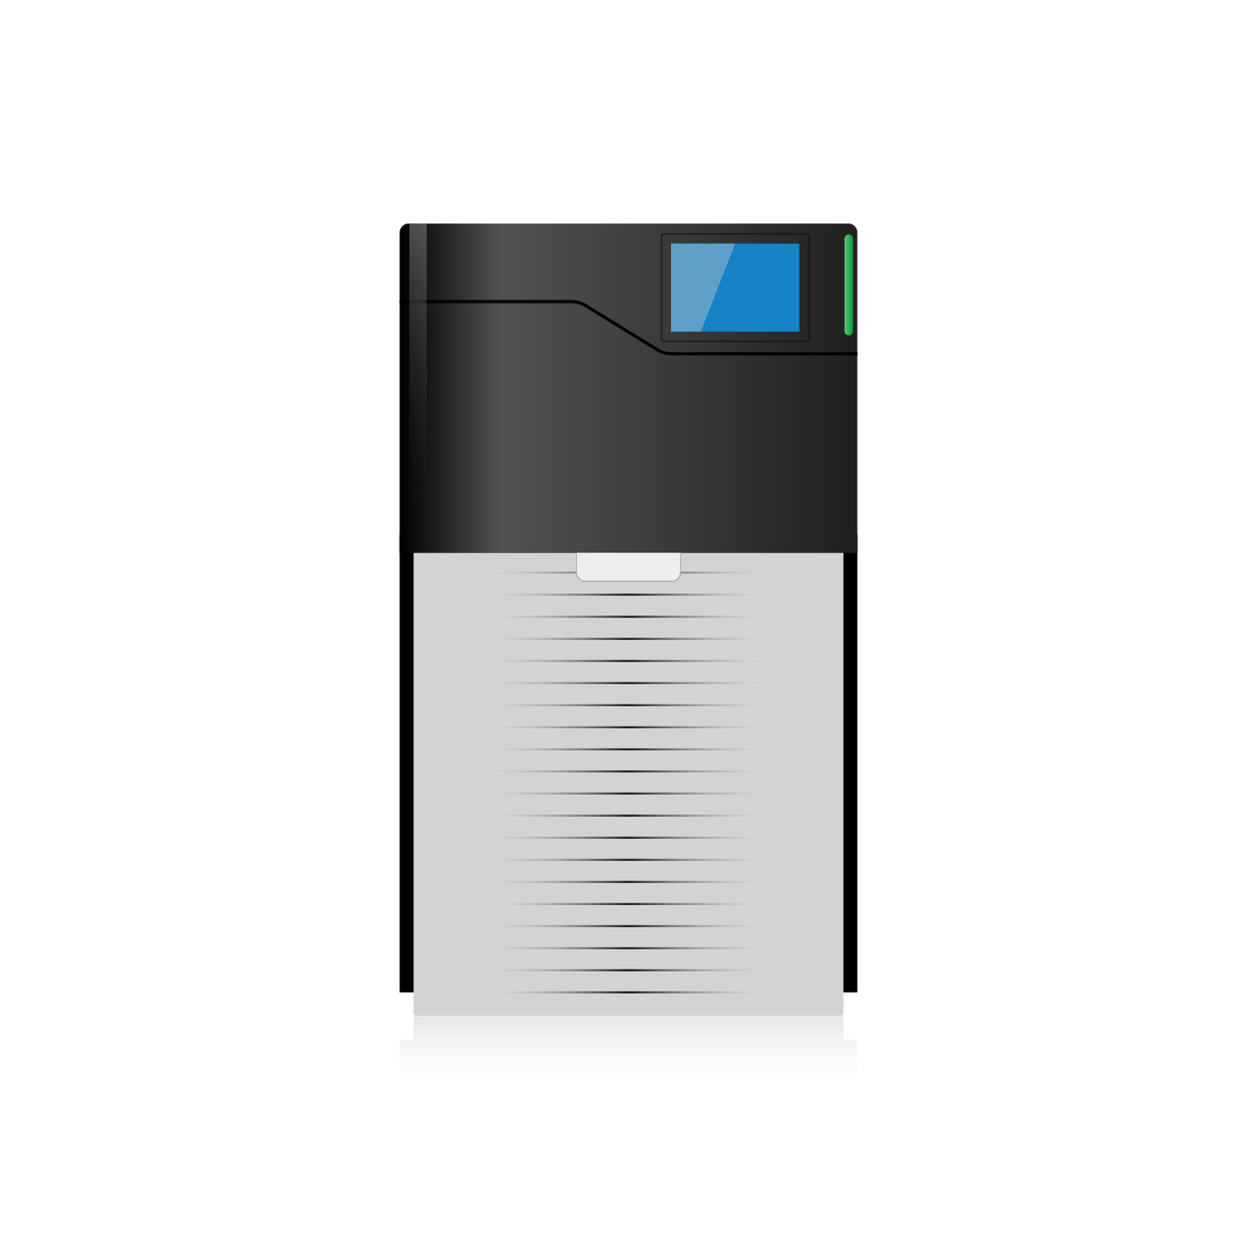
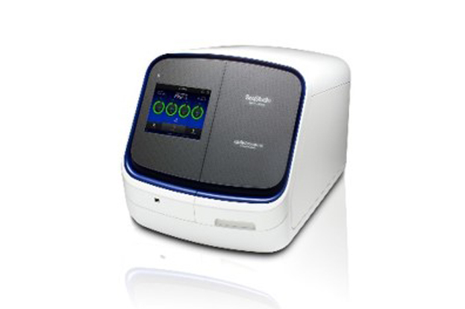
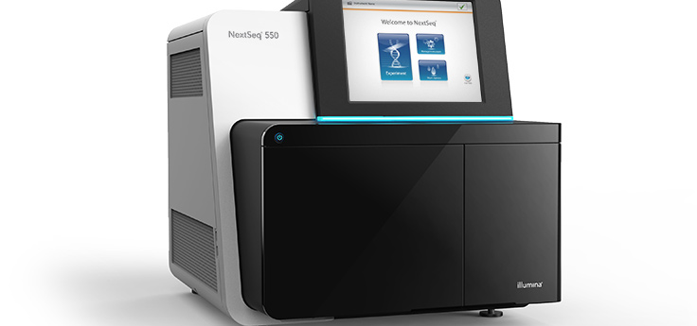
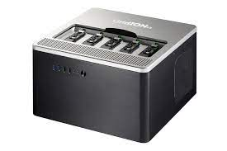
Quality control of sequencing data
@SEQ_ID
GATTTGGGGTTCAAAGCAGTATCGATCAAATAGTAAATCCATTTGTTCAACTCACAGTTT
+
!''*((((***+))%%%++)(%%%%).1***-+*''))**55CCF>>>>>>CCCCCCC65
Nanopore
PacBIO
Sanger
Illumina

Slide 8
The FASTQ format
@SEQ_ID
GATTTGGGGTTCAAAGCAGTATCGATCAAATAGTAAATCCATTTGTTCAACTCACAGTTT
+
!''*((((***+))%%%++)(%%%%).1***-+*''))**55CCF>>>>>>CCCCCCC65
Sequence identifier / FASTQ header
Nucleotide sequence
The ”+” line
Quality scores

Slide 9
The FASTQ format
@SEQ_ID
GATTTGGGGTTCAAAGCAGTATCGATCAAATAGTAAATCCATTTGTTCAACTCACAGTTT
+
!''*((((***+))%%%++)(%%%%).1***-+*''))**55CCF>>>>>>CCCCCCC65
Sequence identifier
Nucleotide sequence
The ”+” line
Quality scores

Slide 10
The FASTQ format
@SEQ_ID
GATTTGGGGTTCAAAGCAGTATCGATCAAATAGTAAATCCATTTGTTCAACTCACAGTTT
+
!''*((((***+))%%%++)(%%%%).1***-+*''))**55CCF>>>>>>CCCCCCC65
Sequence identifier
Nucleotide sequence
The ”+” line
Quality scores

Slide 11
The FASTQ format
@SEQ_ID
GATTTGGGGTTCAAAGCAGTATCGATCAAATAGTAAATCCATTTGTTCAACTCACAGTTT
+
!''*((((***+))%%%++)(%%%%).1***-+*''))**55CCF>>>>>>CCCCCCC65
Sequence identifier
Nucleotide sequence
The ”+” line
Quality scores

Slide 12
The FASTQ format
@SEQ_ID
GATTTGGGGTTCAAAGCAGTATCGATCAAATAGTAAATCCATTTGTTCAACTCACAGTTT
+
!''*((((***+))%%%++)(%%%%).1***-+*''))**55CCF>>>>>>CCCCCCC65
Quality scores are encoded with ASCII characters.

Slide 13
The FASTQ format
!''*((((***+))%%%++)(%%%%).1***-+*''))**55CCF>>>>>>CCCCCCC65
33 39 39 34 34 42 42 42 40 40 40 40 42 42 42 43 43 43 37 37 37 43 43
41 41 41 37 37 37 37 46 49 42 42 42 45 43 42 42 39 41 41 42 42 42 42
42 42 42 53 53 67 67 67 70 62 62 62 62 62 62 67 67 67 67 67 67 54 53
Quality scores are encoded with ASCII characters which correspond to ASCII numbers.

Slide 14
The FASTQ format
!''*((((***+))%%%++)(%%%%).1***-+*''))**55CCF>>>>>>CCCCCCC65
33 39 39 34 34 42 42 42 40 40 40 40 42 42 42 43 43 43 37 37 37 43 43
41 41 41 37 37 37 37 46 49 42 42 42 45 43 42 42 39 41 41 42 42 42 42
42 42 42 53 53 67 67 67 70 62 62 62 62 62 62 67 67 67 67 67 67 54 53
0 6 6 1 1 9 9 9 7 7 7 7 9 9 9 10 10 10 4 4 4 10 10 8 8 8 4 4 4 4 13 8 9 9
9 12 10 9 9 6 8 8 9 9 9 9 9 9 9 22 22 34 34 34 37 29 29 29 29 29 29 34
34 34 34 34 34 23 22
Quality scores are encoded with ASCII characters which correspond to ASCII numbers which again correspond to phred quality scores.

Slide 15
Phred quality score
=
Phred score
=
Quality score

Slide 16
Phred quality scores
P = 10^{-Q/10}
Q = -10 log₁₀(P)
P = the probability that a base is incorrect
Q = Phred quality score

Slide 17
Phred quality score exercise
Identify the Phred quality scores in read1 and read2 at the top of the page.
For each base, convert the ASCII character to a Phred quality score
Find the mean quality score of each read
Note, Phred quality score are log probabilities so simply taking the average of these will give a wrong result. Instead you need to average the error probabilities and calculate the mean Q-score from this.¹
@read1
ACGTGAGTCTAGCTAGCTAG
+
?<:>>C8<==0@B1?@B
@read2
CGTAGCTAGCTAGCTAGCTA
+
77<<7774:=4.4:=4.

Slide 18
Phred quality score exercise
Identify the Phred quality scores in read1 and read2 at the top of the page.
For each base, convert the ASCII character to a Phred quality score
Find the mean quality score of each read
Note, Phred quality score are log probabilities so simply taking the average of these will give a wrong result. Instead you need to average the error probabilities and calculate the mean Q-score from this.
@read1
ACGTGAGTCTAGCTAGCTAG
+
?<:>>C8<==0@B1?@B
@read2
CGTAGCTAGCTAGCTAGCTA
+
77<<7774:=4.4:=4.

Slide 19
Phred quality score exercise
Identify the Phred quality scores in read1 and read2 at the top of the page.
For each base, convert the ASCII character to a Phred quality score
Find the mean quality score of each read
Note, Phred quality score are log probabilities so simply taking the average of these will give a wrong result. Instead you need to average the error probabilities and calculate the mean Q-score from this.
@read1
ACGTGAGTCTAGCTAGCTAG
+
?<:>>C8<==0@B1?@B
30 27 25 29 29 34 23 27 28 28 15 31 33 16 30 31 33
@read2
CGTAGCTAGCTAGCTAGCTA
+
77<<7774:=4.4:=4.
22 22 27 27 22 22 22 19 25 28 19 13 19 25 28 19 13

Slide 20
Phred quality score exercise
 | Q_score | P_error
 | 30 | 0,001
 | 27 | 0,001995
 | 25 | 0,003162
 | 29 | 0,001259
 | 29 | 0,001259
 | 34 | 0,000398
 | 23 | 0,005012
 | 27 | 0,001995
 | 28 | 0,001585
 | 28 | 0,001585
 | 15 | 0,031623
 | 31 | 0,000794
 | 33 | 0,000501
 | 16 | 0,025119
 | 30 | 0,001
 | 31 | 0,000794
 | 33 | 0,000501
Sum | 469 | 0,079583
mean_qscore | 27,58824 | 23,29628
Identify the Phred quality scores in read1 and read2 at the top of the page.
For each base, convert the ASCII character to a Phred quality score
Find the mean quality score of each read
Note, Phred quality score are log probabilities so simply taking the average of these will give a wrong result. Instead you need to average the error probabilities and calculate the mean Q-score from this.
@read1
ACGTGAGTCTAGCTAGCTAG
+
?<:>>C8<==0@B1?@B
30 27 25 29 29 34 23 27 28 28 15 31 33 16 30 31 33
@read2
CGTAGCTAGCTAGCTAGCTA
+
77<<7774:=4.4:=4.
22 22 27 27 22 22 22 19 25 28 19 13 19 25 28 19 13
P = 10^{-Q/10}
Q = -10 log₁₀(P)

Slide 21
ILOs
Describe the FASTQ format
Explain what a phred quality score is
Explain how phred quality scores are used to assess sequencing accuracy
Describe the output from a Nanopore sequencing run
Name and execute QC software for Nanopore data

Slide 22
Nanopore sequencing
Important differences from NGS
Read length is determined by input DNA length
Nanopore
Illumina
0
300
4,000,000

Slide 23
Nanopore sequencing
Important differences from NGS
Read lengths are determined by input DNA length
Relatively high error-rate
Illumina
Q30+
Nanopore
They promise Q20+
We get Q15-Q18

Slide 24
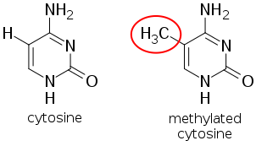
Nanopore sequencing
Important differences from NGS
Read lengths are determined by input DNA length
Relatively high error-rate
Base modifications

Slide 25
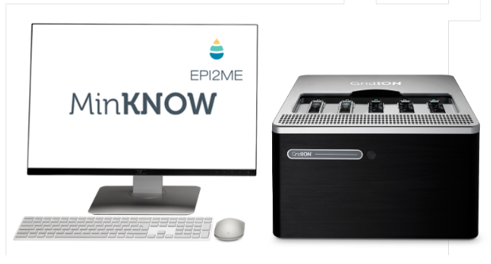
Nanopore sequencing
Important differences from NGS
Read lengths are determined by input DNA length
Relatively high error-rate
Base modifications
Real-time sequencing

Slide 26
Nanopore sequencing output
Real-time sequencing → output is available right away
Monitor run with MinKNOW

Slide 27
Nanopore sequencing output
Real-time sequencing and real-time base calling
FAST5/POD5
FASTQ
AGCCATGGTATATCGAGCATAGCTGACATAGCTGCCCAGGAGGGGGACCACATTATATTATTT
Experiment run time

Slide 28
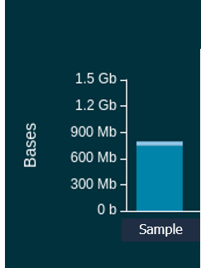
Nanopore sequencing output
Real-time sequencing → output is available right away

Slide 29
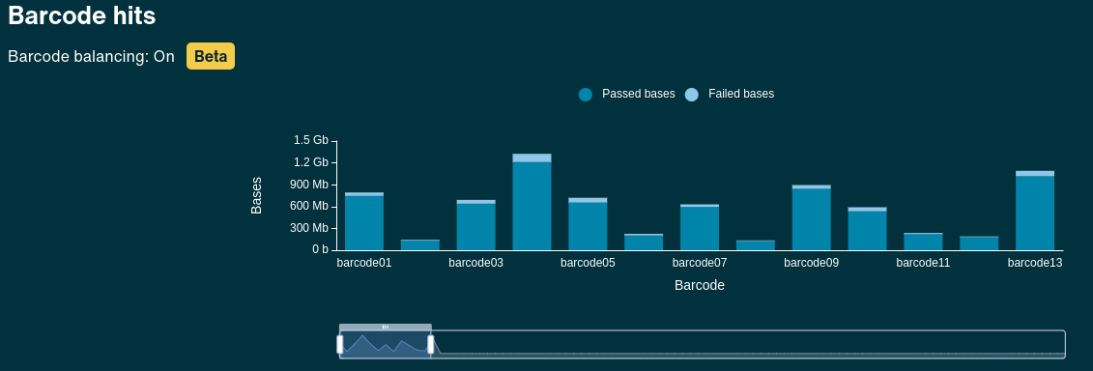
Nanopore sequencing output
Real-time sequencing → output is available right away

Slide 30
Nanopore sequencing output
Real-time sequencing → output is available right away
Depends on prespecified Q-score

Slide 31
Nanopore sequencing output
Real-time sequencing and real-time base calling
FAST5_pass
FAST5_fail
FASTQ_pass
FASTQ_fail

Slide 32
Nanopore sequencing output
Real-time sequencing and real-time base calling
barcode01
barcode02
barcode03
barcode04
barcode05
barcode06
barcode07
barcode08
barcode09
barcode10
barcode11
…
barcode96
FASTQ_pass

Slide 33
Nanopore sequencing output
Real-time sequencing and real-time base calling
barcode01
barcode02
barcode03
barcode04
barcode05
barcode06
barcode07
barcode08
barcode09
barcode10
barcode11
…
barcode96
File1.fastq.gz
File2.fastq.gz
File3.fastq.gz
File4.fastq.gz
File5.fastq.gz
File6.fastq.gz
File7.fastq.gz
File8.fastq.gz
File9.fastq.gz
File10.fastq.gz
File11.fastq.gz
File12.fastq.gz
File13.fastq.gz
File14.fastq.gz
File15.fastq.gz
File16.fastq.gz
….
FASTQ_pass

Slide 34
Nanopore sequencing output
Real-time sequencing and real-time base calling
barcode01
barcode02
barcode03
barcode04
barcode05
barcode06
barcode07
barcode08
barcode09
barcode10
barcode11
…
barcode96
File1.fastq.gz
File2.fastq.gz
File3.fastq.gz
File4.fastq.gz
File5.fastq.gz
File6.fastq.gz
File7.fastq.gz
File8.fastq.gz
File9.fastq.gz
File10.fastq.gz
File11.fastq.gz
File12.fastq.gz
File13.fastq.gz
File14.fastq.gz
File15.fastq.gz
File16.fastq.gz
….
FASTQ_pass
Each fastq.qz file contains 4000 reads

Slide 35
Nanopore sequencing output
Real-time sequencing and real-time base calling
barcode01
barcode02
barcode03
barcode04
barcode05
barcode06
barcode07
barcode08
barcode09
barcode10
barcode11
…
barcode96
File1.fastq.gz
File2.fastq.gz
File3.fastq.gz
File4.fastq.gz
File5.fastq.gz
File6.fastq.gz
File7.fastq.gz
File8.fastq.gz
File9.fastq.gz
File10.fastq.gz
File11.fastq.gz
File12.fastq.gz
File13.fastq.gz
File14.fastq.gz
File15.fastq.gz
File16.fastq.gz
….
FASTQ_pass
Ec0*_super.fastq.qz

Slide 36
Look at a Nanopore FASTQ file exercise
Use less [file.fastq.gz] to look at a gzipped FASTQ file
Choose a Nanopore FASTQ file and look at it
Which barcode was your isolate marked with?
When was the first read in the FASTQ file sequenced?
What other information can you extract from the header?

Slide 37
Nanopore sequencing output
More files are generated after a run is finished
FAST5_pass
FAST5_fail
Report.html
Sequencing_summary.txt
FASTQ_pass
FASTQ_fail

Slide 38
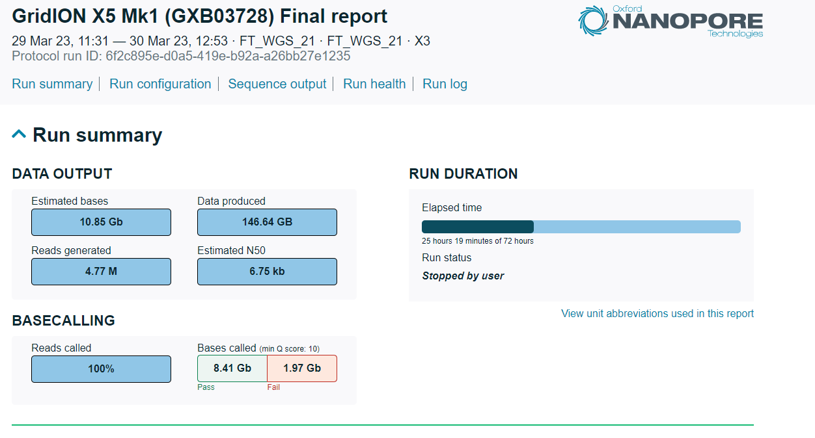
Report.html
General run information

Slide 39
Sequencing_summary.txt
Very large file.
Contains information on all reads.
Used as input for many quality control tools.

Slide 40
ILOs
Describe the FASTQ format
Explain what a phred quality score is
Explain how phred quality scores are used to assess sequencing accuracy
Describe the output from a Nanopore sequencing run
Name and execute QC software for Nanopore data

Slide 41
ILOs
Describe the FASTQ format
Explain what a phred quality score is
Explain how phred quality scores are used to assess sequencing accuracy
Describe the output from a Nanopore sequencing run
Name and execute QC software for Nanopore data

Slide 42
Outline
This session consists of the following elements
Barcode and adapter trimming
Contamination control of reads
Exercises
Sequencing depth
NanoPlot
Quality trimming

Slide 43
Nanopore sequencing output
barcode01
barcode02
barcode03
barcode04
barcode05
barcode06
barcode07
barcode08
barcode09
barcode10
barcode11
…
barcode96
File1.fastq.gz
File2.fastq.gz
File3.fastq.gz
File4.fastq.gz
File5.fastq.gz
File6.fastq.gz
File7.fastq.gz
File8.fastq.gz
File9.fastq.gz
File10.fastq.gz
File11.fastq.gz
File12.fastq.gz
File13.fastq.gz
File14.fastq.gz
File15.fastq.gz
File16.fastq.gz
….
FASTQ_pass
Ec0*_super.fastq.qz

Slide 44
Read trimming
Trim barcodes and adapters with qcat
or Porechop
Or
Turn on barcode/adapter trimming in MinKNOW sequencing software

Slide 45
Read trimming
Trim barcodes and adapters with qcat
or Porechop
Or
Turn on barcode/adapter trimming in MinKNOW sequencing software

Slide 46
Read trimming
qcat, trimming tool (https://github.com/nanoporetech/qcat)
deprecated
qcat –f [input_reads.fastq] -t [threads] --trim -o [output_reads_trim.fastq]
Porechop abi, trimming tool (https://github.com/bonsai-team/Porechop_ABI)
porechop_abi -abi -i [input_reads.fastq] -o [output_reads.fastq]

Slide 47
Contamination control
Kraken, a taxonomic sequence identifier (https://github.com/DerrickWood/kraken) made for short reads.
KMA, a mapping method for both short and long reads (https://bitbucket.org/genomicepidemiology/kma/src/master/)
Both methods need a pre-build database which they will map your reads against.

Slide 48
Contamination control
Kraken, a taxonomic sequence identifier (https://github.com/DerrickWood/kraken) made for short reads.
#download NCBI taxonomic information, as well as the complete genomes in RefSeq for the bacterial, archaeal, and viral domains.
kraken-build --standard --db [DBNAME]
kraken-build --db [DBNAME] --clean
#run kraken
kraken --threads [t] --db [DBNAME] --output [output_kraken] [file.fastq.gz]

Slide 49
Contamination control
KMA, a mapping method for both short and long reads (https://bitbucket.org/genomicepidemiology/kma/src/master/)
#download fasta files for database
#index database
kma index -i [templates.fsa.gz] -o [database/name]
#run kma
kma -i [someLongReads.fq.gz] -o [output/name] -t_db [database/name] -bcNano -bc 0.7

Slide 50
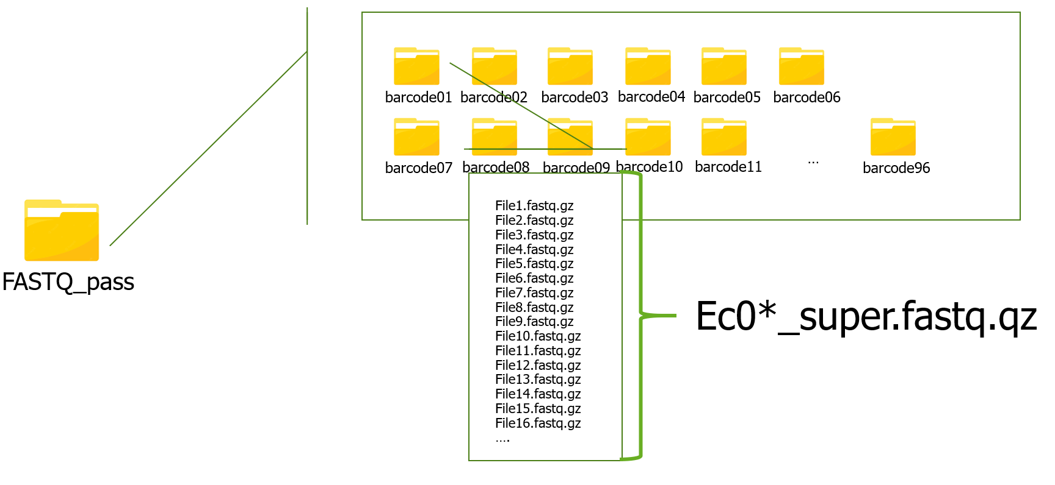
Data
Adapter trimming
qcat
Contamination control
kraken
Filtering
chopper
Filtlong
Ec0*_super.fastq.qz

Slide 51
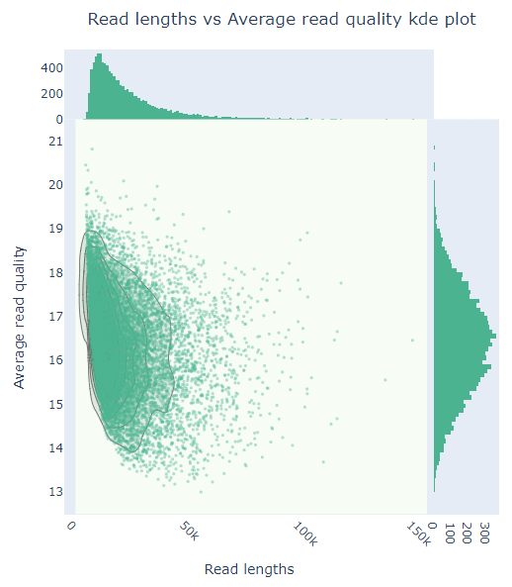
Exercise
Day3_long_read_QC_practical on NanoPlot and Chopper
>Q10
<Q10

Slide 52
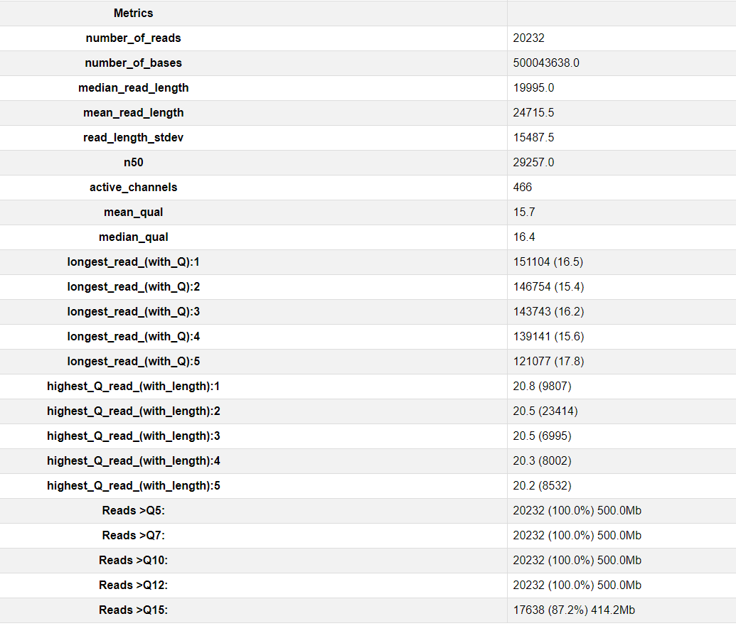
Quality control of long-read data
Step 1: Nanoplot
1. Which input types does NanoPlot take?
5b. What is the sequencing depth of the genome if this is an E. coli?
5c. Which Q-score has this data been filtered on?
5d. Do you think this data could be filtered further?

Slide 53
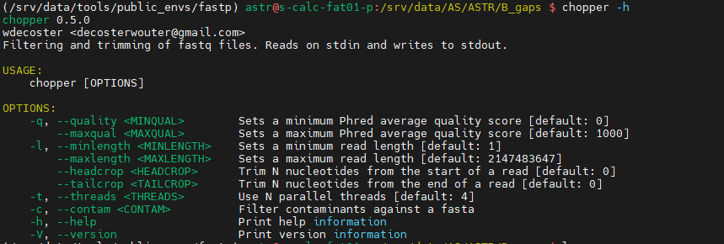
Quality control of long-read data
Step 2: Quality filtering with Chopper
2. What does Chopper give you of information and can it be used to infer a new sequencing depth after filtering?

Slide 54
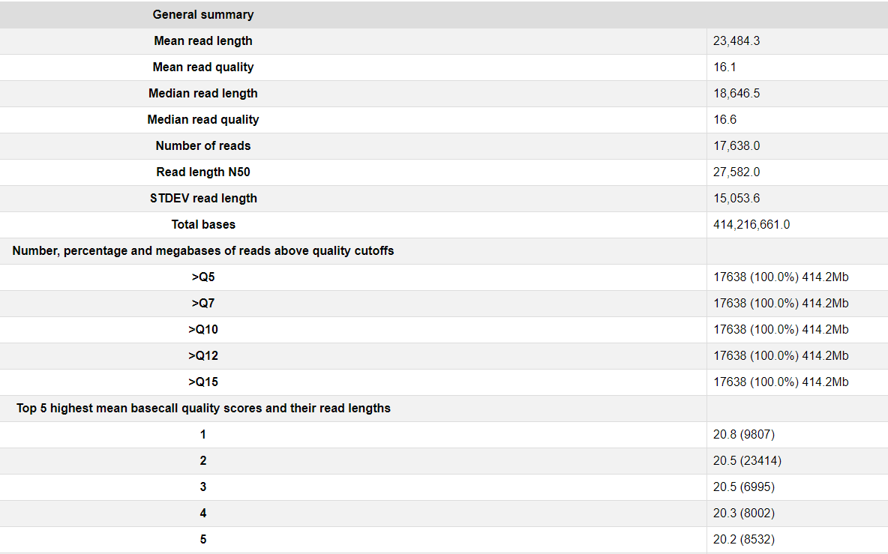
Quality control of long-read data
Step 3: NanoPlot again..
1a. What is the mean read quality before filtering
1b. What is the mean read quality after filtering
2. At what depth do the filtered reads cover your E. coli genome?
3. What is most important, high quality or high sequencing depth?

Slide 55
ILOs
Describe the FASTQ format
Explain what a phred quality score is
Explain how phred quality scores are used to assess sequencing accuracy
Describe the output from a Nanopore sequencing run
Name and execute QC software for Nanopore data

Slide 56
References
Nanoplot and chopper
Wouter De Coster, Svenn D’Hert, Darrin T Schultz, Marc Cruts, Christine Van Broeckhoven, NanoPack: visualizing and processing long-read sequencing data, Bioinformatics, Volume 34, Issue 15, August 2018, Pages 2666–2669, https://doi.org/10.1093/bioinformatics/bty149

