Slide 1
Getting started with Python
Bridging the gaps in Bioinformatics

Slide 2
Objectives
Specific objectives of this session:
Get familiar with Python
Hands-on experience with Python
Prepare you for the future exercises
You will use Python and Bash scripts for the rest of the course.
You have different coding experiences, so this is to have a baseline.
Notes:
N one expects you to be experts, but we want you not to be scared when you see code

Slide 3
Outline
Introduction to Python – lecture
Hands-on experience with Python – exercises

Slide 4
What is python?
High-level interpreted language
Very easy to read
Simple but powerful syntax
Solve complex tasks with less code
Large ecosystem of libraries, frameworks, and tools
Python files end in .py:
superduper.py
Notes:
A multi-purpose language with a simple, and beginner-friendly syntax
Compared to other languages, you can solve complex tasks with less code

Slide 5
Why is python important to learn
One of the most popular languages
Easy to learn, yet practical
Used for big data analysis, machine learning, and Ai
Apps for mobile, desktop and web
Automation, automation, automation!
Simplicity and growth has made it very popular throughout the ages.
It’s an essential bioinformatic tool

Slide 6
Compared to other languages
R
Statistical computing
Data analysis
Graphics.
Bash
Automation
System administration

Slide 7
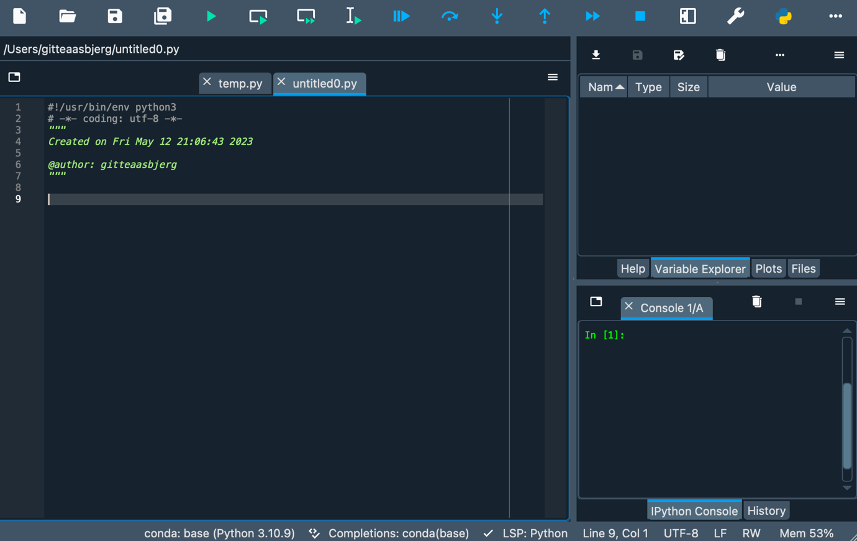
IDE: Integrated development environment
Notes:
IDE is a software application that provides major assistance to programmers.

Slide 8
Hello world – print statements in python
Script:
# This is a comment
print(’This will be printed out’)
’’’
This is a multiline way of commenting
’’’
Output:
This will be printed out

Slide 9
Types: Strings, Intergers and floats
str: Text data type
A = ‘The meaning of everything’ B = ‘42’
int: Numeric data type
C = 42
float: Numeric data type with decimals
D = 42.22

Slide 10
How to assign variables in Python
cute_animal = ”Polar bears”
amount_cuties = 30
danger = 78.5
print(‘I have just adopted’, amount_cuties, cute_animal)
print(‘My life expectancy has fallen by ’ + danger, ‘percent, but they are so fluffy!’)
Output:
I have just adopted 30 Polar bears
My life expectancy has fallen by 78.5 percent, but they are so fluffy!

Slide 11
Boolean
 | Logical operator meaning |  | Boolean True/False
1 | == Equal to | 1 | True
1 | != Not equal to | 1 | False
1 | > Greater than | 1 | False
1 | < Less than | 1 | False
1 | >= Greater than or equal to | 1 | True
1 | <= Less than or equal to | 1 | True
data type that represents one of two possible values:
True or False
Notes:
Booleans are often the result of comparison or logical operations. For example, you can compare two values using comparison operators such as:

Slide 12
Indexing
With indexing, you can access specific elements in a data structure.
These can be strings, lists, etc
Indexing starts from 0
language = ‘python’
language[2] = ‘t’
p y t h o n
Index: 0 1 2 3 4 5
Notes:
Indexing refers to accessing specific elements within a data structure, such as a string or a list, by their position or index. Indexing starts from 0, so the first element is at index 0, the second element is at index 1, and so on. By using square brackets [] after the variable containing the data, you can retrieve a specific element or a range of elements from the data structure.

Slide 13
Lists – One of the must useful types in Python
Lists are a collection of comma-separated items enclosed in [ ].
list_healthyfood = [‘cake’, ‘burger’, ‘chips’, ‘icecream’, ‘spinach’]
It is important to note that a single list can contain several data types:
Intergers, floats, strings, lists, etc
Input: print(list_healthyfood[2])
Output: chips
Notes:
You create a list similarly as you would assign variables:

Slide 14
If statements – conditional execution
Only executed if a specific requirement is met.
General Syntax:
if <expression>:
<statement1>
<statement2>
<statement3>
The end of the if statement is marked with the end of an indentation level
Notes:
If statements are used to add conditional execution of a statement. Such that, only if specific requirements are met, the code will be executed.

Slide 15
If statements – conditional execution
General Syntax:
if <expression>:
<statement1>
<statement2>
<statement3>
Example:
if x > 42:
print(x, ‘pieces of cake!’)
print(‘Are you okay!?’)
print(‘Is there room for some desert?’)
Notes:
If statements are used to add conditional execution of a statement. Such that, only if specific requirements are met, the code will be executed.

Slide 16
Indentation is key in Python!
In other languages, indentation is for readability, but for python it’s key!
Use indentation to define code blocks
General Syntax:
if <expression>:
<statement1>
<statement2>
<statement3>
Code blocks:
Code block 1
Code block 2
Code block 2
Code block 1
Notes:
Eliminates the need for curly brackets and semicolons as in other languages

Slide 17
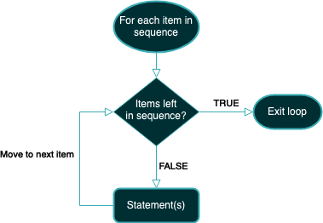
For loops
For loops loops through an iterable object and performs the same action for every entry in the object.
Examples of iterable objects:
String
Set
List
Notes:
For loops are used to loop through an iterable object, such as a string, a list, or a set, and perform the same action for each entry in the iterable object.

Slide 18
For loops
General Syntax:
for <var> in <iterable>: <statement(s)>
Iterable object:
list_drinks = [‘Soda’, ‘Beer’, ‘Acid’]
Example:
for drink in list_drinks:
print(drink, ‘is good for the soul’)
print(‘Maybe we should get water’)
Output:
Soda is good for the soul
Beer is good for the soul
Acid is good for the soul
Maybe we should get water
Notes:
For loops are used to loop through an iterable object, such as a string, a list, or a set, and perform the same action for each entry in the iterable object.

Slide 19
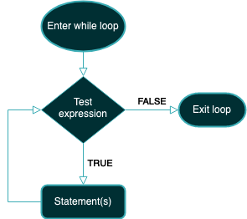
While loops
A while loop is an indefinite iteration.
It will only stop when a given condition stops being True.
General Syntax:
while <expression>:
<statement(s)>
Notes:
A while loop is an indefinite iteration that stops when a given condition stops being TRUE.

Slide 20
While loops
General Syntax:
while <expression>:
<statement(s)>
Example:
people = 0
while people < 40:
print(‘Walk right in’)
people += 1
print(‘I’m sorry we are only letting 40 people in today’)
print(‘Try another coronation’)
Notes:
A while loop is an indefinite iteration that stops when a given condition stops being TRUE.

Slide 21
Using modules
‘Module’ is an umbrella term for importable and reusable code
A python package usually consists of several modules
Example 1:
sqrt(4)
Output: NameError: name 'sqrt' is not defined
Example 2:
import math
math.sqrt(4)
Output: 2

Slide 22
Conda
Packaging and environment management system.
Load environments with specific versions of programs and packages.
Help you have multiple versions of a program with no issues.
Notes:
Conda is a package and environment management system. With it, you can load an environment with specific versions of certain programs and packages.

Slide 23
Biopython – a bioinformatics package
Biopython is a set of tools that are used for bioinformatics and coded in Python.
It is excellent for handling fasta files.
Use conda to activate an environment with Biopython.
23

Slide 24
Exercises
There are two documents:
Exercises
Handout
The handout has all the information needed to perform the exercises
There are again extra if you are fast to finish the regular ones.
Have fun!

Slide 25
Acknowledgements The creation of this training material was commissioned by ECDC to Statens Serum Institut with the direct involvement of Gitte Nygaard Aasbjerg and Leandro Andrés Escobar-Herrera. The revision and update of this training material was commissioned by ECDC to Statens Serum Institut with the direct involvement of Gitte Nygaard Aasbjerg and Leandro Andrés Escobar-Herrera.

