Slide 1
Introduction to the Command-line
GenEpi-BioTrain - Training in Genomic Epidemiology and Public Health Bioinformatics “Bridging the Gap” - Third edition (TB and AMR)
February 23rd 2025

Slide 2
Who are we?
Astrid
Gitte
Leandro

Slide 3
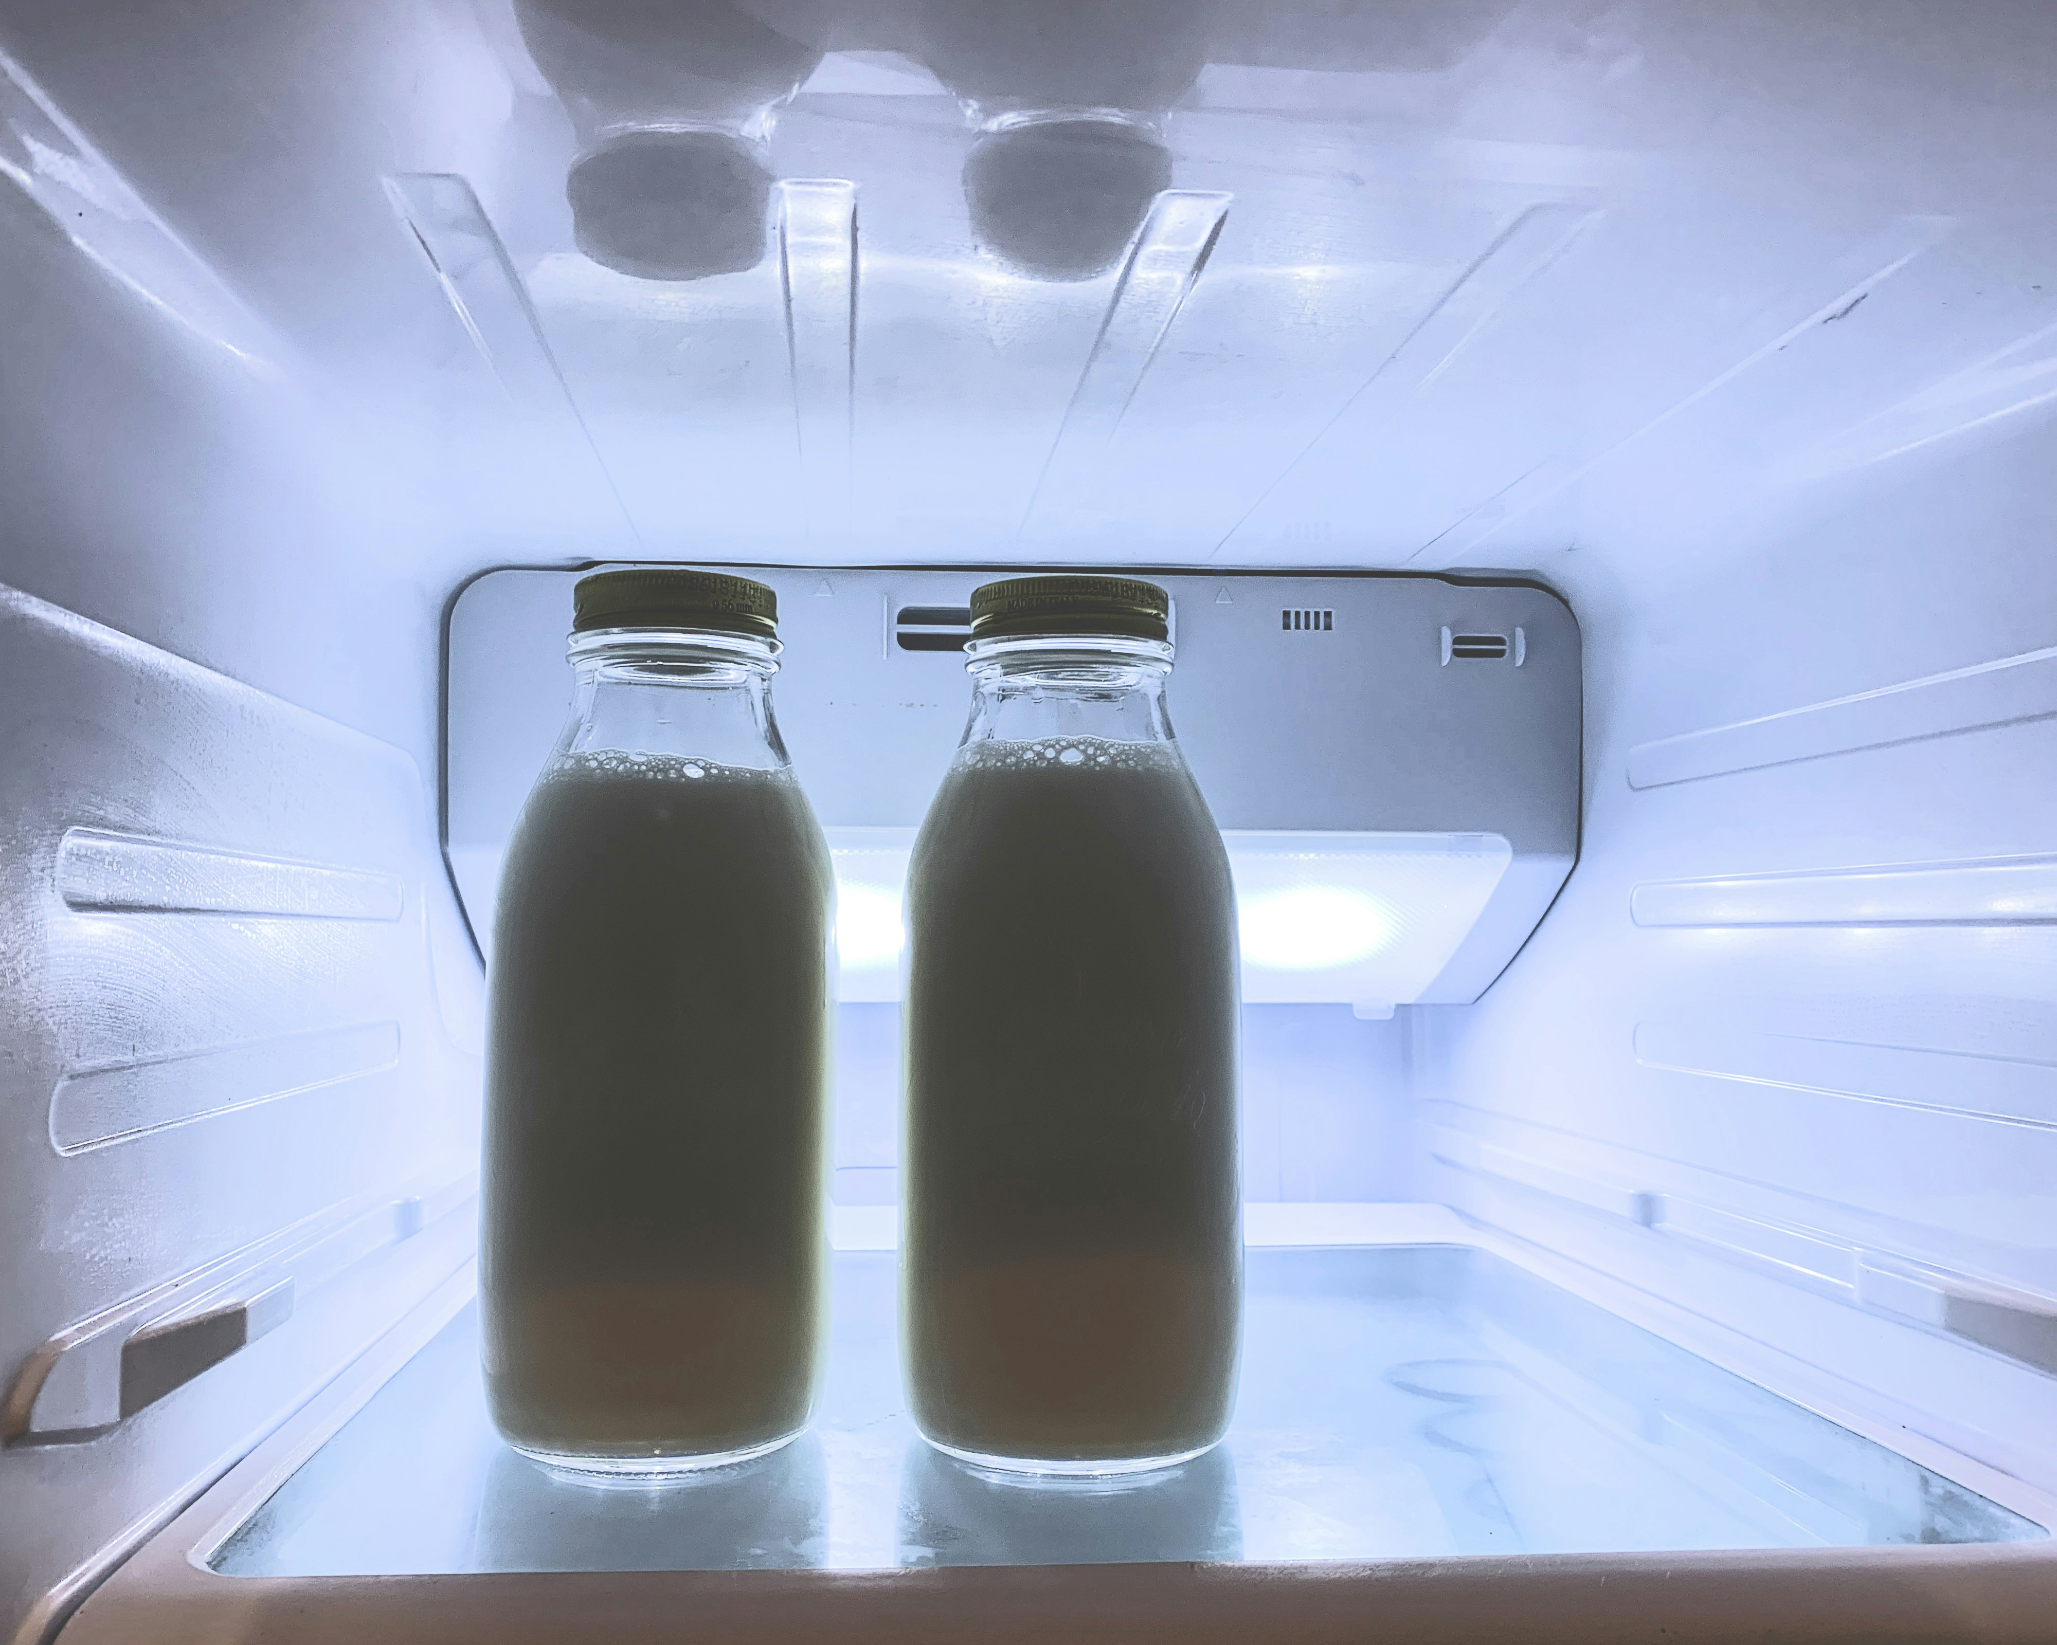
Short introduction to Linux
Linux is an operating system, just like Windows.
The operating system is the communication layer between your software and your hardware.
Linux is around everywhere, from cars, refrigerators to supercomputers.
Notes:
Only 2% of desktop computers use Linux.
It is used in all top500 supercomputers in the world.
The vast majority of other electronics use Linux.
It is free
It is open source
It is reliable
Derivatives can be licensed
These three reasons combined means that there is no point in creating new OS. Any company who needs that, can take Linux and customize it to their needs.

Slide 4
Why use Linux?
Linux is:
Free
Less vulnerable to attacks
Open source – adds more freedom
Linux comes in many different flavors (distribution)
Here, you will be using Ubuntu
The command-line is very important for the Linux ecosystem.
And it relies on it much more than other operating systems.
Notes:
Only 2% of desktop computers use Linux.
It is used in all top500 supercomputers in the world.
The vast majority of other electronics use Linux.
It is free
It is open source
It is reliable
Derivatives can be licensed
These three reasons combined means that there is no point in creating new OS. Any company who needs that, can take Linux and customize it to their needs.

Slide 5
Outline
Today’s session consists of the following elements:
Short talk: Introducing the command-line
Practical: Exercises
--- Lunch ---
Short talk: Command-line continued
Practical: Exercises continued

Slide 6
Objectives
Specific objectives of this session:
Introducing the command-line
Navigating the File System
Working the File System
Special Characters

Slide 7
Objectives
Specific objectives of this session:
Introducing the command-line
Navigating the File System
Working the File System
Special Characters

Slide 8
Command syntax
command [- options] [arguments]
command: The action you want to perform
options: Flags that modify a command's behaviour
arguments: The targets on which the command acts

Slide 9
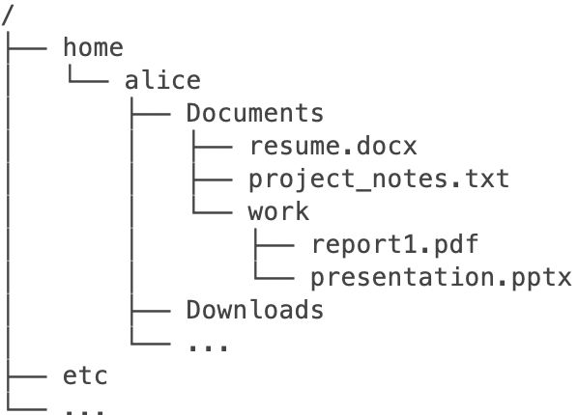
File System
Hierarchical tree—like structure

Slide 10
Objectives
Specific objectives of this session:
Introducing the command-line
Navigating the File System
Working the File System
Special Characters

Slide 11
Navigating the File System

Slide 12
Navigating the File System
Absolute path: /home/alice/Documents/work/presentation.pptx
Relative path: Documents/work/presentation.pptx

Slide 13
Where am I? pwd
Print working directory

Slide 14
Where am I? pwd
Print working directory
pwd
output: /home/alice/Documents

Slide 15
Change directory cd [directory]
Change directory (folder)
cd /home/alice/Documents

Slide 16
Change directory cd [directory]
Change directory (folder)
cd /Documents

Slide 17
Change directory cd [directory]
Change directory (folder)
cd ../

Slide 18
Change directory cd [directory]
Change directory (folder)
cd ../../Downloads

Slide 19
List content ls [- options] [path]
List content of directory
ls output: resume.docx project_notes.txt work

Slide 20
List content ls [- options] [path]
List content of directory
ls -l output:
-rw-r--r-- | 1 | alice | 53579 | May 13 | 15:22 | resume.docx
-rw-r--r-- | 1 | alice | 157017 | Feb 6 | 07:27 | project_notes.txt
drwxr-xr-x | 1 | alice | 736 | Apr 23 | 09:02 | work

Slide 21
List content ls [- options] [path]
List content of directory
ls -l work/ output:
-rw-r--r-- | 1 | alice | 643222 | Aug 11 | 15:22 | report1.pdf
-rwx------ | 1 | alice | 66360 | Dec 19 | 07:27 | presentation.pptx

Slide 22
Path to file readlink [options] path_name
Display the path to file or directory
readlink –f resume.docx output: /home/alice/Documents/resume.docx

Slide 23
Objectives
Specific objectives of this session:
Introducing the command-line
Navigating the File System
Working the File System
Special Characters

Slide 24
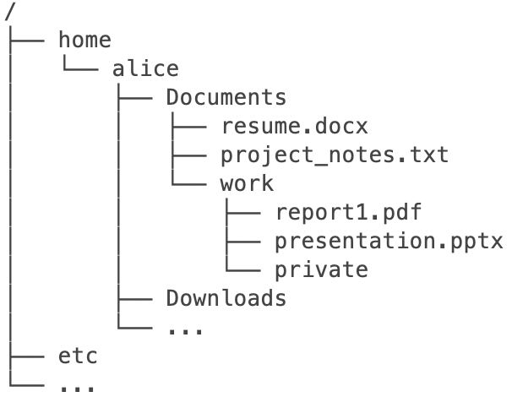
Create Directory mkdir [options] directory
Create new empty directory
mkdir private

Slide 25
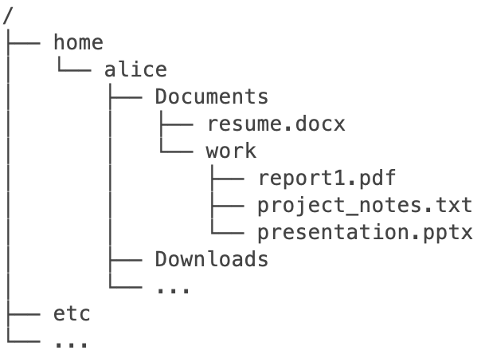
Move mv [options] source destination
Move file to destination
mv project_notes.txt work/

Slide 26
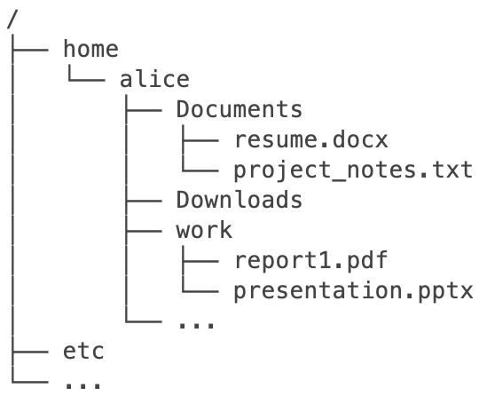
Move mv [options] source destination
Move directory to destination
mv Documents/work/ /home/alice/

Slide 27
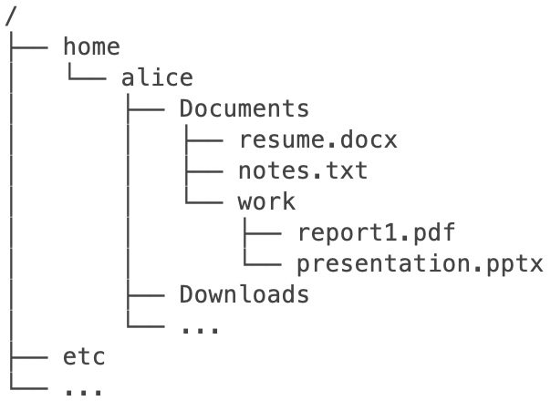
Rename mv [options] old_name new_name
Rename Files or Directories
mv Documents/project_notes.txt Documents/notes.txt

Slide 28
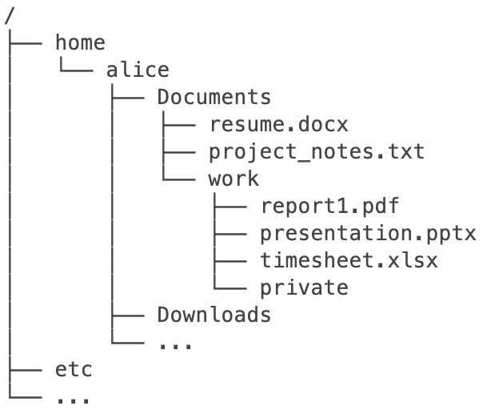
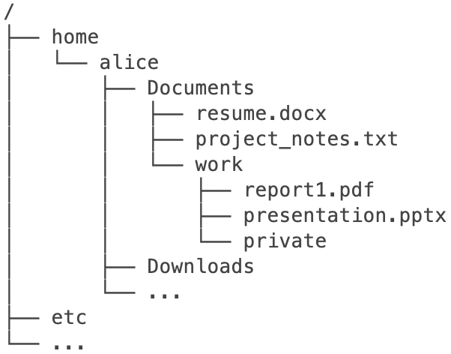
Remove rm [options] file
Remove File
rm timesheet.xlsx

Slide 29
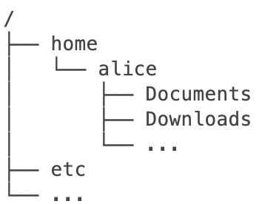
Remove rm [options] file
Remove Directory: Use caution!
rm -rf Documents/

Slide 30
Objectives
Specific objectives of this session:
Introducing the command-line
Navigating the File System
Working the File System
Special Characters

Slide 31
Move mv [options] source destination
Move directory to destination
mv Documents/work/ /home/alice/

Slide 32
Move mv [options] source destination
Current Directory Reference (dot)
mv Documents/work/ .

Slide 33
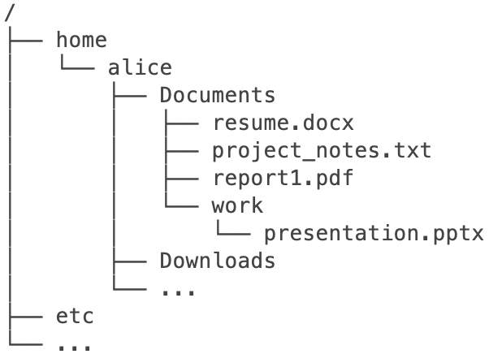
Special characters
Current Directory Reference (dot)
mv work/report1.pdf .

Slide 34
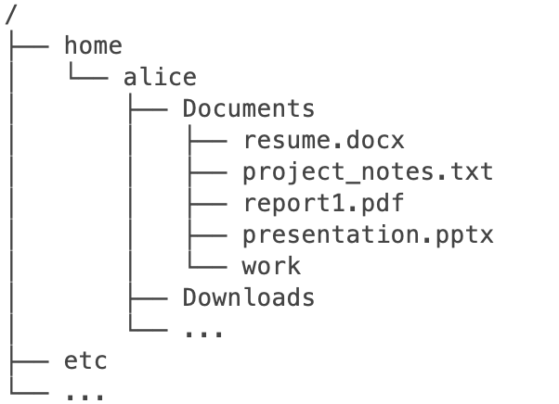
Special characters
Wildcard * represents zero or more characters in file or directory names
mv work/* .
Notes:
You use a wildcard * when you want to handle multiple files.
A wild card acts like a placeholder, so if multiple files fit the pattern, the command will be used on those files.

Slide 35
Special characters
Wildcard * represents zero or more characters in file or directory names
mv *.fasta | E_coli.fasta | E_coli.fasta.gz | coli.fasta | E_coli123.fasta | E_coli.txt | fasta.gz
mv E_coli* | E_coli.fasta | E_coli.fasta.gz | coli.fasta | E_coli123.fasta | E_coli.txt | fasta.gz
mv E_coli*.fasta | E_coli.fasta | E_coli.fasta.gz | coli.fasta | E_coli123.fasta | E_coli.txt | fasta.gz
Notes:
You use a wildcard * when you want to handle multiple files.
A wild card acts like a placeholder, so if multiple files fit the pattern, the command will be used on those files.

Slide 36
Edit nano [options] file
nano project_notes.txt
Ctrl + O: Save changes
Ctrl + X: Exit
Notes:
To open a file using nano, simply type nano in front of the file you wish to edit; for example
In the very bottom of the nano text editor, you will see a section of key options, including saving changes (Ctrl + O), exiting (Ctrl + X), etc. To perform one of these options, press Ctrl and the letter associated with the option. You can save the script when exiting.

Slide 37
Remove rm [options] file
Remove Directory
rm -rf private

Slide 38
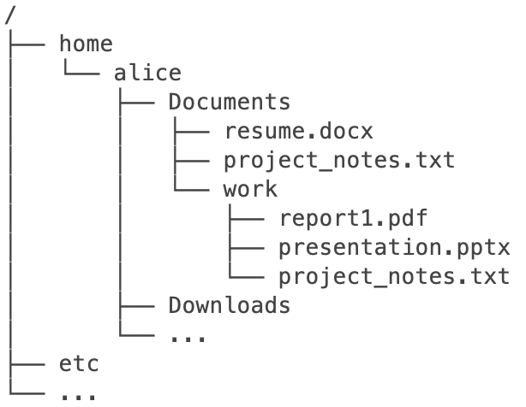
Copy cp [options] source destination
Copy file to destination
cp project_notes.txt work/

Slide 39
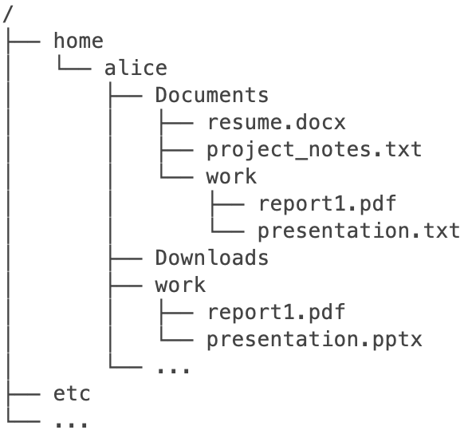
Copy cp [options] source destination
Copy directory to destination
cp –r Documents/work /home/alice

Slide 40
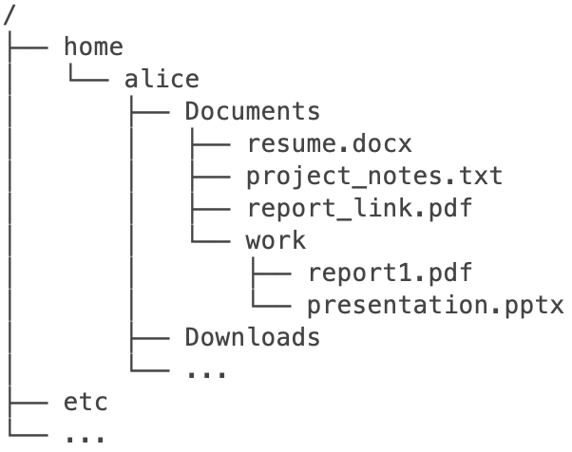
Symbolic link ln [-s] target link_name
Pointers/shortcuts to other files or directories
Use relative path: ln –sr work/report1.pdf report_link.pdf
(macOS: ln –s work/report1.pdf report_link.pdf)
Notes:
Different projects might utilize the same data
It is space-inefficient to copy files over for each project
Instead, you would use symbolic links
A link is a pointer to a file (shortcut)
If you perform commands on a link, the program will perform them on the original file
A symbolic link is a link that includes the path to its target
Symbolic links are not updated
The link is dead if you move the original file

Slide 41
Gitte

Slide 42
View command [options] file
Display the content of a file directly in the terminal
cat project_notes.txt
Display the content of a file in a separate screen (press q to exit)
less project_notes.txt
Display the first five lines directly in the terminal (default 10)
head –n 5 project_notes.txt
Display the last seven lines directly in the terminal (default 10)
tail –n 7 project_notes.txt

