Slide 1
Intro to Bash
Bridging the gaps
24/02/2025

Slide 2
Objectives
Specific objectives of this session:
Get familiar with Bash
Hands-on experience with Bash
Prepare you for the future exercises
You will use Python and Bash scripts for the rest of the course.
You have different coding experiences, so this is to have a baseline.

Slide 3
Outline
A quick introduction to Bash
The focus of this session is hands-on experience
Exercises in Bash

Slide 4
What is Bash?
Bash is a command language and command line interpreter.
It can be used to interpret commands that carry out various actions.
A combination of these commands in a series within a text file is called a Shell script.
1989
Notes:
Released in 1989m and replaced the bourne shell program from 1979

Slide 5
Why is Bash so neat?
Easy to create
Easy to handle complicated tasks
Easy to run on multiple files with scripts
Can be automatically run
Notes:
Bash scripting makes rutine tasks easy Saves a lot of time

Slide 6
Writing Bash scripts
#!/bin/bash
echo “This is a print statement”
echo “It will be printed out when running the script”
Notes:
The shebang line (#!) tells the interpreter which language it is written in. This is a sample script that will print 2 lines to the terminal when run.

Slide 7
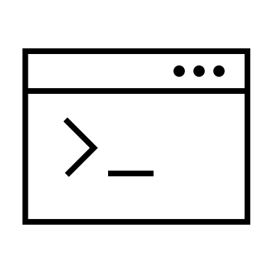
Running Bash
Run the script with added interpreter:
bash scriptname.sh
Making the script executable:
chmod 755 scriptname.sh
./scriptname.sh
Notes:
You can run a bash script in two ways from the terminal. Either by providing an interpreter
OR by making the script executable, so it can run without providing an interpreter
Here is when you show the example live! This slide and the previous one!

Slide 8
Variables
#!/bin/bash
WholesomeActivity=parasail
echo “Our 2-year old loves to $WholesomeActivity
echo “She does it all the time!”

Slide 9
Variables
#!/bin/bash
WholesomeActivity=dance
echo “Our 2-year old loves to $WholesomeActivity
echo “She does it all the time!”

Slide 10
Variables
Variables are useful in scripts that are rerun with different inputs.
Especially long scripts

Slide 11
If statements
An if statement is a programming conditional statement that performs an action when proven true.
If true, then all statements between then and fi will run.
Indentation is key for easy readability.
General if statement:
if [ <expression> ]
then
<statement>
fi
------------------------------------------------------
Example:
if [ 8 -lt 12 ]
then
echo “Wow, 8 is smaller than 12!”
fi
Notes:
Indentation is key, it tells the program what is part of the

Slide 12
How this session is built
From here on, it is only exercises
There are two documents:
Exercises
Handout
You are expected to do the first seven exercises.
Extra are for those who finish quickly.
Notes:
Handout has all the information needed to do the exercices.

Slide 13
Acknowledgements The creation of this training material was commissioned by ECDC to Statens Serum Institut with the direct involvement of Gitte Nygaard Aasbjerg and Leandro Andrés Escobar-Herrera The revision and update of this training material was commissioned by ECDC to Statens Serum Institut with the direct involvement of Gitte Nygaard Aasbjerg and Leandro Andrés Escobar-Herrera

