Slide 1
Notes for facilitator
Presentation 1.7 - Data collection tools
One-day training course for data collectors
Lecture 7
30 minutes
Suggested time of delivery – 15:15
National/hospital contact points may wish to amend this presentation to their local setting.
Notes:
Facilitator notes:

Slide 2
ECDC PPS data collection tools
Epidemiological methods for point prevalence surveys of healthcare-associated infections and antimicrobial use in acute care hospitals
Version 2017
Revision: 2018
Notes:
Facilitator notes:

Slide 3
Objectives
Specific objectives of this session:
1. Use data collection tool to enter, view and export data
Related to the course objectives:
Have an insight into the HelicsWin.Net PPS data collection tool
Supply PPS data to the national coordinator
Notes:
Facilitator notes:

Slide 4
Outline
This session consists of the following elements
Background to HelicsWin.Net
Minimum system requirements and settings
Download and installation
Features of HelicsWin.Net
Data entry fields
Data quality checks and export
Reporting data to the national coordinator
Notes:
Facilitator notes:

Slide 5
HelicsWin.Net
HelicsWin.Net originates from the Microsoft Access application HelicsWin developed by the former European HELICS (Hospitals in Europe for Infection Control through Surveillance) network for the surveillance of HAI.
HelicsWin.Net was originally developed by the ICT department of the Scientific Institute of Public Health, Brussels, Belgium under contract ECD.2218 and its amendment ECD.2764 until September 2011. In September 2011, development of HelicsWin.Net was transferred to ECDC.
Current version v2.2 was released in spring 2016 for ECDC PPS 2016-2017.
See also HelicsWin.Net manual v3.2 and the quick start guide.
Notes:
Facilitator notes:

Slide 6
Minimum requirements
PC running Microsoft Windows XP or later version
Administrator rights for installation
Microsoft .NET framework 3.5 SP1 or later version
Minimum 100MB free storage
Screen settings
Minimum resolution 1024 x 768 pixels (otherwise parts of screen hidden)
Notes:
Facilitator notes:

Slide 7
Download and installation
Download
From ECDC HelicsWin.Net webpage: http://ecdc.europa.eu/en/activities/surveillance/hai/about_hai-net/pages/helicswinnet-download-page-hwn.aspx
Save and extract the .zip file to drive into a folder with full access
Run setup.exe
Follow the on-screen instructions
The application files are installed by default to C:\HWN2\
The files include:
HelicsWinNet***.mdb – database file for each module (PPS, CDI and ICU)
Reference.mdb – all reference lists of values and labels in application
Translation.mdb – translation module
Notes:
Facilitator notes:

Slide 8
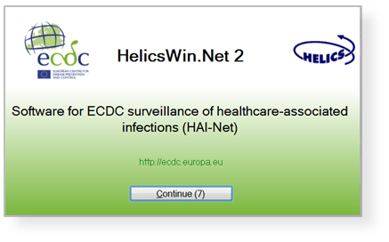
Start up screen
Press continue

Slide 9
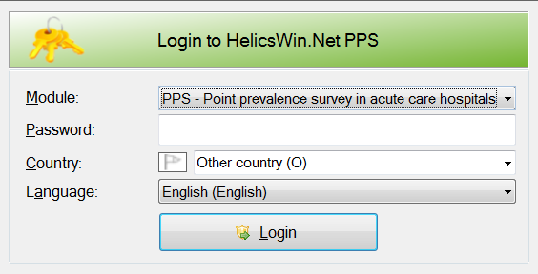
Login to HelicsWin.Net
For ECDC PPS, select module: PPS
Default password: helics
After selecting your country and language (in case of translation), click ’Login’

Slide 10
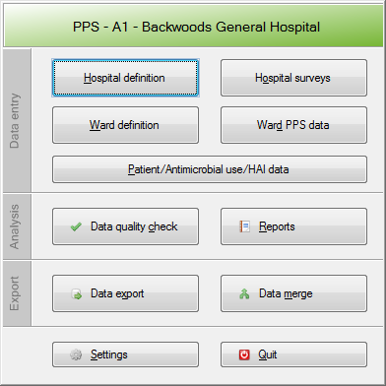
PPS main menu
1. Define your hospital
2. Enter the data of your hospital
3. Define your hospital
wards
4. Enter the data of
your hospital wards
5. Define and enter data
for your patients, their
antimicrobial use and their
healthcare-associated
infections

Slide 11
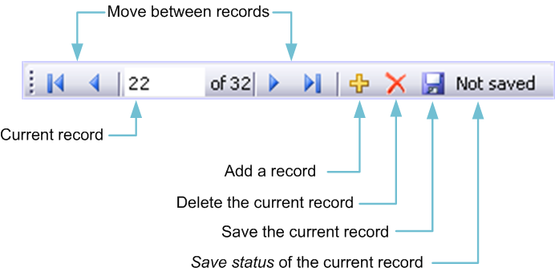
Working with HelicsWin.Net forms
ALWAYS start a new observation by clicking Add item
icon
Entered or changed data are NOT automatically stored, you need to click Save icon to save (or press Ctrl+S)
After saving, record is added to the internal database. You can access each record from this form through the Forwards  and Backwards  buttons on the toolbar

Slide 12
General features of the user interface
General outlook of data forms: directly underneath the toolbar, the selected hospital code is displayed.
You have to enter most categorical variables through drop-down lists.
Tabbing: keyboard tabbing first follows the order of input fields, after which focus will be put on toolbar.
You can access fields with keyboard shortcuts made up of the Alt key and the underlined letter on the field label.
Once the focus is on the field, if you enter the first letter of the required value, you can select the value from the drop-down list.
The default buttons in the warning messages—for example, Yes and No buttons—are displayed in the language of the installed Windows operating system.

Slide 13
Understanding reported errors
There are three types of field validation in HelicsWin.Net:
Type 1: mandatory fields are left blank or have been assigned invalid values: an error message is displayed, the relevant field labels are shown in red and you cannot save the data
Type 2: required fields are left blank: a warning message is displayed, the relevant field labels are shown in blue, but saving is possible.
Type 3: optional fields that can be empty: no warning or error message is displayed

Slide 14
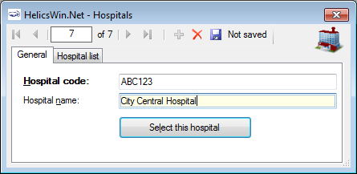
Defining your hospital
1. After clicking icon : enter your hospital’s code
and name and click Save
3. After saving, select
your hospital (to proceed to enter hospital data)
2. To add additional hospitals, click Hospital definition in the main menu

Slide 15
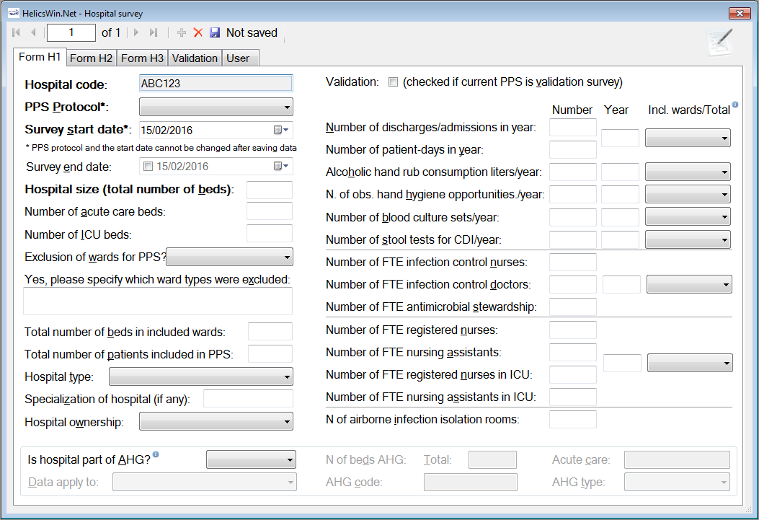
Entering hospital data
1. Click Hospital surveys in the main menu
2. After adding a new item , fill in
each Form (H1, H2 and H3) and Save

Slide 16
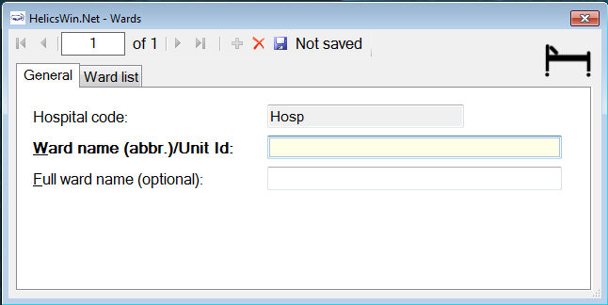
Defining hospital wards
1. Click Ward definition in the main menu
2. After adding a new item , enter your ward Id and name and click Save
3. After saving, you can repeat (2) for defining further ward(s)

Slide 17
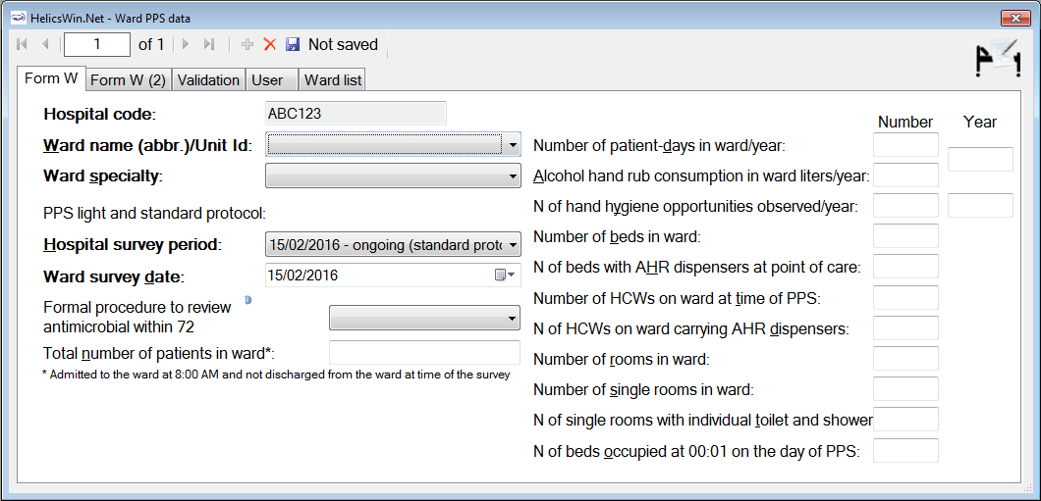
Entering ward data: Standard protocol
1. Click Ward PPS data in the main menu
2. After adding a new item , fill in each form W and W (2) and name and click Save
3. After saving, you can repeat (2) for entering data for further ward(s)

Slide 18
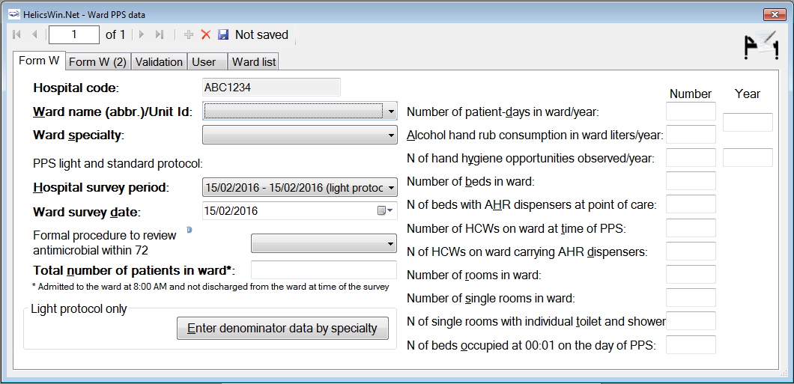
Entering ward data: Light protocol
1. Click Ward PPS data in the main menu
2. After adding a new item , fill in each form W and W (2) and name and click Save
3. Add also the denominator data by specialty for each ward (opens a new form)
4. After saving, you can repeat (2) for entering data and denominators for further ward(s)

Slide 19
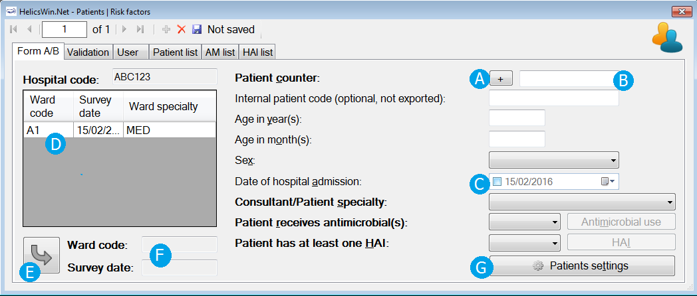
Entering PPS patient data
1. Click Patient/Antimicrobial use/HAI data in the main menu
2. After adding a new item , fill in Form A/B and click Save
3. Select ’Yes’ for patients that receive AM and/or have an HAI and enter details into a new form (see next slides)
4. After saving, you can repeat (2) (and 3, if AM/HAI) for entering data for further patient(s)

Slide 20
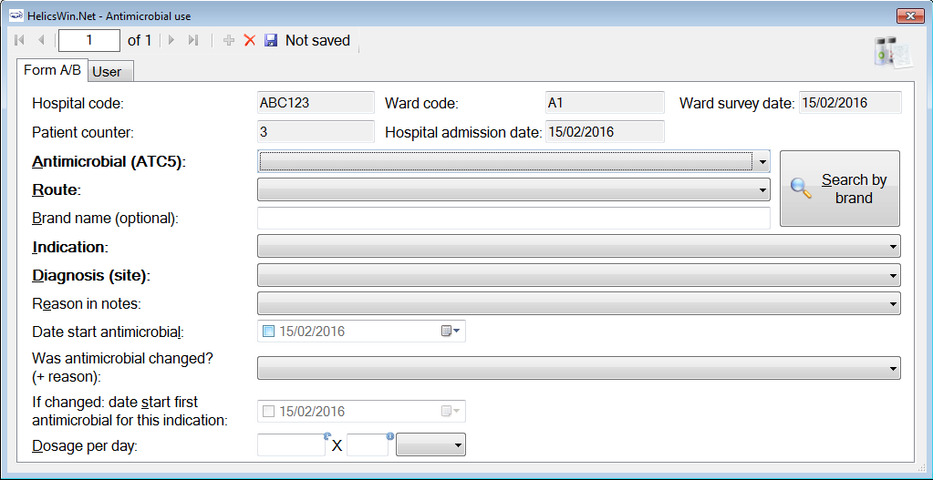
Entering PPS antimicrobial use data
After selecting ’Yes’ for ’Patient receives antimicrobial(s)’,
click Antimicrobial use in the Patient | Risk factors form
2. After adding a new item , fill in Form A/B and click Save
3. After saving, you can repeat (2) for entering data for further antimicrobial(s)

Slide 21
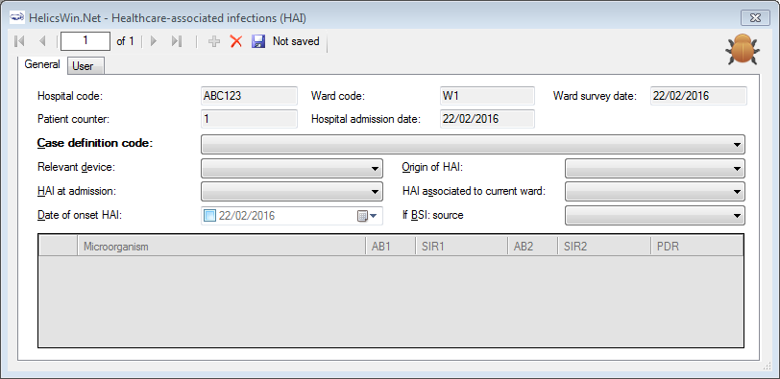
Entering PPS HAI data
After selecting ’Yes’ for ’Patient has at least one HAI’,
click HAI in the Patient | Risk factors form
2. After adding a new item , fill in Form A/B and click Save
3. After saving, you can repeat (2) for entering data for further HAI(s)

Slide 22
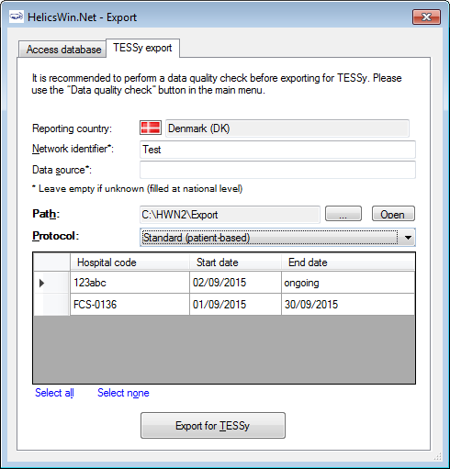
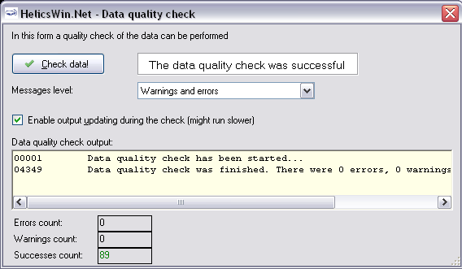
Data quality check and data export
Data quality check can be performed within the software during and after data entry (click Data quality check in the main menu)
Data can be exported in .mdb or TESSy .csv format (Click Data Export in the main menu)

Slide 23
How to send data to the national coordinator
To be amended to the national/local setting

Slide 24
In summary
List of learning points in this session:
Simple data entry
Data can be entered directly to the software or entered from the forms.
Software can be translated to by the national coordinators/teams.
Software offers standardized data entry tool, data format and data quality checks before export e.g. to TESSy format.
Notes:
Facilitator notes:

Slide 25
Acknowledgements The creation of this training material was commissioned in 2010 by ECDC to Health Protection Agency (UK) with the direct involvement of Dr. S. Hopkins, Prof. J. Reilly, S. Cairns, Dr. E. Sheridan, Dr. G. Hughes, Prof. B. Cookson, Dr. A. Charlett, G. Kafatos, B. Muller Pebody, F. Cowan, and Y. Sueiro. The revision and update of this training material was commissioned in 2017 by ECDC to Transmissible (NL) with the direct involvement of Dr. Arnold Bosman and Dr. Ágnes Hajdu
Notes:
Facilitator notes:

