Slide 1
Welcome to the ”GenEpi-BioTrain”, Block 1
Training programme in genomic epidemiology and public health bioinformatics – “GenEpi-BioTrain”
Theresa Enkirch, ECDC (Microbiology and Molecular Surveillance Group)​
15 May 2023

Slide 2
EU investments triggered by the pandemic
‘HERA Incubator’ (February 2021), a new EU bio-defence preparedness plan against SARS-CoV-2 variants
Rapid detection of SARS-CoV-2 variants
On 25 February 2021, President Ursula von der Leyen announced that the EU would provide EUR 200 M to strengthen detection and monitoring of SARS-CoV-2 variants:
Whole genome sequencing (WGS)
short-term support for access to high-capacity WGS services
longer-term support for national investments into WGS infrastructure for the public health laboratories
cross-border networking activities such as bioinformatics, standardisations, and training
Notes:
In order to start implementing the type of activities that HERA would be supporting, EC launched a programme called HERA Incubator

Slide 3
Overview of European Commission/ECDC* activities to boost genomic epidemiology
Access to high-capacity, rapid turn-around time WGS services
National WGS and RT-PCR infrastructure projects
National WGS and RT-PCR infrastructure projects (EU4Health)
Consolidation of national infrastructure (EU4Health)
Cross-border capacity-building support programme
2021
2022
2023
2024

Slide 4
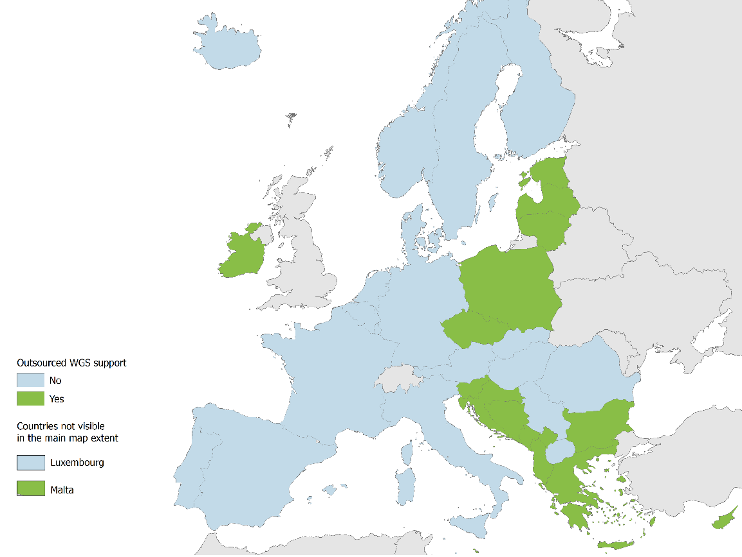
Access to high-capacity WGS services through outsourced WGS support
Immediate sequencing capacity is provided to EU/EEA countries and (since August 2021) Western Balkans through access to a WGS service contract
Services include shipping of RNA samples, cDNA synthesis, sequencing and basic bioinformatics
Since Feb 2021, over 234 018 samples have been sequenced from 12 EU/EEA countries and 4 Western Balkans
Notes:
Short-term action – stop-gap measure to address an urgent need in Feb 2021
Not a sustainable model, but has delivered a lot of data for 14 MS and 4 WB

Slide 5
HERA Incubator WGS infrastructure support grants
17 projects concluded
7 projects extended to 2023 due to force majeure
46 ECDC staff members involved
61,132,114 EUR paid* by ECDC in 2021 and 2022
39,000,000 EUR assigned by HERA for continued support 2022-2024 within EU4Health

Slide 6
Updated EU regulations, November 2022
The Centre should broaden its collection and analysis of data in terms of epidemiological surveillance and related special health issues, progression of epidemic situations, unusual epidemic phenomena or new diseases of unknown origin, including in third countries, molecular pathogen data and health systems data.
The national competent authorities ….shall communicate the following information…to the participating authorities of the network for epidemiological surveillance:
…molecular pathogen data, if required for detecting or investigating serious cross-border threats to health
Updated ECDC mandate
Regulation on serious cross-border threats to health and repealing Decision No 1082/2013/EU

Slide 7
Whole Genome Sequencing: ECDC Vision 2020
This expert opinion addresses the following questions:
What are the strengths and weaknesses of WGS-based typing for multi-country outbreak detection/investigation and disease surveillance?
What is the current state and medium-term outlook for the development, harmonisation and interlaboratory portability of WGS-based typing for epidemiological investigation of diseases for surveillance?
https://www.ecdc.europa.eu/sites/default/files/media/en/publications/Publications/whole-genome-sequencing-for-public-health-surveillance.pdf

Slide 8
ECDC strategy for integrated genomic typing
Support to multi-country outbreak investigations through sequence-based typing: Campylobacter spp., Clostridium difficile, hepatitis A virus, Legionella spp., Listeria monocytogenes, multidrug-resistant Mycobacterium tuberculosis (MDR TB), Neisseria meningitidis, Salmonella enterica, Shiga-toxin producing E. coli, West Nile virus and emerging multi- or extensively drug-resistant (MDR or XDR) bacteria, new pathogens or new modes of transmission of healthcare-associated or community pathogens.
EU-wide sequence-based continuous surveillance: influenza virus, Listeria monocytogenes, MDR TB, Neisseria meningitidis, Salmonella enterica and Shiga-toxin producing E. coli.
Sentinel surveillance or surveys: antibiotic-resistant Neisseria gonorrhoeae, Bordetella pertussis, carbapenem- or colistin-resistant Enterobacteriaceae, carbapenem-resistant Acinetobacter baumannii, HIV-transmitted drug resistance, and Streptococcus pneumoniae.

Slide 9
What we can get from WGS
Models predicting some properties of the pathogen:
Virulence and transmissibility
Resistance to antimicrobials
Effectiveness of vaccines
Models to investigate the relationship between isolates/samples/cases
Allows for very precise case definitions
Outbreak delineation with a high degree of confidence
May identify additional cases that initially have no obvious epidemiological link to other outbreak cases

Slide 10
Different types of genomic / WGS surveillance in public health
Outbreak / Event-based surveillance
Investigating the extent (in time and space) of an outbreak
Informing control measures in response to the outbreak
Informing measures to prevent future outbreaks
Control-oriented / Indicator-based surveillance
Detecting outbreaks from continuous surveillance data
Strategy-oriented surveillance
Through surveys and/or continuous surveillance informing strategic response to infectious diseases

Slide 11
Outbreak/Event investigation at ECDC
At ECDC, event-based surveillance is mainly performed using the EpiPulse Events section
When an event where WGS data may be of help is launched, countries are asked to contribute WGS data
ECDC then analyses these data and use the results in conjunction with other epidemiological data to draw conclusions
The results are shown in the EpiPulse molecular typing system, and are linked to the EpiPulse event

Slide 12
Example: SARS-CoV-2 variant analysis
Every week, ECDC downloads a snapshot of the GISAID EpiCoV database
The mutations of all the sequences are analysed to detect trends in the variant landscape
Finding emerging variants and defining them
Early detection of increasing trends that correlate with epi indicators
Assigning VUM/VOI/VOC designations as soon as the required evidence is available
Monitoring proportions of variants

Slide 13
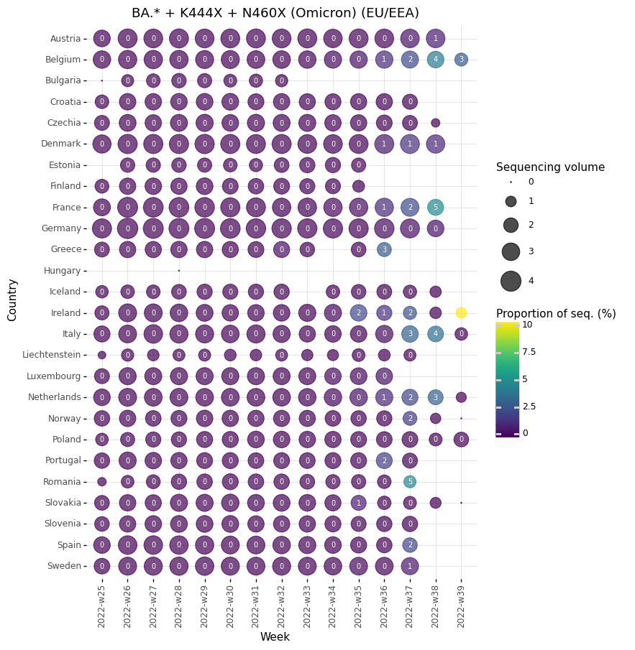
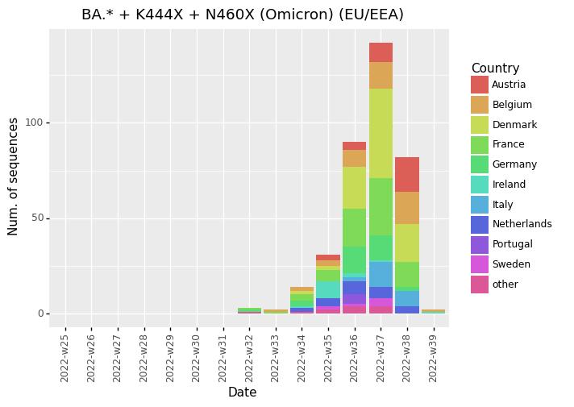
Early increasing trend for novel variants

Slide 14
Limiting factors for using genomic data for outbreak detection/investigations and surveillance
Typing takes time!
Reporting delay
Incomplete typing data
Countries have different sampling strategies
Incomplete background data
Lack of epidemiological follow-up
Lack of trained staff (bioinformaticians)!
Notes:
Reporting delay
Some typing data is submitted late compared to the date of sampling / receipt by the reference lab. May be due to delay in the typing itself or in the submission to ECDC.
Incomplete data:
Not all cases are typed.
Not all typed isolates are submitted.
Not all submitted cases are complete.
Countries have different sampling strategies:
Combining representative national data sets created from sampling strategies are unlikely to create a representative EU-level data set
ECDC has only collected typing data systematically since January 2013
Although many MS have submitted background data, it is not complete
ECDC does risk assessment only!
Identify signals and collect enough information to assess if there may be an EU-level PH threat
EC and MS responsible for risk management (i.e. source tracing, taking actions to stop prevent manufacturing/distribution of contaminated food etc)

Slide 15
Training programme in genomic epidemiology and public health bioinformatics – “GenEpi-BioTrain”
Aim:
Increase capacity to respond to Covid-19 pandemic
Increase capacity for genomic epidemiology for other diseases
Objectives: ​
Support countries in building up their capacity in genomic epidemiology and bioinformatics for public health purposes​
Increase the interdisciplinary collaboration between bioinformaticians, epidemiologists and microbiologists within a country ​
Facilitate the routine use of genomic information for surveillance, preparedness and outbreak response

Slide 16
Expectations after finishing the training:
Participants will
Improve the genomic surveillance in countries and EU/EEA
Improve EU-wide outbreak investigations in countries and EU/EEA
Improve collaborations within multidisciplinary teams
Apply what they learned in their home institutes
Cascade the training at their home institutes
Enhance data sharing & collaborations amongst Member States
Bring countries together to work on common goals!

Slide 17
Big thanks for your interest in the “Genepi-BioTrain”!
Big thanks to all the trainers from DTU and SSI for this course!

