Slide 1
Notes for facilitator
Presentation 1.4 - Data collection methods
One-day training course for data collectors
Lecture 4
45 minutes
Suggested time of delivery – 11:00
Notes:
Facilitator notes:

Slide 2
Data collection methods
Epidemiological methods for point prevalence surveys of healthcare-associated infections and antimicrobial use in acute care hospitals
Version 2017
Revision: 2018
Notes:
Facilitator notes:

Slide 3
Objectives
Specific objectives of this session:
Learn about the general content of the ECDC PPS protocol
Learn about the required data items and data collection forms
Learn about the ECDC PPS data collection process
Related to the course objectives:
Describe the ECDC PPS data collection process
Collect data on the ECDC PPS data collection forms
Implement a local PPS in their hospital
Notes:
Facilitator notes:

Slide 4
Outline
This session consists of the following elements
Introduction Contents of the ECDC PPS protocol
Summary of data items and data collection forms
National
Hospital
Denominator (standard and light)
Numerator (HAI and antimicrobial)
3. Data collection process
General guidance
Work plan for collection of data on the ward
Notes:
Facilitator notes:

Slide 5
The ECDC PPS 2016-2017 protocol

Slide 6
In brief: contents of the protocol v5.3
Background and changes to the protocol 1
Objectives 3
Inclusion/exclusion criteria 4
Sample design 5
Data collection 8
Overview of collected data 9
Hospital data 10
Ward data 18
Patient data (standard protocol) 20
Antimicrobial use data and HAI data 23
National/regional data 29
Data structure and variable names 31
Acknowledgements 33
Annex 1. Additional materials 39
Annex 2. Codebook 40
Notes:
Facilitator notes:

Slide 7
Summary of data items and data collection forms

Slide 8
Hospital data 1
European Prevalence Survey of Healthcare-Associated Infections and Antimicrobial Use
Form H1. Hospital data 1/3
Hospital code:
Survey dates: From __ / __ /____ To: __ / __ / ____
dd / mm / yyyy dd / mm / yyyy
Hospital size (total number of beds)
Number of acute care beds
Number of ICU beds
Exclusion of wards for PPS? ◻ No
◻ Yes, please specify which ward types were excluded:
_______________________________________________
Total number of beds in included wards:
Total number of patients included in PPS:
Hospital type ◻ Primary ◻ Secondary ◻ Tertiary ◻ Specialised, specify : ______________________
Hospital ownership: ◻ Public ◻ Private, not-for-profit
◻Private, for profit ◻ Other/unknown
 | Number | Year data | Inc./ Total (1)
Number of discharges/admissions in year |  |  | Inc Tot
Number of patient-days in year
Alcohol hand rub consumption liters/year |  |  | Inc Tot
N observed hand hygiene opportunities/year |  |  | Inc Tot
Number of blood culture sets/year |  |  | Inc Tot
Number of stool tests for CDI/year |  |  | Inc Tot
Number of FTE infection control nurses |  |  | Inc Tot
Number of FTE infection control doctors
Number of FTE antimicrobial stewardship
Number of FTE registered nurses |  |  | Inc Tot
Number of FTE nursing assistants
Number of FTE registered nurses in ICU
Number of FTE nursing assistants in ICU
N of airborne infection isolation rooms
Hospital is part of administrative hospital group (AHG):
◻ No ◻ Yes → if yes:
Data apply to: ◻ Hospital site only ◻ All hospitals in AHG
AHG code: AHG type: Prim Sec Tert Spec
N of beds AHG: Total Acute care beds
(1) Data were collected for Included wards only (Inc , = recommended) or for the total hospital (Tot); if all wards were included in PPS (Inc=Tot), mark “Inc”; N=Number
PPS Protocol: ◻ Standard ◻ Light
Is the hospital part of a national representative sample of hospitals ? ◻ No ◻ Yes ◻ Unknown
Notes:
Facilitator notes:

Slide 9
Hospital data 2
European Prevalence Survey of Healthcare-Associated Infections and Antimicrobial Use
Form H2. Hospital data 2/3
Does your hospital have the following in place for HAI prevention or antimicrobial stewardship? (Y/N/U)
Hospital code:
Survey dates: From __ / __ /____ To: __ / __ / ____
dd / mm / yyyy dd / mm / yyyy
Infection prevention and control (IPC) programme:
Is there an annual IPC plan, approved by the hospital CEO or a senior executive officer? ◻ Yes ◻ No
Is there an annual IPC report, approved by the hospital CEO or a senior executive officer? ◻ Yes ◻ No
Participation in surveillance networks:
In the previous year, which surveillance networks did your hospital participate in ? (tick all that apply)
SSI ◻ ICU ◻ CDI ◻ Antimicrobial resistance
Antimicrobial consumption ◻ Other, specify ____________ ________________________________________________
Microbiology/diagnostic performance:
At weekends, can clinicians request routine microbiological tests and receive back results?
Clinical tests: ◻ Saturday ◻ Sunday
Screening tests: ◻ Saturday ◻ Sunday
 | Guideline | Care bundle | Training | Checklist | Audit | Surveillance | Feedback
ICU
Pneumonia
Bloodstream infections
Urinary tract infections
Antimicrobial use
Hospital-wide / other wards
Pneumonia
Bloodstream infections
Surgical site infections
Urinary tract infections
Antimicrobial use
CEO: Chief Executive Officer, Managing Director; SSI: surgical site infections; ICU: intensive care unit (HAIs in ICUs); CDI: Clostridium difficile infections.
Pneumonia, bloodstream infections and urinary tract infections: healthcare-associated and/or device-associated; Care bundle: 3-5 evidence-based practices to improve patient outcome; Training: training or education; Checklist: self-applied; Audit: external process (process surveillance, observations…)
Comments/observations: _________________________________________________________________________
___________________________________________________________________________________________
Notes:
Facilitator notes:

Slide 10
Hospital data 3
European Prevalence Survey of Healthcare-Associated Infections and Antimicrobial Use
Form H3. Hospital data 3/3
Hospital code: Survey dates: From __ / __ /____ To: __ / __ / ____
dd / mm / yyyy dd / mm / yyyy
Optional: ward indicators collected at hospital-wide level:
 | Number | Inc./ Total (1)
Number of beds with AHR dispensers at point of care
Number of beds assessed for presence of AHR dispensers
Number of patient rooms in hospital
Number of single patient rooms in hospital
Number of single patient rooms with individual toilet and shower in hospital
Number of beds occupied at 00:01 on the day of PPS
Number of beds assessed for occupancy at 00:01 on the day of PPS
(1) Data were collected for Included wards only (Inc = recommended) or for the total hospital (Tot); if all wards were included in PPS (Inc=Tot), mark “Inc”
In your hospital, do healthcare workers (HCW) carry AHR dispensers (e.g. in their pockets) ? (if yes, please estimate percentage)
O No O >0-25% of HCW O >25-50% of HCW O >50-75% of HCW O >75% of HCW O Yes, percentage unknown
Is there a formal procedure to review the appropriateness of an antimicrobial within 72 hours from the initial order in the hospital (post-prescription review)?
O Yes, in all wards O Yes, in selected wards only O Yes, in ICU only O No
AHR = Alcohol hand rub; Number of beds assessed for presence of AHR dispensers and Number of beds assessed for occupancy at 00:01 on the day of PPS = denominator data, typically same number as the total number of beds in the hospital; ICU=intensive care unit.
Notes:
Facilitator notes:

Slide 11
Denominator Data
Denominator data are required to determine the prevalence of HAI in the surveyed patients: e.g. Number of patients with HAI/Total number of patients
Denominator data are collected for all patients present on the ward at 8am on survey date and not discharged at the time of survey
The light denominator collects only the aggregated number of patients included in the survey and does not allow risk-adjusted analysis of data
The standard denominator data includes risk factor data for all patients (with and without HAI) enabling risk-adjusted analysis of data- change notes below too if light not available
Notes:
Notes to trainer:
These data are collected for each patient on the ward at 8am either individually or as aggregated data (TBC).
The “light” denominator form collects aggregated denominator (page ??)
There are two “standard” denominator forms (TBC). The first collects data on the same form as the numerator (page ??) and the second is a separate table where a row is completed for each patient (page ??).

Slide 12
Ward data
European Prevalence Survey of Healthcare-Associated Infections and Antimicrobial Use
Form W. Ward data
Survey date¹: ___ / ___ / _______ Hospital code [__________] Ward name (abbr.) /Unit Id [__________]
dd / mm / yyyy
Ward specialty² ◻ PED ◻ NEO ◻ ICU ◻ MED ◻ SUR ◻ G/O ◻ GER ◻ PSY ◻ RHB ◻ LTC ◻ OTH ◻ MIX
Total number of patients in ward³ [__________]
Number of patients by consultant/patient specialty
(LIGHT only):
Is there a formal procedure to review the appropriateness of an antimicrobial within 72 hours from the initial order in this ward (post-prescription review)? O Yes O No
 | Number | Year⁵
Number of patient-days in ward / year
Alcohol hand rub consumption in ward liters/year⁶
N of hand hygiene opportunities observed /year
Number of beds in ward
N of beds with AHR dispensers at point of care
Number of HCWs on ward at time of PPS
Number of HCWs on ward carrying AHR dispensers
Number of rooms in ward
Number of single rooms in ward
N of single rooms with individual toilet and shower
N of beds occupied at 00:01 on the day of PPS
Consultant/patient Specialty | Number of patients in ward⁴
¹Patients on the same ward should be included on a single day if possible; ²Main ward specialty: >=80% of patients belong to this specialty, otherwise choose mixed ³Optional for standard, mandatory for light data collection; ³⁻⁴ number of patients admitted to the ward before or at 8:00 AM and not discharged from the ward at time of the survey; ⁵Year: year of data, previous year or most recent available year; ⁶Alcohol hand rub solution in liters delivered to the ward during the same year; N = number; AHR=alcohol hand rub; HCW=healthcare worker.
Comments/observations: _________________________________________________________________________

Slide 13
Ward data
European Prevalence Survey of Healthcare-Associated Infections and Antimicrobial Use
Form W. Ward data
Survey date¹: ___ / ___ / _______ Hospital code [__________] Ward name (abbr.) /Unit Id [__________]
dd / mm / yyyy
Ward specialty² ◻ PED ◻ NEO ◻ ICU ◻ MED ◻ SUR ◻ G/O ◻ GER ◻ PSY ◻ RHB ◻ LTC ◻ OTH ◻ MIX
Total number of patients in ward³ [__________]
Number of patients by consultant/patient specialty
(LIGHT only):
Is there a formal procedure to review the appropriateness of an antimicrobial within 72 hours from the initial order in this ward (post-prescription review)? O Yes O No
 | Number | Year⁵
Number of patient-days in ward / year
Alcohol hand rub consumption in ward liters/year⁶
N of hand hygiene opportunities observed /year
Number of beds in ward
N of beds with AHR dispensers at point of care
Number of HCWs on ward at time of PPS
Number of HCWs on ward carrying AHR dispensers
Number of rooms in ward
Number of single rooms in ward
N of single rooms with individual toilet and shower
N of beds occupied at 00:01 on the day of PPS
Ward name (abbreviated) of the ward in the hospital
Ward specialty (≥80% patients belong to this specialty). <80%= mixed ward (MIX)
Consultant/patient Specialty | Number of patients in ward⁴
¹Patients on the same ward should be included on a single day if possible; ²Main ward specialty: >=80% of patients belong to this specialty, otherwise choose mixed ³Optional for standard, mandatory for light data collection; ³⁻⁴ number of patients admitted to the ward before or at 8:00 AM and not discharged from the ward at time of the survey; ⁵Year: year of data, previous year or most recent available year; ⁶Alcohol hand rub solution in liters delivered to the ward during the same year; N = number; AHR=alcohol hand rub; HCW=healthcare worker.
Comments/observations: _________________________________________________________________________

Slide 14
Numerator data
Collects patient level data on all those
on antimicrobial
that have HAI
According to standard definitions….
Notes:
Facilitator notes:

Slide 15
Patient-based data
European Prevalence Survey of Healthcare-Associated Infections and Antimicrobial Use
Form A. Standard protocol: Patient data, Antimicrobial (AM) use and HAI data
Antimicrobial (generic or brand name) | Route | Indication | Diagnosis (site) | Reason in notes | Date start AM | Changed? (+ reason) | If changed: Date start 1st AM | Dosage per day
 |  |  |  |  |  |  |  | Number of doses | Strength of 1 dose | mg/g/IU
 |  |  |  |  | / / |  | / /
 |  |  |  |  | / / |  | / /
 |  |  |  |  | / / |  | / /
Patient data (to collect for all patients)
X
Hospital code [__________] Ward name (abbr.)/Unit Id [__________]
Survey date: ___ / ___ / 20___ (dd/mm/yyyy)
Patient Counter: [_________________________________]
Age in years: [____] yrs; Age if < 2 year old: [_____] months
Sex: M / F Date of hospital admission: ___ / ___ / _____
Consultant/Patient Specialty: [__________]
Surgery since admission:
O No surgery O Minimal invasive/non-NHSN surgery
O NHSN surgery -> specify (optional): [__________] O Unknown
McCabe score:
O Non-fatal disease O Ultimately fatal disease
O Rapidly fatal disease O Unknown
If neonate, birth weight: [______] grams
Central vascular catheter: ◻ No ◻ Yes ◻ Unk
Peripheral vascular catheter: ◻ No ◻ Yes ◻ Unk
Urinary catheter: ◻ No ◻ Yes ◻ Unk
Intubation: ◻ No ◻ Yes ◻ Unk
Patient receives antimicrobial(s)⁽¹⁾: ◻ No ◻ Yes
Patient has active HAI⁽²⁾: ◻ No ◻ Yes
Route: P: parenteral, O: oral, R: rectal, I: inhalation; Indication: treatment intention for community (CI), long-term care (LI) or acute hospital (HI) infection; surgical prophylaxis: SP1: single dose, SP2: one day, SP3: >1 day; MP: medical prophylaxis; O: other; UI: Unknown indication; Diagnosis: see site list, only for CI-LI-HI; Reason in notes: Y/N; AM Changed? (+ reason): N=no change; E=escalation; D=De-escalation; S=switch IV to oral; A=adverse effects; OU=changed, other/unknown reason; U=unknown; If changed, date start 1st AM given for the indication; Dose/day e.g. 3 x 1 g; g=gram, mg=milligram, IU=international units, MU=million IU
dd / mm / yyyy
 | HAI 1 |  |  |  | HAI 2
Case definition code
Relevant device ⁽³⁾ | O Yes O No O Unknown |  |  |  | O Yes O No O Unknown
Present on admission | O Yes O No |  |  |  | O Yes O No
Date of onset ⁽⁴⁾ | / / |  |  |  | / /
Origin of infection | O current hospital O other hospital O other origin/ unk |  |  |  | O current hospital O other hospital O other origin/ unk
HAI associated to current ward | O Yes O No O Unknown |  |  |  | O Yes O No O Unknown
If BSI: source ⁽⁵⁾
 | MO code | AMR |  | PDR | MO code | AMR |  | PDR
 |  | ^{AM (6)} | ^{SIR} |  |  | ^{AM (6)} | ^{SIR}
Microorganism 1
Microorganism 2
Microorganism 3
IF YES
(1) At the time of the survey, except for surgical prophylaxis 24h before 8:00 AM on the day of the survey; if yes, fill antimicrobial use data; if patient receives >3 antimicrobials, add a new form; (2) [infection with onset ≥ Day 3, OR SSI criteria met (surgery in previous 30d/90d), OR discharged from acute care hospital <48h ago, OR CDI and discharged from acute care hospital < 28 days ago OR onset < Day 3 after invasive device/procedure on D1 or D2] AND [HAI case criteria met on survey day OR patient is receiving (any) treatment for HAI AND case criteria are met between D1 of treatment and survey day]; if yes, fill HAI data; if patient has > 2 HAIs, add new form.
(3) relevant device use before onset infection (intubation for PN, CVC/PVC for BSI, urinary catheter for UTI);
(4) Only for infections not present/active on admission (dd/mm/yyyy); (5) C-CVC, C-PVC, S-PUL, S-UTI, S-DIG, S-SSI, S-SST, S-OTH, UO, UNK; (6) AB: tested antibiotic(s): STAAUR: OXA+ GLY; Enterococci: GLY; Enterobacteriaceae: C3G + CAR; PSEAER and Acinetobacter: CAR; SIR: S=sensitive, I=intermediate, R=resistant, U=unknown; PDR: Pan-drug resistant: N=no, P=possible, C=confirmed, U=Unknown
Notes:
Facilitator notes:

Slide 16
Unit-based data
European Prevalence Survey of Healthcare-Associated Infections and Antimicrobial Use
Form B. Light protocol: Antimicrobial (AM) use and HAI data
Antimicrobial (generic or brand name) | Route | Indication | Diagnosis (site) | Reason in notes | Date start AM | Changed? (+ reason) | If changed: Date start 1st AM | Dosage per day
 |  |  |  |  |  |  |  | Number of doses | Strength of 1 dose | mg/g/IU
 |  |  |  |  | / / |  | / /
 |  |  |  |  | / / |  | / /
 |  |  |  |  | / / |  | / /
Patient data (patients with HAI and/or antimicrobial only)
X
Hospital code [__________]
Ward name (abbr.)/Unit Id [__________]
Patient Counter: [_________________________________]
Age in years: [____] yrs; Age if < 2 years old: [_____] months
Sex: M / F
Date of hospital admission: ___ / ___ / _____ (dd/mm/yyyy)
Consultant/Patient Specialty: [__________]
Patient receives antimicrobial(s)⁽¹⁾: ◻ No ◻ Yes
Patient has active HAI⁽²⁾: ◻ No ◻ Yes
Route: P: parenteral, O: oral, R: rectal, I: inhalation; Indication: treatment intention for community (CI), long-term care (LI) or acute hospital (HI) infection; surgical prophylaxis: SP1: single dose, SP2: one day, SP3: >1 day; MP: medical prophylaxis; O: other; UI: Unknown indication; Diagnosis: see site list, only for CI-LI-HI; Reason in notes: Y/N; AM Changed? (+ reason): N=no change; E=escalation; D=De-escalation; S=switch IV to oral; A=adverse effects; OU=changed, other/unknown reason; U=unknown; If changed, date start 1st AM given for the indication; Dose/day e.g. 3 x 1 g; g=gram, mg=milligram, IU=international units, MU=million IU
 | HAI 1 |  |  |  | HAI 2
Case definition code
Relevant device ⁽³⁾ | O Yes O No O Unknown |  |  |  | O Yes O No O Unknown
Present on admission | O Yes O No |  |  |  | O Yes O No
Date of onset ⁽⁴⁾ | / / |  |  |  | / /
Origin of infection | O current hospital O other hospital O other origin/ unk |  |  |  | O current hospital O other hospital O other origin/ unk
HAI associated to current ward | O Yes O No O Unknown |  |  |  | O Yes O No O Unknown
If BSI: source ⁽⁵⁾
 | MO code | AMR |  | PDR | MO code | AMR |  | PDR
 |  | ^{AM (6)} | ^{SIR} |  |  | ^{AM (6)} | ^{SIR}
Microorganism 1
Microorganism 2
Microorganism 3
IF YES
(1) At the time of the survey, except for surgical prophylaxis 24h before 8:00 AM on the day of the survey; if yes, fill antimicrobial use data; if patient receives >3 antimicrobials, add a new form; (2) [infection with onset ≥ Day 3, OR SSI criteria met (surgery in previous 30d/90d), OR discharged from acute care hospital <48h ago, OR CDI and discharged from acute care hospital < 28 days ago OR onset < Day 3 after invasive device/procedure on D1 or D2] AND [HAI case criteria met on survey day OR patient is receiving (any) treatment for HAI AND case criteria are met between D1 of treatment and survey day]; if yes, fill HAI data; if patient has > 2 HAIs, add new form.
(3) relevant device use before onset infection (intubation for PN, CVC/PVC for BSI, urinary catheter for UTI);
(4) Only for infections not present/active on admission (dd/mm/yyyy); (5) C-CVC, C-PVC, S-PUL, S-UTI, S-DIG, S-SSI, S-SST, S-OTH, UO, UNK; (6) AB: tested antibiotic(s): STAAUR: OXA+ GLY; Enterococci: GLY; Enterobacteriaceae: C3G + CAR; PSEAER and Acinetobacter: CAR; SIR: S=sensitive, I=intermediate, R=resistant, U=unknown; PDR: Pan-drug resistant: N=no, P=possible, C=confirmed, U=Unknown
Notes:
Facilitator notes:

Slide 17
Numerator data items: antimicrobials
Turn to page 23 of protocol v5.3
Collected for patients receiving antimicrobials on the day of survey or prophylaxis in 24 hours preceding 8 AM on survey day
Antimicrobial (generic or brand name) | Route | Indication | Diagnosis (site) | Reason in notes | Date start AM | Changed? (+ reason) | If changed: Date start 1st AM | Dosage per day
 |  |  |  |  |  |  |  | Number of doses | Strength of 1 dose | mg/g/IU
 |  |  |  |  | / / |  | / /
 |  |  |  |  | / / |  | / /
 |  |  |  |  | / / |  | / /
Protocol v5.3, p. 43
Protocol v5.3, p. 42
Notes:
Facilitator notes:

Slide 18
Numerator data items: HAI
Turn to page 24/49 of protocol v5.3
Collected for patients with an active healthcare-associated infection
 | HAI 1 |  |  |  | HAI 2
Case definition code
Relevant device ⁽³⁾ | O Yes O No O Unknown |  |  |  | O Yes O No O Unknown
Present on admission | O Yes O No |  |  |  | O Yes O No
Date of onset ⁽⁴⁾ | / / |  |  |  | / /
Origin of infection | O current hospital O other hospital O other origin/ unk |  |  |  | O current hospital O other hospital O other origin/ unk
HAI associated to current ward | O Yes O No O Unknown |  |  |  | O Yes O No O Unknown
If BSI: source ⁽⁵⁾
 | MO code | AMR |  | PDR | MO code | AMR |  | PDR
 |  | ^{AM (6)} | ^{SIR} |  |  | ^{AM (6)} | ^{SIR}
Microorganism 1
Microorganism 2
Microorganism 3
Protocol v5.3, p. 53-72
Protocol v5.3, p. 73
Notes:
Facilitator notes:

Slide 19
Data collection process

Slide 20
General guidelines
All patients present on the ward at 8:00 AM and not discharged at the time of survey should be included.
Complete each ward within one day.
Complete the hospital within 2-3 weeks.
Units where patients are admitted for elective procedures on a Monday should preferably be surveyed between Tuesday and Thursday.
Notes:
Facilitator notes:

Slide 21
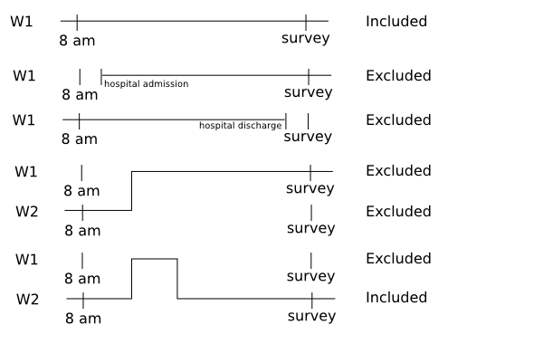
Inclusion and exclusion criteria by 8:00 AM rule
Include all patients admitted to the ward before or at (≤) 8:00 AM and not discharged from the ward at the time of the survey
Legend:
W1: ward 1
W2: ward 2
Include those who are temporarily off the ward for investigations, procedures or on Patient Administration system but at home for a number of hours
Notes:
Facilitator notes:

Slide 22
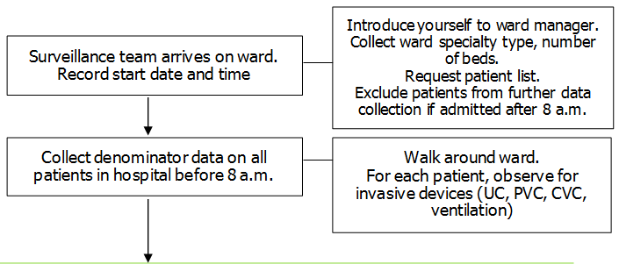
Work plan for ward data collection
Arrive at ward
Request list of patients present on ward at 8:00 AM
Collect aggregated denominator data (if using the light option)
Review each patient:
Collect patient level denominator (if using patient-level denominator option)
Notes:
Facilitator notes:

Slide 23
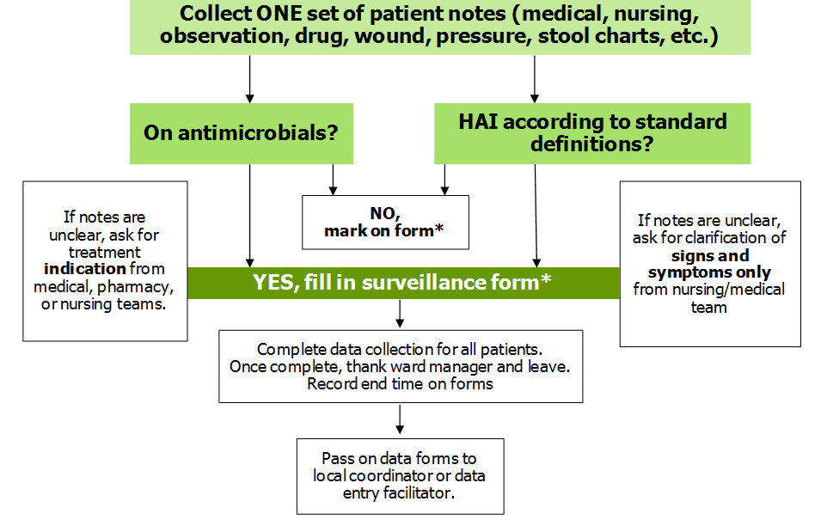
Work plan for ward data collection continued
Notes:
Facilitator notes:

Slide 24
In summary
List of learning points in this session:
Requirements for effective PPS
Good familiarity with protocol, data collection forms and definitions (to be covered in detail later)
Good organisation
Notes:
Facilitator notes:

Slide 25
Acknowledgements The creation of this training material was commissioned in 2010 by ECDC to Health Protection Agency (UK) with the direct involvement of Dr. S. Hopkins, Prof. J. Reilly, S. Cairns, Dr. E. Sheridan, Dr. G. Hughes, Prof. B. Cookson, Dr. A. Charlett, G. Kafatos, B. Muller Pebody, F. Cowan, and Y. Sueiro. The revision and update of this training material was commissioned in 2017 by ECDC to Transmissible (NL) with the direct involvement of Dr. Arnold Bosman and Dr. Ágnes Hajdu
Notes:
Facilitator notes:

