Slide 1
Planning a Learning Unit
Training of Trainers in Epidemiology of Vaccine Preventable Diseases
Created in February 2012, Revised May 2018
Notes:
Facilitator notes:

Slide 2
Objectives
Specific objectives of this session:
Describe the characteristics of the adult learner;
Explain the reasons for resistance to change in adult learners;
Describe strategies to promote active participation and involvement of adult learners;
Describe some interactive and adult learning methods, e.g. case studies;
Formulate learning objectives of a training course;
Choose the appropriate learning method to achieve learning objectives.
Related to the course objectives:
A. Familiarity with interactive and adult learning methods, e.g. case studies;
B. Ability to facilitate case studies in these areas;
C. Ability to define the target audience and to adjust material/contents.
Notes:
Facilitator notes:

Slide 3
Outline
This session consists of the following elements
Formulating the learning objectives
How to make a Learning Unit plan
Group exercise on planning a learning unit
Notes:
Facilitator notes:

Slide 4
Formulating the learning objectives

Slide 5
The Training Planning in Public Health
Performance
Evaluation
Monitoring
Process and Outcome
Evaluation
Traning Implementation
Problem analysis
Supervision
Evaluation plan setting
Project cycle
in public health
HEALTH GOALS definition
Training cycle
Learning strategies
and methods definition
Strategies choice
Realisation
Expected results and activities definition
Learning objectives
definition
Resources provision
Participants and tasks description
Learning needs
analysis
Performance goals
definition
Timetable
Notes:
Facilitator notes:

Slide 6
Planning of Training
Problem Analysis
Health Goal definition
Expected results and definition of activities
Target and task description
Learning needs analysis
Learning objectives definition
Choice of methods
Evaluation Plan
Notes:
Facilitator notes:

Slide 7
Target definition and task description
Front-line professionals, i.e. professionals involved in outbreak investigation
What do we expect from them: Competent action
What do they need to develop: competencies
Learning strategy: comprehensive training course, including field experience
Involved people: i.e. decision makers, paediatricians, GPs, vaccination services, other
What do we expect from them: advocacy, ownership, motivation, collaboration
What do they need: knowledge, attitudes, some practical skills
Learning strategy: short event (workshop, communication plan)
Informed people: i.e. general population, local authorities, scientific societies, other
What do we expect from them: to be informed
What do they need: knowledge
Learning strategy: communication plan
Notes:
Facilitator notes:

Slide 8
Selected core competencies for Public Health Epidemiologists working in the VPD area
4.1.1. Develop and conduct a plan to evaluate an immunisation programme.
4.1.2 Contribute to and monitor vaccine efficacy, effectiveness and impact of vaccines.
4.1.3. Present conclusions to stakeholders in order to prioritise programme activities based on the results collected.
4.2.2 Be familiar with the concept of plausibility and causality in relation to adverse events.
4.2.3 Provide scientific evidence for protection level and vaccine safety related concerns.
4.2.6 Perform analysis of adverse event following injection based on the core variables.
4.2.7 Conduct research to test the hypothesis generated by the post-marketing surveillance and investigations.
4.2.8 Produce technical report with conclusions and recommendations based on the results of investigations and data analysis.
4.2.9 Conduct analysis focused on identifying gaps in immunisation programme as it will lead to operational and policy decisions by management.
4.3.1 Critical appraisal, judging validity and applicability of a study (including ability to see the limitation of the study).
4.3.2 Evaluating evidence, levels of evidence and strength of recommendations.
5.1.3 Describe the national immunisation programme.
https://ecdc.europa.eu/en/publications-data/vaccine-preventable-diseases-and-immunisation-core-competencies
Notes:
Facilitator notes:

Slide 9
Planning of Training
Problem Analysis
Health Goal definition
Expected results and definition of activities
Target and task description
Learning needs analysis
Learning objectives definition
Choice of methods
Evaluation Plan
Notes:
Facilitator notes:

Slide 10
Learning needs analysis
Whose needs?
Organizations – Professional roles – Individuals
What for?
Gap between requested competencies and actual competencies
How?
Participated process
Where do I get data on learning needs?
Indirect sources – policies, epidemiological data, projects, community demand
Direct sources – interview, focus group, questionnaires
Notes:
Facilitator notes:

Slide 11
Planning of Training
Problem Analysis
Health Goal definition
Expected results and definition of activities
Target and task description
Learning needs analysis
Learning objectives definition
Choice of methods
Evaluation Plan
Notes:
Facilitator notes:

Slide 13
Outcomes of learning objectives
Acquisition of new knowledge
“Participants will be able to describe risk for mother-to-child transmission of HIV”
Enhancement of thinking skills
“Participants will be able to compare the infant feeding options for the HIV-positive mother”
Development of practical skills
“Participants will conduct a training session using information they have received”
Change in attitudes, values of feeling
“Participants will be able to advocate....”
Notes:
Facilitator notes:

Slide 14
Why learning objectives are useful?
Guidelines for choosing course content and training methods
Basis of evaluating what participants have learned
Guidelines for learners to help organize their own learning
Guidelines for teams and networks of trainers
Notes:
Facilitator notes:

Slide 15
Qualities of learning objectives
S Specific, well explained
M Measurable and based on observable behaviour
A Appropriate (or adequate) within the capacity of the group, feasible, achievable (resources are there, and obstacles can be overcome)
R Relevant (or realistic), pertinent, related to the problem and proposed solutions
T Time bound, and able to be met within a stated time
Notes:
Facilitator notes:

Slide 16
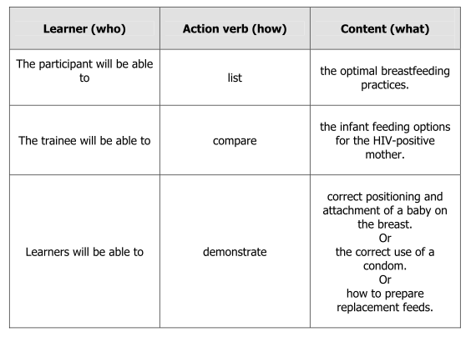
Formulation of learning objectives
Notes:
Facilitator notes:

Slide 17
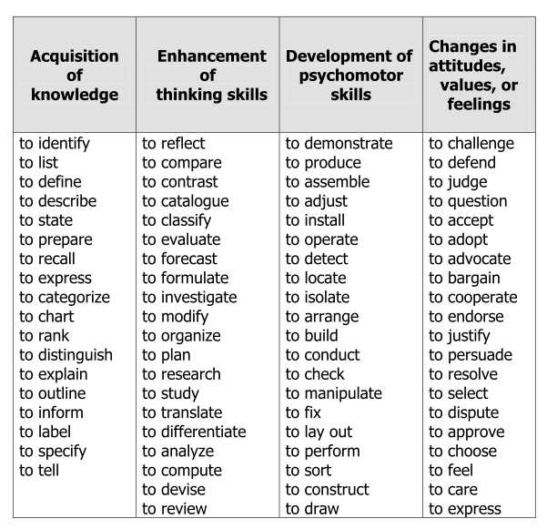
Action words for learning objectives
Notes:
Facilitator notes:

Slide 18
Planning of Training
Problem Analysis
Health Goal definition
Expected results and definition of activities
Target and task description
Learning needs analysis
Learning objectives definition
Choice of methods
Evaluation Plan
Notes:
Facilitator notes:

Slide 19
Training methods based on the category of learning
Learning through acquiring a new skill | Learning through enhancing thinking skills | Learning through acquiring a new attitude of belief | Learning through acquiring knowledge
Demonstration with return demonstration Field experience ... | Role Play Case Study Self-case study Problem solving Brainstorming Action plan Workshop ... | Role Play Self-case study Group discussion Theatre ... | Talk or presentation Plenary discussion Theatre ...
Notes:
Facilitator notes:

Slide 20
How to make a Learning Unit plan

Slide 21
How to reach the defined learning objectives?
Macro-planning
single event or modular training
learning environments (on place, field training, web)
learning strategies (choice of methods)
Micro-planning
planning of single Learning Units
Evaluation strategies and methods definition
Notes:
Facilitator notes:

Slide 22
Modular design
Preliminary Module
Module 1
Module 2
Module n
Learning Unit 1
Learning Unit 1
Learning Unit 1
Learning Unit 2
Learning Unit 2
Learning Unit 2
…
…
…
Learning Unit X
Learning Unit X
Learning Unit X
Notes:
Facilitator notes:

Slide 23
Learning Unit
Conceptualization
Learning Unit
Workshop/Debriefing Learning assessment
Notes:
Facilitator notes:

Slide 24
Group exercise on planning a learning unit

Slide 25
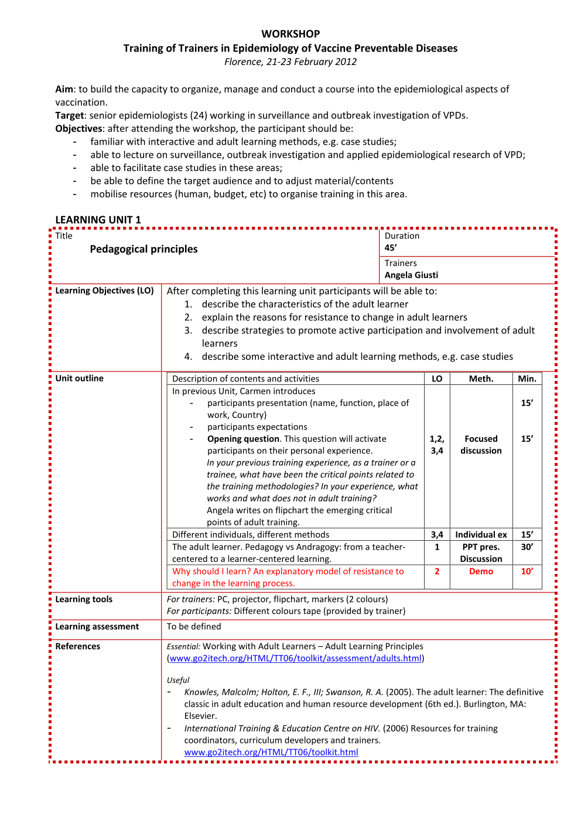
Notes:
We should distribute the empty learning unit planning checklists and plan sessions related to a VPD course emphasized in the future. Each group should receive/select one topic for the session.

Slide 26
Acknowledgements The creation of this training material was commissioned in 2012 by ECDC to the consortium of experts with the direct involvement of Angela Giusti The revision and update of this training material was commissioned in 2017 by ECDC to Transmissible with the direct involvement of Pawel Stefanoff and Arnold Bosman
Notes:
Facilitator notes:

