Slide 1
Essential components of descriptive studies in acute care hospitals Sebastian Haller
Investigation and control of outbreaks of healthcare-associated infections
20 October 2023

Slide 2
Objectives
Specific objectives of this session:
Essential components in outbreak description
Apply 10 Steps to HAI outbreaks
Identify particularities and similarities with community outbreaks

Slide 3
Outline
This session consists of the following elements

Slide 4
10 Steps of an outbreak investigation
Establish the existence of an outbreak
Confirm the diagnosis
Define a case
Search for cases
Generate hypotheses using descriptive findings (time – place – person)
Test hypotheses using analytical epidemiology (associations exposure – outcome)
Draw conclusions
Conduct additional investigations
Communicate findings
Execute control and prevention measures

Slide 5
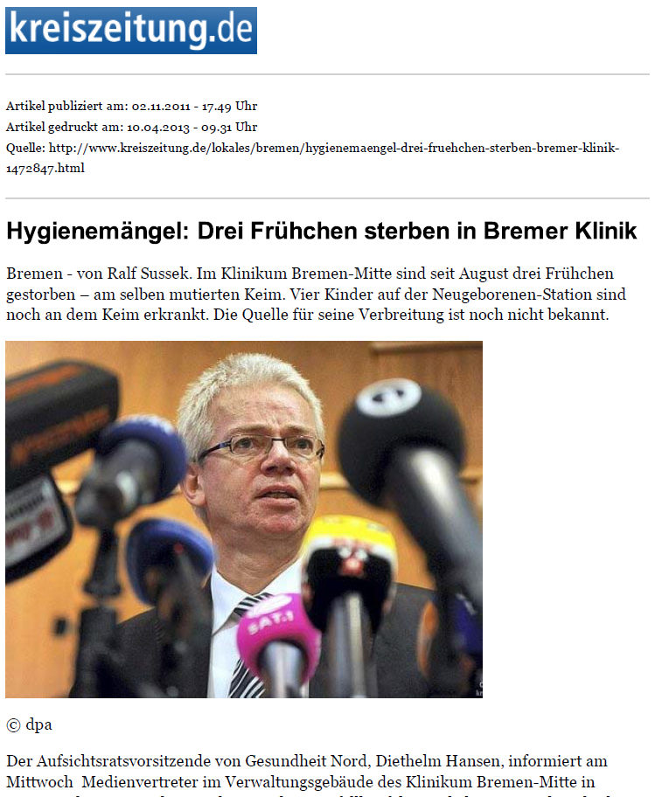
ESBL-producing Klebsiella pneumonia outbreak on a German NICU
In February 2012, a German neonatal intensive care unit (NICU) was closed due to a large outbreak of ESBL-producing Klebsiella pneumonia.
Paediatric clinic in Bremen, Germany
160 beds with 11 000 inpatients, 40 000 outpatients/year
37 infants were affected by this outbreak.
Ten cases developed a bloodstream infection and 7 cases died.
The NICU has remained closed ever since.
Haller, et al. BMJ Open 2015;5:e007397.;
https://www.ncbi.nlm.nih.gov/pmc/articles/PMC4431171/pdf/bmjopen-2014-007397.pdf

Slide 6
Establish the existence of an outbreak: Increased incidence in a place at a given time?
Elements needed: Numerator, denominator and baseline data
For healthcare-associated infections, the denominator may be unusual
Who is at risk?
Immunosuppressed versus all patients?
Risk factor hospitalisation or procedure?
Procedure: E. g. colonoscopy or surgery

Slide 7
Baseline data example
ESBL-Klebsiella pneumoniae
Notes:
Die vom Routinelabor bereitgestellte „Erreger-Entwicklung“ seit Mai 2014 zeigte einen Anstieg der K. pneumoniae-Nachweise seit Beginn des Jahres 2015
Neben einer typischen Fluktuation erkennt man einen Anstieg der “Klebsiella pneumoniae 3MRGN“ - Erstnachweise Anfang 2015.

Slide 8
Pseudo-outbreaks not linked with any recent increase of incidence
Artifact in the numerator:
Increased awareness
Change in surveillance practices
Reporting of prevalent cases as incident cases (e. g., Screening)
Laboratory error
Variation of the denominator:
Changing population denominators
E. g. number of hospital patients?
Outpatient visits?

Slide 9
10 Steps of an outbreak investigation
Establish the existence of an outbreak
Confirm the diagnosis
Define a case
Search for cases
Generate hypotheses using descriptive findings (time – place – person)
Test hypotheses using analytical epidemiology (associations exposure – outcome)
Draw conclusions
Conduct additional investigations
Communicate findings
Execute control and prevention measures

Slide 10
Question 1
1. What are essential components of descriptive outbreak analyses?
a) Linelist
b) Timeline
c) Laboratory data
d) Sequencing data
e) Case definiton

Slide 11
Case definitions
Confirmed case Any patient treated in the paediatric clinic in Bremen with the ESBL-K. pneumoniae outbreak strain (DNA macrorestriction) detected prior to May 15, 2012.
Probable case Patients having received treatment in the paediatric clinic between January 1, 2011 and May 15, 2012, with ESBL-K. pneumoniae record, but with no isolate available for bacterial typing.

Slide 12
10 Steps of an outbreak investigation
Establish the existence of an outbreak
Confirm the diagnosis
Define a case
Search for cases
Generate hypotheses using descriptive findings (time – place – person)
Test hypotheses using analytical epidemiology (associations exposure – outcome)
Draw conclusions
Conduct additional investigations
Communicate findings
Execute control and prevention measures

Slide 13
Question 2
2. What are the lead questions in descriptive epidemiology?
a) Where is the outbreak?
b) When did cases occur?
c) Who is ill?
d) Whose fault is it?
e) Who is the index case?

Slide 14
Case search
Retrospective case search
Data sources: Laboratory data, patient charts …
Prospective case search
Passive surveillance
Active surveillance
Screening
Chose a uniform strategy to search for cases
Monitor factors with influence on case finding

Slide 15
Line list
In a linelist all information about cases is collected
Preparation for automated descriptive analysis
Data can be collected systematically, new informaiton added easily to linelist
Linelists can be prepared for routine analyses, e.g.: ww.rki.de/linelisttool

Slide 16
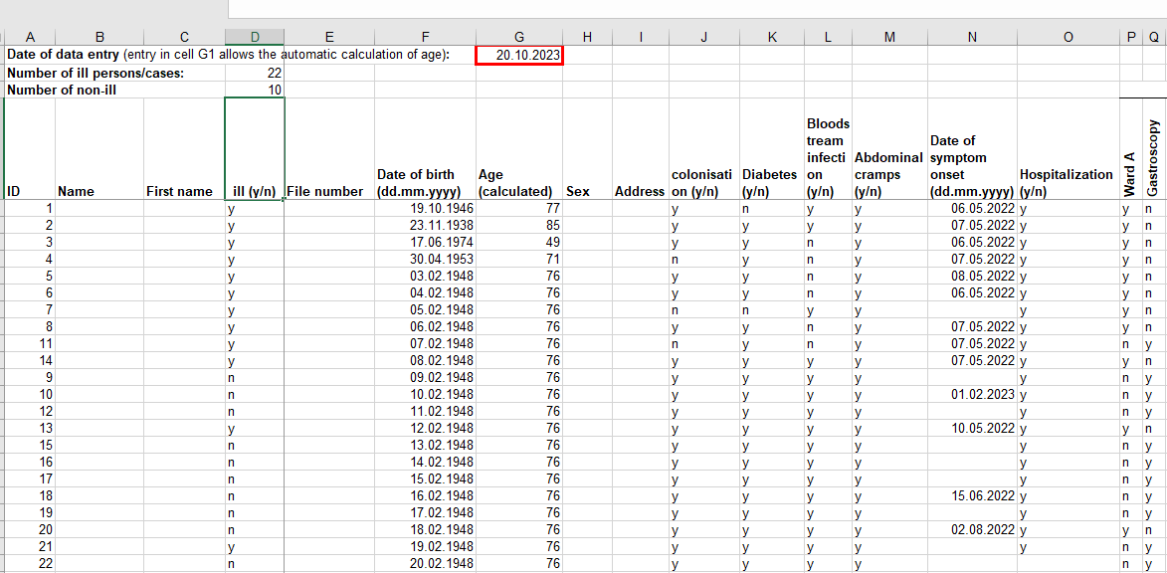
https://www.rki.de/DE/Content/InfAZ/L/Lebensmittel/Linelist-Tool/Linelist_Werkzeuge_Tab_gesamt.html

Slide 17
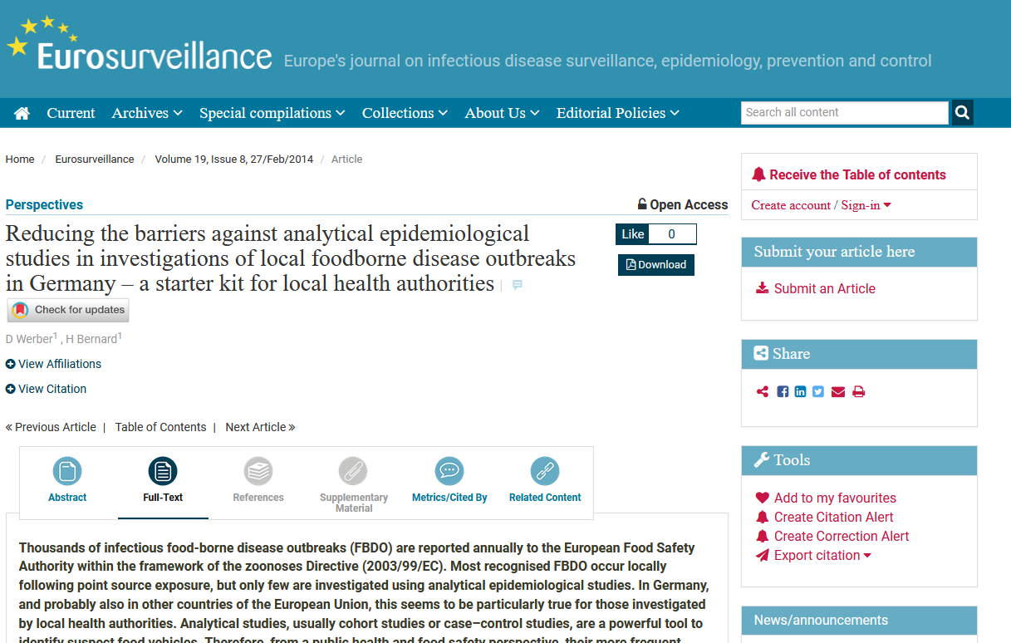

Slide 18
Case search
cases n=28
screening
paediatric clinic
screening ward 4027
Notes:
MRSA Screening hatte scheinbar zur Folge, dass Kliniker von bakteriologischem Screening ausgingen, aber lediglich eine suche nach MRSA stattfand

Slide 19
10 Steps of an outbreak investigation
Establish the existence of an outbreak
Confirm the diagnosis
Define a case
Search for cases
Generate hypotheses using descriptive findings (time – place – person-bug)
Test hypotheses using analytical epidemiology (associations exposure – outcome)
Draw conclusions
Conduct additional investigations
Communicate findings
Execute control and prevention measures

Slide 20
The multiple dimensions of time, place and person in health care associated outbreaks
Time: Do you have incident cases?
What date to use: Onset? Specimen collection? Events?
Place:
Ward? Room? Operating theatre?
Dialysis machine?
Person:
Incidence by age, sex, etc.
Information on patients (Risk factors)
Clinical information: Can be massive
Bug:
Species
Phenotypic information (e.g. resistograms)
Typing results

Slide 21
Question 3
What is special about healthcare associated infection outbreaks?
a) The usual outbreak investigation tools cannot be applied.
b) There is more data available, then in other outbreaks.
c) They are often more severe (e.g. more deaths) then community outbreaks?
d) General infection prevention control measures are often effective.
e) So much data available, that you get lost.

Slide 22
Person to person transmission Time-Line NICU ESBL-Klebsiella outbreak 2011-2012
Haller S, et al.; BMJ Open 2015;5:e007397
Notes:
When we investigated an ESBL-Klebsiella outbreak on a neonatal intensive care unit in northern Germany in 2011 we were able to illustrate how each infant was prior to first positive ESBL-Klebsiella finding on a ward with at least one infant who was already tested positive. On the x-axis we marked the time in days, each line represents a case. In this graph the colours blue, green, yellow and grey symbolise on which ward a case was for each day during the outbreak. The red squares show on which day an infant was tested positive for the first time for ESBL-Klebsiella. The index case was tested positive already in 2009. In total there were 37 cases including10 cases with ESBL (extended-spectrum beta-lactamase)-producing K. pneumoniae bloodstream infection. Descriptive epidemiology indicated that a continuous transmission from person to person was most likely, which was further confirmed with a cohort study where frequent manipulation by the hospital personnel was a significant risk factor for becoming positive.

Slide 23
Components of a timeline
Time spent at specific locations
Epidemiological information
Cases
1
2
3
4
5
t₀
Specified time interval (day/week/month)
t_{k}

Slide 24
10 Steps of an outbreak investigation
Establish the existence of an outbreak
Confirm the diagnosis
Define a case
Search for cases
Generate hypotheses using descriptive findings (time – place – person)
Test hypotheses using analytical epidemiology (associations exposure – outcome)
Draw conclusions
Conduct additional investigations
Communicate findings
Execute control and prevention measures

Slide 25
Question 4
What are the available data sources in HAI-outbreaks?
Word cloud

Slide 26
Testing hypotheses with analytical study
Is the study going to be of public health relevance?
Define study objectives: One or multiple hypotheses?
Risk factor for colonization?
Risk factor for infection?
Who is at risk? (numerator/ denominator)
Population or hospital patients (e. g., Listeria outbreaks)
Patients who underwent a procedure?
Design: Case control? Cohort? Case cohort? Other?
Write protocol
Define exposure period
Ensure time comparability

Slide 27
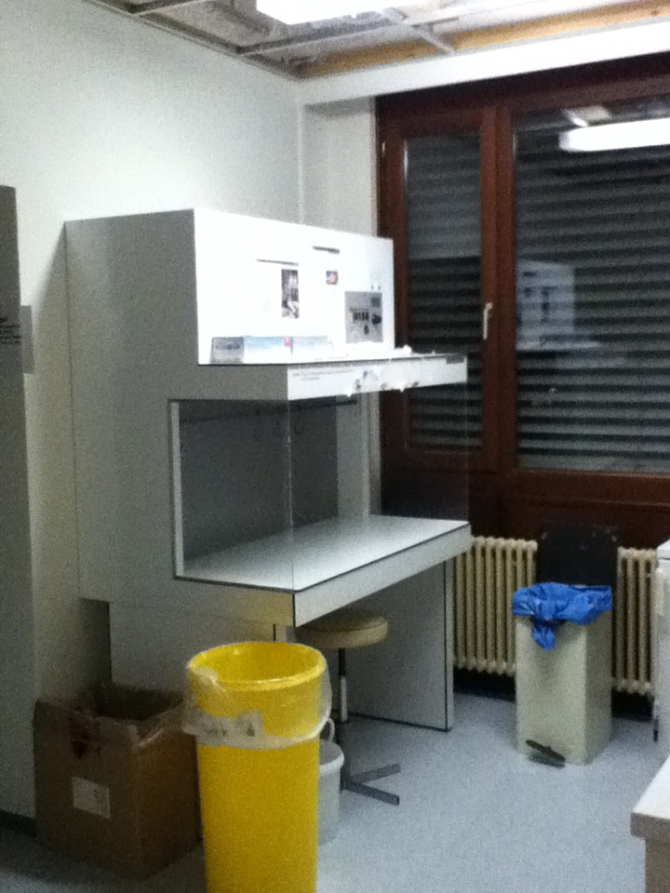
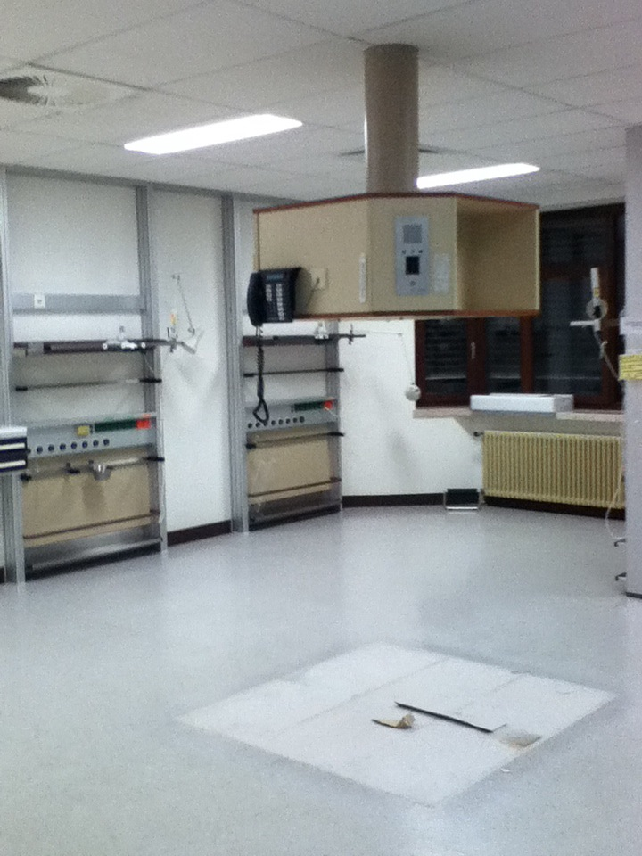

Slide 28
10 Steps of an outbreak investigation
Establish the existence of an outbreak
Confirm the diagnosis
Define a case
Search for cases
Generate hypotheses using descriptive findings (time – place – person)
Test hypotheses using analytical epidemiology (associations exposure – outcome)
Draw conclusions
Conduct additional investigations
Communicate findings
Execute control and prevention measures

Slide 29
Question 5
What additional investigations can be performed?
Word cloud

Slide 30
Additional investigations
Microbiological studies
Environmental sampling
only guided by hypothesis
Screening of staff?
Assessment of infection control practices
Analysis of understaffing and overcrowding

Slide 31
Maximum-likelihood tree
Haller S, et al.; BMJ Open 2015;5:e007397; https://www.ncbi.nlm.nih.gov/pmc/articles/PMC4431171/pdf/bmjopen-2014-007397.pdf
Notes:
We sequenced the available isolates, which revealed that all (48 bacterial) isolates available for sequencing (from 31 cases) were closely related (maximum genetic distance, 12 single nucleotide polymorphisms). With a maximum likelihood tree we could further illustrate relatedness of all ESBL-Klebsiella positive isolates and show how they derived from three clusters.

Slide 32
Minimum Spanning Tree
Haller S, et al.; BMJ Open 2015;5:e007397; https://www.ncbi.nlm.nih.gov/pmc/articles/PMC4431171/pdf/bmjopen-2014-007397.pdf
Notes:
The illustration in a minimum spanning tree further increased our understanding of transmission throughout the outbreak. It supported patient-to-patient transmission as the principle route of pathogen spread, since in the minimum spanning tree all but one furcation nodes in clades 1, 2 and 3 are occupied by isolates sampled from patients, rather than from parents, staff or any environmental source. This becomes clear if we look into cluster 2/ environment samples 04 and 05. The phylogenetic results do not link cases to cases here, the samples are positioned as outliers. It is thus likely that we found a secondary contamination of the environment.
In a recent outbreak we could conduct these analysis during the outbreak investigation, our increasing expertise allowed early understanding of transmission routes in HAI outbreaks by combination of microbiological findings and epidemiological findings. NGS has now allowed to establish a specific PCR analysis allowing for differentiate outbreak clones from non outbreak clones within ~24h

Slide 33
Conclusions: ESBL-producing Klebsiella pneumonia outbreak on a German NICU
Late detection and delayed response in this person to person transmission outbreak
Numerous unknown cases but
Control measures, such as cohorting and barrier nursing only applied to known cases.
Outbreak spread from the NICU to other wards of the paediatric clinic
Readmissions of known and unknown cases may have reintroduced the outbreak strain into the NICU

Slide 34
10 Steps of an outbreak investigation
Establish the existence of an outbreak
Confirm the diagnosis
Define a case
Search for cases
Generate hypotheses using descriptive findings (time – place – person)
Test hypotheses using analytical epidemiology (associations exposure – outcome)
Draw conclusions
Conduct additional investigations
Communicate findings
Execute control and prevention measures

Slide 35
Confirm outbreak
Develop hypothesis
Case search
Implement prevention measures
Confirm diagnosis
Test hypothesis
Describe outbreak
Communicate
Case definition
Notes:
In der Zeit vom Verdacht auf einen möglichen Ausbruch bis zur Aufklärung des Ausbruchs werden eine Vielzahl von Schritten unternommen, die nicht unbedingt immer dieselbe Chronologie haben. Wir stellen uns eine Ausbruchsuntersuchung daher eher als ein Zusammentragen verschiedener Puzzleteile vor, die in ihrer Gesamtheit ein Bild des Ausbruchsgeschehens darstellen. Verschiedene Literaturquellen geben meist zwar ähnliche, aber im Detail etwas unterschiedliche Schritte einer Ausbruchsuntersuchung an.

Slide 36
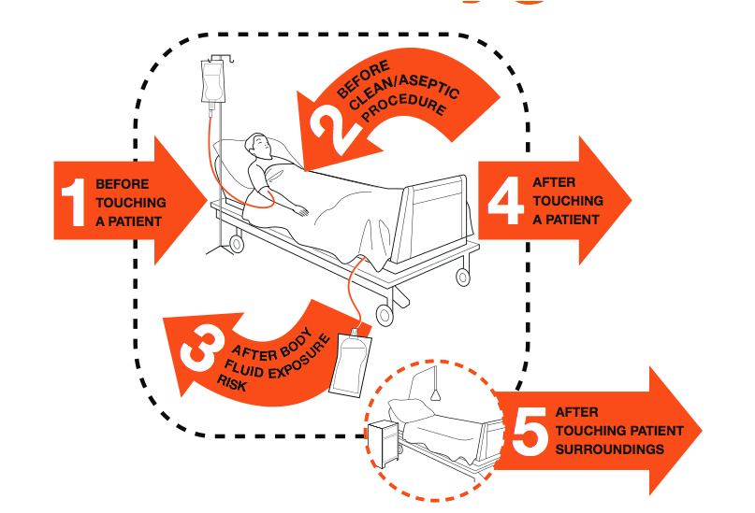
Hand hygiene
Source: WHO guidelines on hand hygiene in health care, WHO, 2009 (originally from Sax et al., Journal of Hospital Infection, 2007)
Notes:
2009 WHO launched worldwide campaign
My five moments of hand hygiene
Before patient contact
Before aseptic procedures
After blood and body fluid exposure risk also during care in the same patient
After patient contact
After contact with surfaces and items in patient vicinity

Slide 37
http://www.disease-detectives.org/Welcome.html

Slide 38
Acknowledgements Thanks to Robert Koch Institute – Infectious Disease Epidemiology The creation of this training material was commissioned by ECDC to Sebastian Haller

