Slide 1
Notes for facilitator
Presentation 1.8 - Local organisation of PPS
One-day training course for data collectors
Lecture 8
30 minutes
Suggested time of delivery – 15:45
National/hospital contact points may wish to amend this presentation to their local setting
Notes:
Facilitator notes:

Slide 2
Local organisation of the ECDC PPS
Epidemiological methods for point prevalence surveys of healthcare-associated infections and antimicrobial use in acute care hospitals
Version 2017
Revision: 2018
Notes:
Facilitator notes:

Slide 3
Objectives
Specific objectives of this session:
Learn about the implementation of a local PPS in your hospital
Learn about supplying PPS data to the national coordinator
Related to the course objectives:
Implement a local PPS in their hospital
Supply PPS data to the national coordinator
Notes:
Facilitator notes:

Slide 4
Outline
This session consists of the following elements
General process for ECDC PPS
Planning the survey
Resources and time required
Considerations for planning
During the survey
Ward data collection work plan
Validation
After the survey
Sending data to the national coordinator
Producing the local report
Notes:
Facilitator notes:

Slide 5
General process for ECDC PPS
National coordinator is trained by ECDC
Hospital is selected for inclusion in the ECDC PPS by national coordinator using ECDC sampling strategy
National coordinator trains local (hospital) coordinators
Local (hospital) coordinator trains data collectors
Local (hospital) coordinator engages infection control teams and pharmacists (if not already involved)
List of included wards collated
Notes:
Facilitator notes:

Slide 6
General process for ECDC PPS
Advise wards of attendance and requirements
Collect numerator and denominator data on the ward
Data validation during data collection
Data entered into HelicsWin.Net
Data transferred to national coordinator
Local report produced and disseminated
Data transferred to ECDC for inclusion in ECDC PPS 2016-2017 Report
Notes:
Facilitator notes:

Slide 7
Planning the survey

Slide 8
Resources and time required
Results from pilot survey required:
Time taken to complete ward and hospital
Notes:
Facilitator notes:

Slide 9
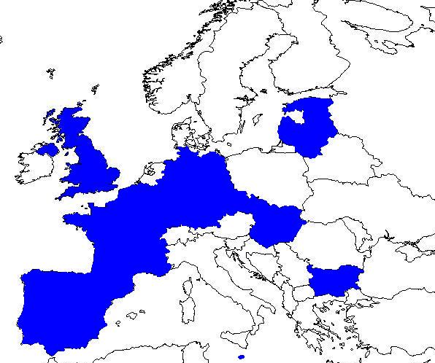
Who performed a pilot for the ECDC PPS 2011-2012?
15 countries
2 hospitals/country
(1-7 hospitals/country)
32 hospitals
300 patients/hospital
(69-619 patients/hospital)
551 wards
17 patients/ward
(1-24 wards/hospital)
9600 patients

Slide 10
Protocol feasibility: personnel and time
Mean personnel per ward=3
Person time (hh:mm:ss) | Standard | Light
Collection time/patient | 0:30:13 | 0:19:56
Entry time/patient | 0:09:31 | 0:05:44
Mean person-time for 25 patients | 16:33:20 | 10:41:40
Minimum person-time for 25 patients | 4:18:20 | 3:15:45

Slide 11
Considerations for planning
Participating hospitals should review in due time the local structural, functional and organisational specifities (i.e. assets and drawbacks concerning a hospital-wide data collection) for a realistic planning of the local PPS and its resource needs.
Aspects to consider:
Stakeholder engagement
Active/passive support from hospital management and head of departments
Hospital type (level of care)
Primary, secondary, tertiary, specialised
Hospital size and teaching status
Small (e.g. ≤100 beds), medium (e.g. 100-200 beds), large non-teaching (e.g. 200-700 beds), large teaching (e.g. ≥350 beds)
Hospital structure
Single site, multiple sites at the same location, multiple sites at multiple locations
Notes:
Facilitator notes:

Slide 12
Considerations for planning
Aspects to consider continued:
Clinical specialties
Number and type of specialities (high vs low risk)
High-risk wards
More labour intensive to collect PPS data
E.g. intensive care unit, surgery, oncology, traumatology, transplantation wards
Consider number of wards, number of beds
Low-risk wards
E.g. general internal medicine, rehabilitation, dermatology, psychiatry wards
Number of wards, number of beds, proportion of acute care beds vs chronic care beds (if any)
Local policies/practices regarding device use
Frequent use of indwelling devices is associated with more HAIs (more labour intensive to collect PPS data on device use and HAIs)
Notes:
Facilitator notes:

Slide 13
Considerations for planning
Aspects to consider continued:
Medical documentation tools
Electronic records, paper-based, mixed
Human resources for data collection and data entry
Number of infection control doctors and nurses
Involvement of clinical staff/ward personnel in data collection (e.g. on indwelling device) can be particularly useful in large hospitals (some form of prior training is necessary)
Prior experience with the PPS methodology locally
Participation in periodic national point prevalence surveys and/or in previous ECDC PPS (pilot studies, ECDC PPS 2011-2012, validation studies)
No prior experience at all
Consideration of necessary costs
E.g. printing costs if PPS data collection is paper-based
Notes:
Facilitator notes:

Slide 14
Considerations for planning
Complete each ward within one day.
Complete the hospital within 2-3 weeks.
All patients present on the ward at 8:00 AM on day of survey and that have not been discharged should be included.
Units where patients are admitted for elective procedures on a Monday should preferably be surveyed Tuesday to Thursday.
Notes:
Facilitator notes:

Slide 15
Considerations for planning
Busy dynamic ward and may be difficult to
Get access to medical notes, drug charts and other data sources
Find space to work
Discuss cases with ward staff
Good communication with the wards is essential.
Notes:
Facilitator notes:

Slide 16
Planning
Create list of wards in the hospital.
Identify wards that will be included in the survey.
Contact included wards to arrange ward survey and provide information about the PPS.
Arrange dates for survey.
Engage infection control and prevention teams and pharmacists.
Notes:
Facilitator notes:

Slide 17
During the survey

Slide 18
During the survey
Collect hospital level data.
Collect patient level data by following the ward data collection work plan.
Notes:
Facilitator notes:

Slide 19
Ward data collection work plan
Arrive at ward and advise ward staff of the survey.
Make list of patients present on ward at 8:00 AM.
Collect aggregated denominator data (if using the light option).
Review each patient:
collect patient level denominator (if using patient level denominator option) using either the patient level form or the patient register form
collect numerator data using the case ascertainment algorithm
Notes:
Facilitator notes:

Slide 20
Validation of data
All Member States are expected to perform a validation study of their national or regional PPS:
at the same time as a national or regional PPS
by a national/regional PPS validation team
a minimum sample of 5 hospitals and 250 patients
a recommended sample of 25 hospitals and 750 patients
National PPS coordinating centre will select and further inform the selected hospitals
Notes:
Facilitator notes:

Slide 21
After the survey

Slide 22
Sending data to national coordinator
Needs confirmation of process for sending data to national coordinator in each country.
Export the data from HelicsWin.Net
Transfer the data to the national coordinator
Security
Size of file
Notes:
Facilitator notes:

Slide 23
Generating the local report
The local PPS report should be produced as soon as possible after completion of the survey.
This report should be disseminated to hospital managers, ward managers, infection prevention and control teams, pharmacists and other relevant stakeholders.
Each country to enter how they will disseminate their reports and the timeline here.
Notes:
Facilitator notes:

Slide 24
In summary
List of learning points in this session:
The methods for implementation of a local PPS are important to ensure:
Timely and locally tailored planning for the survey
All eligible patients and wards are included in the ECDC PPS
The survey runs well with minimal disruption to the ward
Ward staff are aware and prepared for the survey
Good communication with ward staff will minimise disruption to the ward and maximise the engagement of ward staff.
Notes:
Facilitator notes:

Slide 25
Acknowledgements The creation of this training material was commissioned in 2010 by ECDC to Health Protection Agency (UK) with the direct involvement of Dr. S. Hopkins, Prof. J. Reilly, S. Cairns, Dr. E. Sheridan, Dr. G. Hughes, Prof. B. Cookson, Dr. A. Charlett, G. Kafatos, B. Muller Pebody, F. Cowan, and Y. Sueiro. The revision and update of this training material was commissioned in 2017 by ECDC to Transmissible (NL) with the direct involvement of Dr. Arnold Bosman and Dr. Ágnes Hajdu
Notes:
Facilitator notes:

