Slide 1
The role of manual/automated surveillance in identifying HAI outbreaks Sebastian Haller
Investigation and control of outbreaks of healthcare-associated infections
25 October 2023

Slide 2
Objectives
Specific objectives of this session:
Learn about different layers where surveillance may be conducted and different surveillance targets
Learn about event-based outbreak surveillance
Learn about examples for laboratory based and HAI surveillance

Slide 3
Outline
This session consists of the following elements
Introduction surveillance for identifying outbreaks
HAI-outbreak surveillance
HAI-surveillance
Laboratory surveillance

Slide 4
Layers of AMR and HAI Surveillance in Germany
lokal | Hospital | § 23 IfSG (internal surveillance)
regional / national | Laboratory | Mandatory notification systems
national | RKI: ARS | Voluntary (mainly)
 | Nationale Reference Centres | Typing/ phenotype and genotype diagnostics

Slide 5
Surveillance Targets in Germany
HAI-infections and -outbreaks
IfSG § 23, § 6
KISS
Surveillance HAI outbreaks
Pathogens and resistnaces
IfSG § 23, § 7
ARS
KISS
Regional systems
Antimicrobial consumption
IfSG § 23
AVS
ADKA/if
SAMBA (amb.)
ARVIA

Slide 6
Outbreak-notification Flow from hospital to RKI
1
1
2
2
HAI-outbreak
HAI-outbreak
3
3
1
2
3
Local public
health
authority
Public health institute of federal state
Robert Koch-Institut
(RKI)
Hospital
1
Case with HAI-infection
2
Case colonised with same pathogen
3
Case with HAI-infection
Transmiting notification
Direct communication
Notes:
This slide ilustrates notification and transmission: In the hospital there occures a case with an HAI-infecition, a second case colonized with the same pathogen and with an epidemiological linc is detected. The hospital starts screening and implements measures for outbreak control. Nontheless a third case occures and the hospital notifies an outbreak to the local public health authority. From there the outbreak is tranmitted to the public health institut of the federal state and from there to the RKI. Of importance is also direct communication between the institutions.

Slide 7
Distribution of microorganisms causing healthcare-associated outbreaks (n=1,803), Germany 2018

Slide 8
Number of HAI outbreaks by pathogen type and calendar week of notification, 2012-2017, (outbreaks=5.446)
bacteria
virus

Slide 9
Proportion of HA outbreaks due to different pathogens and distribution of AMR, 2012-2017, n (outbreaks)=746

Slide 10
Proportion of colonised and infected cases by year, 2012-2017, n(cases)=3,233

Slide 11
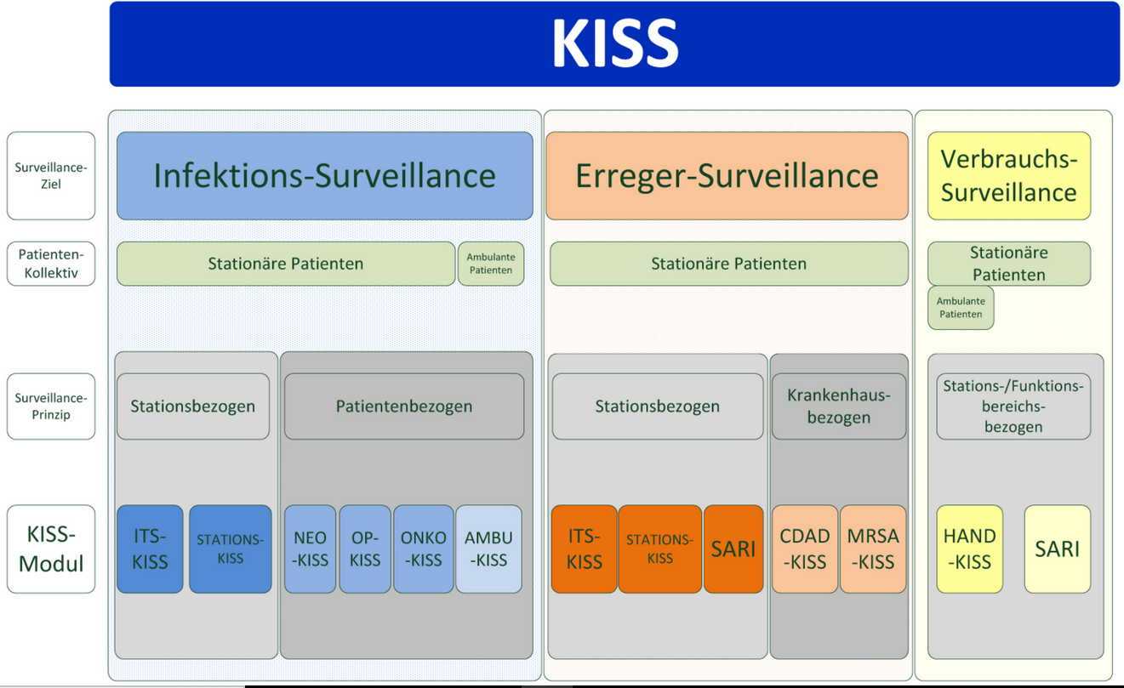
Surveillance of healthcare-associated infections (National Reference Center for the Surveillance of Nosocomial Infections, Institute for Hygiene and Environmental Medicine at Charité)
Voluntary participation (>800 hospitals)
Different moduls (e. g. ICUs, neonatal departments/ICUs, hematology/oncology wards, CDI)
Nosocomial indicator infection
Device-associated infection
Pathogens
Reports and more information at:
http://www.nrz-hygiene.de/surveillance/kiss/

Slide 12
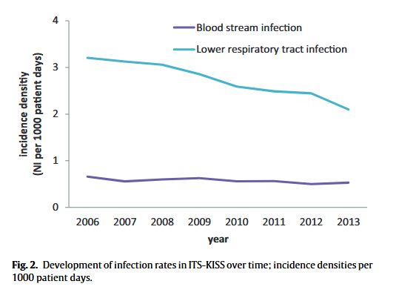
Surveillance-effect on hospital level
Schwab F, Geffers C, Bärwolff S, Rüden H, Gastmeier P. , J Hosp Infect. 2007 Apr;65(4):319-25.;
https://www.sciencedirect.com/science/article/pii/S019567010700014X?via%3Dihub

Slide 13
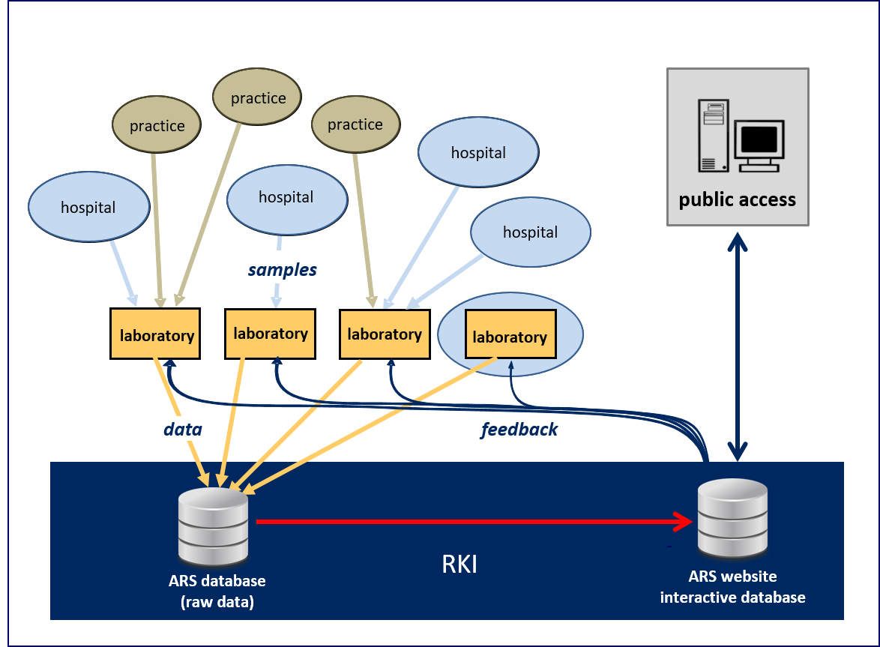
Antimicrobial Resistance Surveillance (ARS)
https://ars.rki.de/
Notes:
main features:
laboratory based system – participation is voluntary
continuous data submission
feedback for participating laboratories
to provide reference data on antimicrobial resistance
in hospital care settings
in outpatient care settings
Scope
all clinically relevant bacterial pathogens & fungi
from any kind of specimen
representativeness (goal, not yet achieved)
Geographically
by institutional characteristics (e.g. hospital type)
developed and managed by Robert Koch Institute
funded by MoH 01.01.2007 – 30.06.2010
now: permanent task of RKI

Slide 14
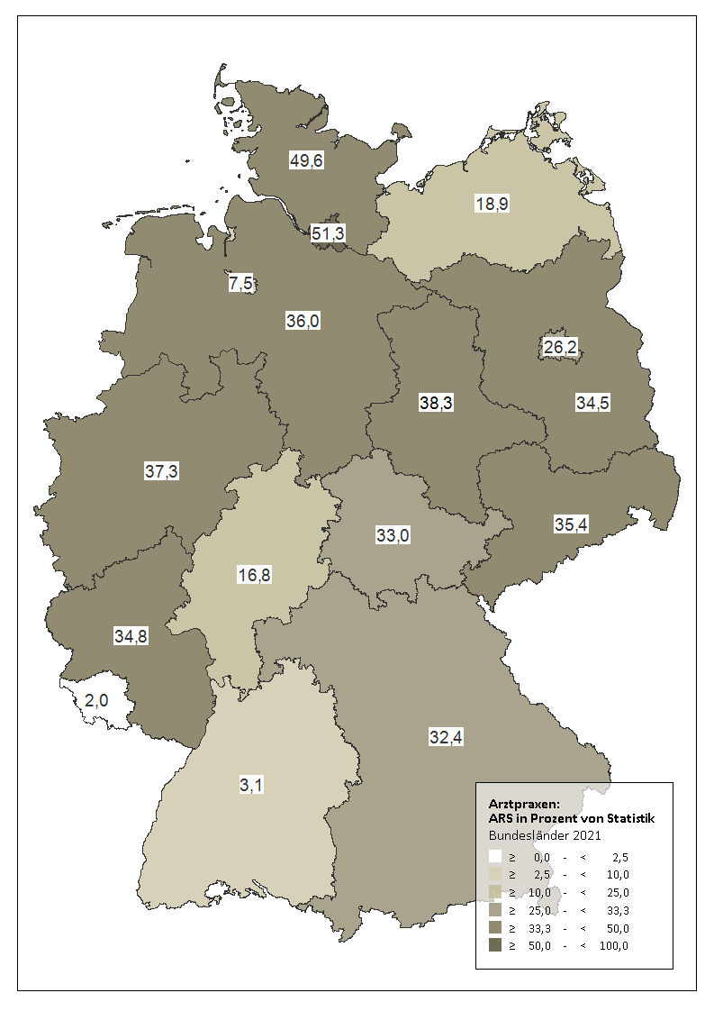
ARS – routine laboratory surveillance ~ 1/3 all isolates in Germany
Pathogen statistics:
about 6 mio pathogens / year

Slide 15
Automated outbreak detection in German notification data

Slide 16
Signal detection
Increase of carbapenemase NDM-1-producing Klebsiella pneumoniae detected in 2022
Large proportion of cases with origin or recent presence in Ukraine
Notifiable diseases surveillance
NRC- isolate surveillance
Sandfort et al, Euro Surveill. 2022;27(50):pii=2200926. ; https://www.eurosurveillance.org/content/10.2807/1560-7917.ES.2022.27.50.2200926

Slide 17
YouTube – Genomic Surveillance of antimicrobial-resistant pathogens in Germany
https://www.youtube.com/watch?v=PaX9lexozUY&t

Slide 18
European prevalence of healthcare associated infectiotns – in hospital versus in the population
 | Population per Country (2016) | Mean N of occupied beds per day per 100000 pop | Number of discharges per 100 pop | LOS (LA) | Pts with HAI % | N of pts with HAI per 1000000 | Pts with Antibiotic % | N of pts with Antibiotic per 1000000
Finland | 5.487.308 | 167 | 18 | 4,3 | 7,4 | 12 | 40,5 | 68
France | 66.759.950 | 250 | 18 | 5,8 | 4,9 | 12 | 21,4 | 53
Germany | 82.175.684 | 426 | 21 | 6,2 | 5,0 | 21 | 23,9 | 102
Italy | 60.665.551 | 224 | 12 | 6,2 | 6,3 | 14 | 44,0 | 99
Netherlands | 16.979.120 | 147 | 10 | 5,2 | 7,4 | 11 | 31,8 | 47
Europe | 510.284.430 | 280 | 18 | 5,7 | 5,7 | 16 | 32,7 | 91
https://www.ecdc.europa.eu/en/publications-data/point-prevalence-survey-healthcare-associated-infections-and-antimicrobial-use-2016-2017

Slide 19
Number of Infections per month
Ward B, 25 beds
20 Infected
0,8 Infection/ bed
150 patients/month
13,3 Infections/ 100 patients
750 patient days
26,7 Infekt./ 1000PT
Length of stay: 5 days
Ward A, 10 beds
10 Infected
1 Infection/ bed
100 patients/month
10 Infections/ 100 patients
300 patient days (PT)
33,3 Infekt./ 1000PT
Length of stay: 3 days
Icidence
Incidence rate
19

Slide 20
In summary
HAI outbrek detection through eventbased and indicator based survaillance
Survaillance for HAI outbreak detection on all layers in health/public health system necessary
Targets can be: (HAI) infections, laboratory results (pathogens and resistance), reference centre data, suspected outbreaks, etc.
Regular communication and discussion about signals neccessary

Slide 21
Acknowledgements The creation of this training material was commissioned by ECDC to Agnes Hajdu and Sebastian Haller

