Slide 1
European Antibiotic Awareness Day: Promoting prudent antibiotic use in Europe
Course on the development, implementation and evaluation of prudent antibiotic use campaigns
Version 2013
Notes:
Facilitator notes:

Slide 2
Outline
This session consists of the following elements
1. About EAAD
2. EAAD toolbox – examples
3. Past campaign activities
4. Looking forward to the future
Planned activities in 2013 and work on self-medication with antibiotics
Notes:
Facilitator notes:

Slide 3
About EAAD

Slide 4
What is EAAD?
- Marked across Europe on November 18th
- Builds on successful national campaigns to:
Raise awareness about the threat of antibiotic resistance to human health
Communicate about prudent antibiotic use
- Launched in 2008 with support from:
European Commission
European Parliament
EU Member States
Non-governmental health stakeholders across EU
-> World Antibiotic Awareness Week (WAAW) launched by WHO since 2015
Notes:
EAAD – European Antibiotic Awareness Day
EAAD is marked across Europe on November 18th.
The campaign builds on successful national campaigns to raise awareness about the threat of antibiotic resistance to human health and communicate about prudent antibiotic use.
EAAD was launched in 2008 with support from the European Commission, European Parliament, EU Member States and non-governmental health stakeholders across the EU.

Slide 5
Why EAAD?
Emergence and spread of antibiotic resistant bacteria has become a serious threat to European public health
Inappropriate use of antibiotics is driving antibiotic resistance
If the current trend continues, antibiotics may not be effective in the future
Few new antibiotics in the pipeline
General public and healthcare professionals are responsible to promote prudent antibiotic use
Notes:
EAAD – European Antibiotic Awareness Day
Why have a European Antibiotic Awareness Day?
The emergence and spread of antibiotic resistant bacteria has become a serious threat to public health in Europe.
Inappropriate use of antibiotics is driving antibiotic resistance.
If the current trend continues, antibiotics may not be effective in the future.
There are few new antibiotics in the pipeline.
The general public as well as health professionals have a responsibility in promoting prudent antibiotic use.

Slide 6
Campaign objectives
Support national activities aimed at raising awareness of prudent antibiotic use among the general public as well as particular target audiences such as primary care prescribers and hospital prescribers
Support national activities aiming at maintaining the efficacy of antibiotics and slowing down the emergence and spread of resistant bacteria
EAAD provides a platform and support to national campaigns on prudent antibiotic use in the community and hospitals
Notes:
EAAD – European Antibiotic Awareness Day

Slide 7
The EAAD toolbox

Slide 8
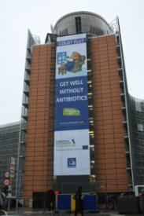
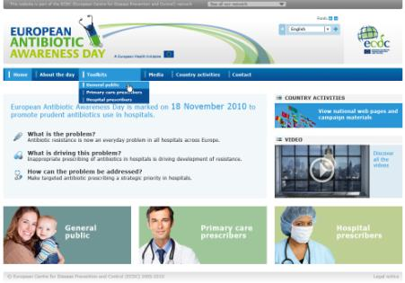
EAAD toolbox
Notes:
EAAD – European Antibiotic Awareness Day
Above are some of the tools provided by ECDC online, for member states to use in their campaigns.
All campaign materials can be found at: http://ecdc2007.ecdc.europa.eu/en/eaad/Pages/antibiotics-materials.aspx (bottom right corner picture)
Panda: a video of a sneezing panda
Light bulb: A TV spot
Hedgehog (with umbrella): A hedgehog animation video
All remaining pictures: posters used in previous campaigns

Slide 9
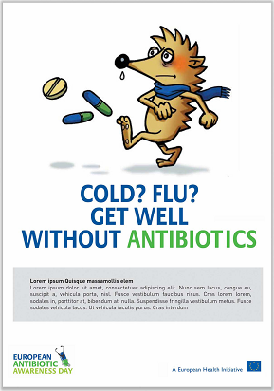
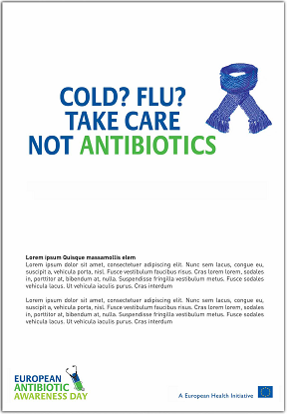
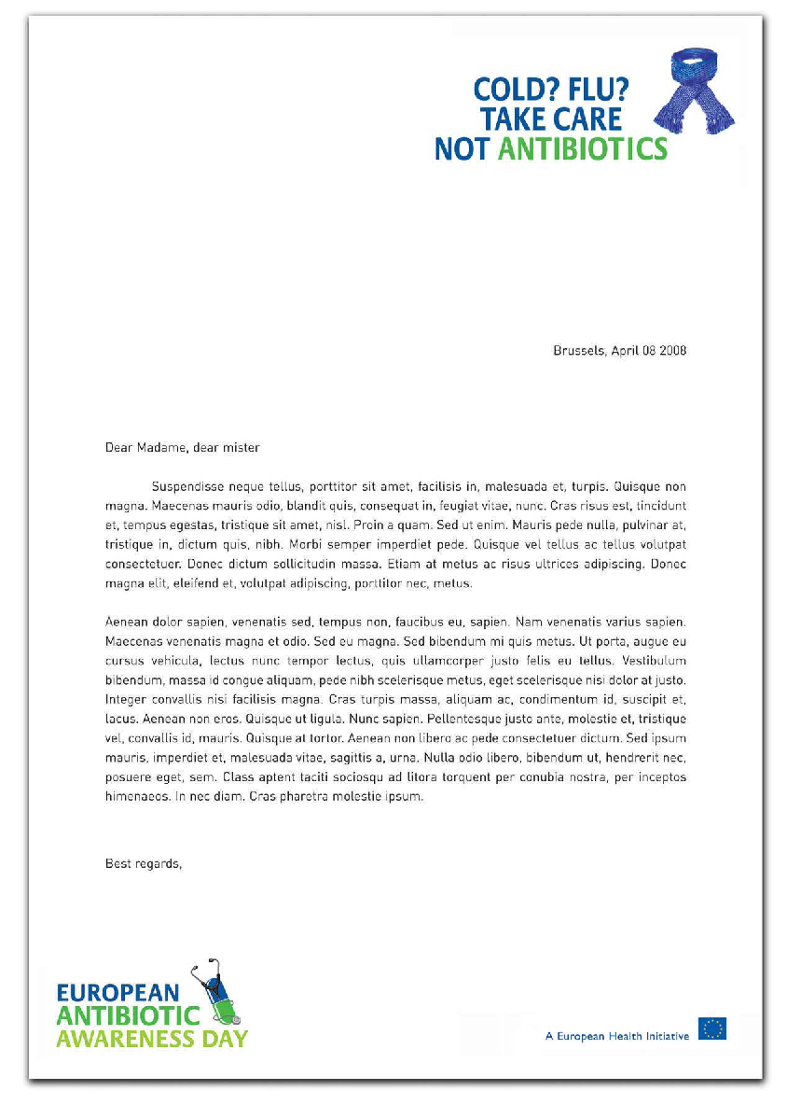
Slogans and visuals: examples
Letterhead
Advert
Poster
Postcard

Slide 10
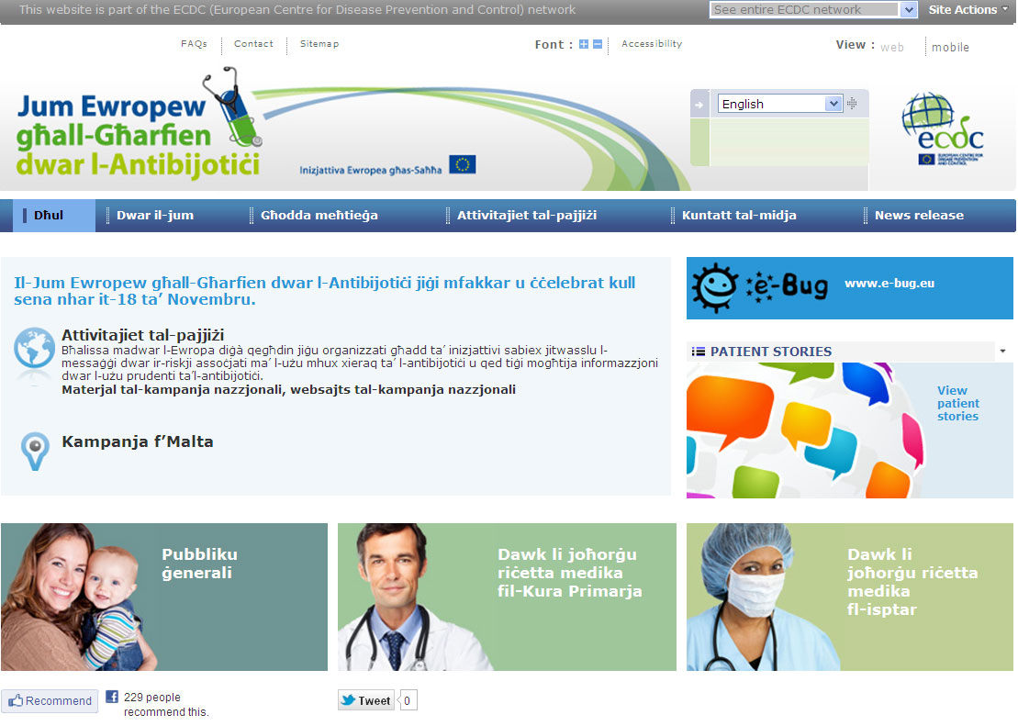
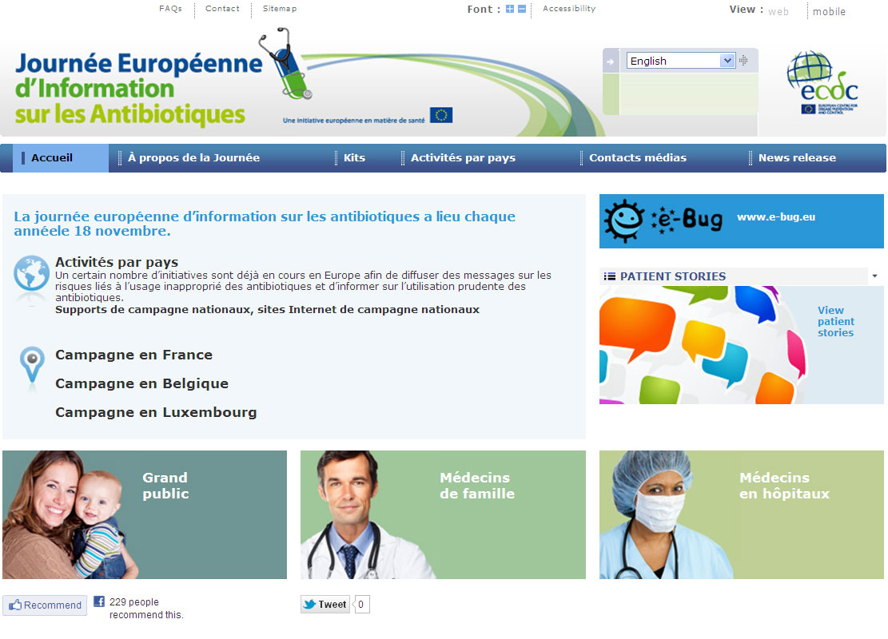
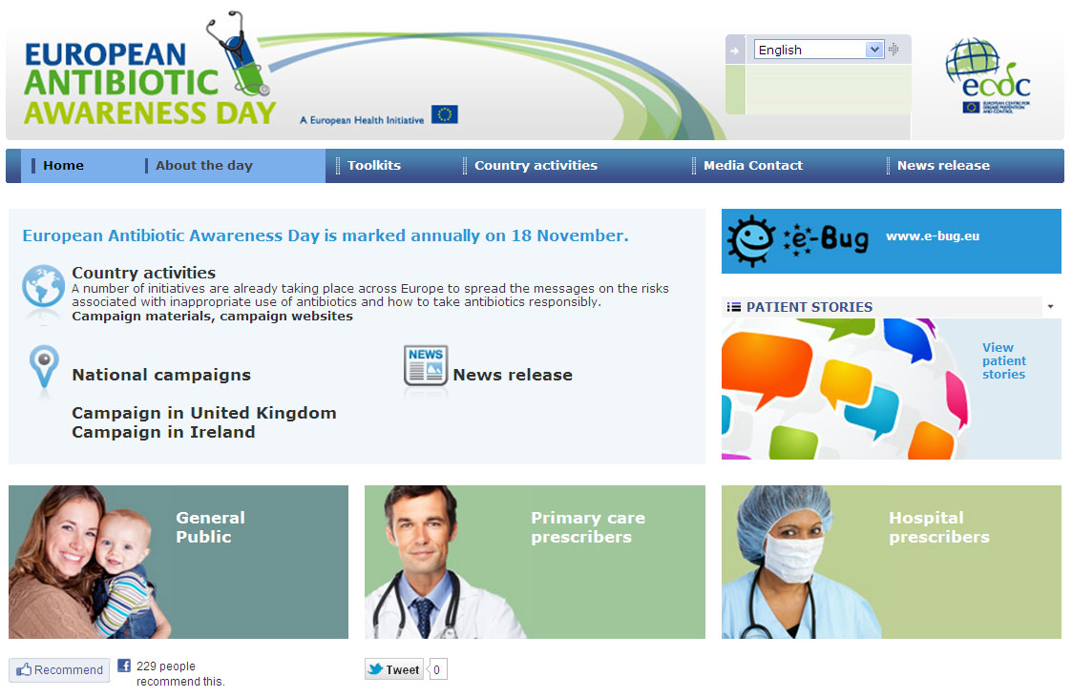
EAAD website, 2011
Key messages & materials translated in all EU languages
Country activities
Link to e-Bug
Patient stories
Links to national campaigns
Notes:
Since 2011, our EAAD website is now multi-lingual, one version for each official EU language.
One of this year’s (2013) activities is performing a usability test to further improve this website according to the users’ needs and antimicrobial resistance (AMR) focal points in the countries.

Slide 11
Images from national campaigns on prudent antibiotic use

Slide 12
Past campaign activities

Slide 13
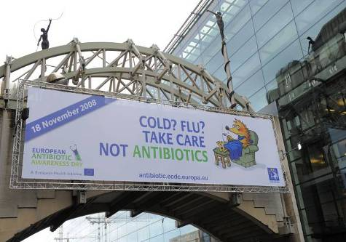
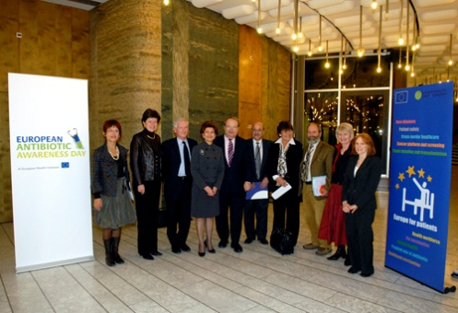
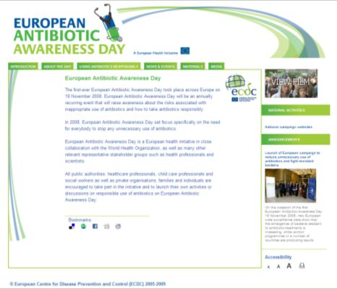
EAAD activities in 2008
Template materials for member states
Campaign website
Two special issues of Eurosurveillance dedicated to antibiotic resistance
Launch of EAAD in the European Parliament
National campaign activities
Notes:
EAAD – European Antibiotic Awareness Day
Template materials for member states: including, logos, visuals, key messages, media toolkit for countries.

Slide 14
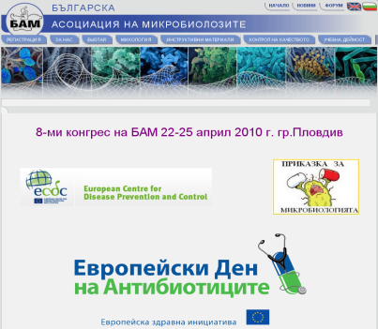
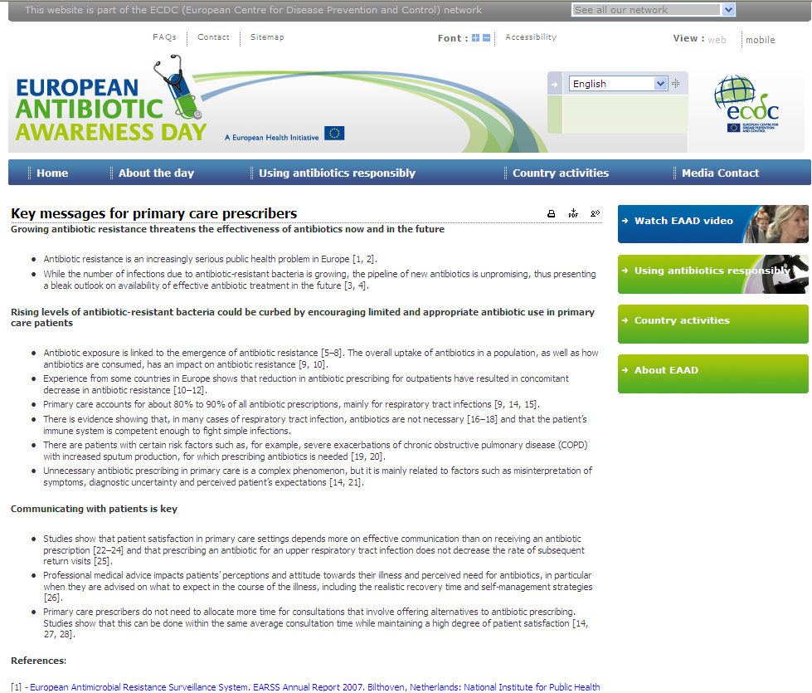
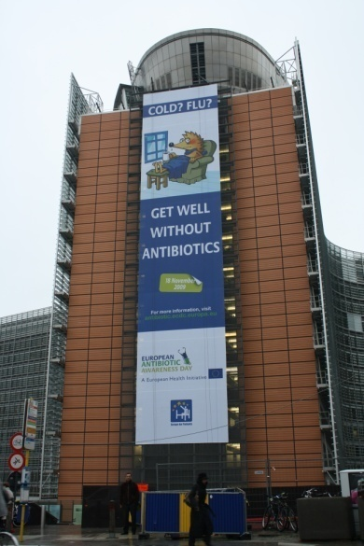
EAAD activities in 2009
Template materials for Member States targeting primary care prescribers
Multi-lingual campaign website with a section targeting primary care prescribers
ECDC/Swedish Presidency conference on EAAD. Podcast and multi-media news release
National campaign activities
Notes:
EAAD – European Antibiotic Awareness Day
Template materials for Member States targeting primary care prescribers: key messages, fact sheet, patient leaflet, flowchart patient dialogue, TV spots.
ECDC/Swedish Presidency conference on EAAD: podcast and multi-media news release.

Slide 15
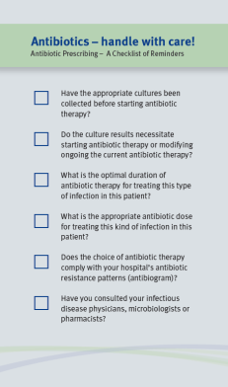
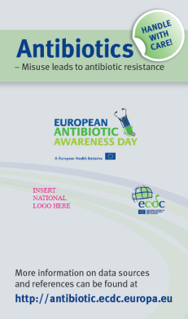
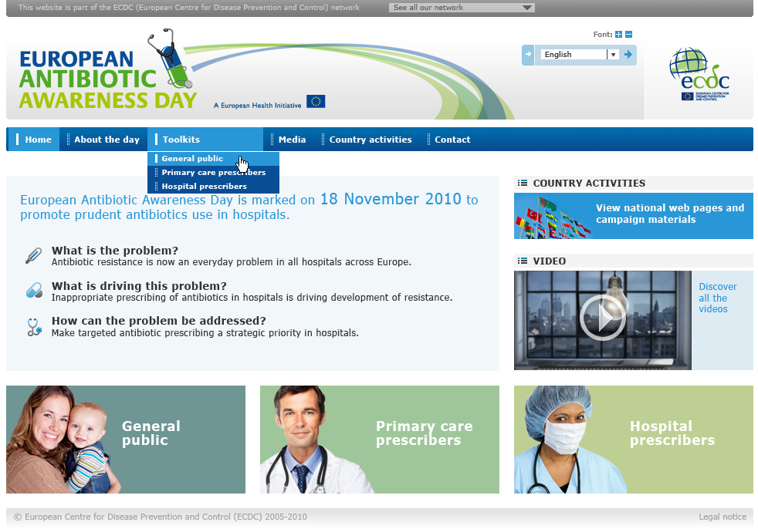
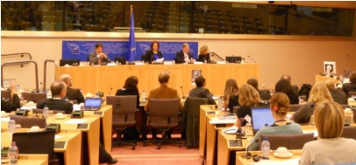
EAAD activities in 2010
Template materials for Member States targeted at hospital prescribers, managers and antibiotic experts
Website section targeted at hospital audiences
European Parliament briefing on the campaign
EU media briefing on antibiotic resistance in hospitals
National campaign activities
Notes:
EAAD – European Antibiotic Awareness Day
Template materials for Member States targeted at hospital prescribers, managers and antibiotic experts: key messages, visuals, letter, presentation, fact sheet, advertorial, checklist, screensaver

Slide 16
EAAD activities in 2017
Notes:
Add slides on more recent activities (this is just an example)

Slide 17
EAAD Website
https://antibiotic.ecdc.europa.eu/en/plan-campaign
Notes:
As a suggestion you can show the website

Slide 18
Looking forward to the future

Slide 19
2011-12: Consolidation phase 2013: new focus – self-medication with antibiotics delete or update slide
In 2011-12 ECDC did not develop new materials targeting additional audiences
Following indications from the EAAD Technical Advisory Committee, a new focus has been identified: self-medication with antibiotics
Despite being illegal, over-the-counter dispensation of systemic antibiotics occurs in several EU Member States
Availability of "leftover" antibiotics: as a result of either patient non-compliance or dispensation of a larger number of tablets than needed for a single course
Toolkit and new materials available in 2014
Notes:
EAAD – European Antibiotic Awareness Day
Toolkit and new materials available in 2014: toolkit and new materials for self-medication with antibiotics available to the countries translated in all languages in 2014
This slide is outdated

Slide 20
Other EAAD activities planned in 2013
EAAD ‘light bulb’ TV spot on Euronews in the weeks around November 18th
Intensify cooperation with stakeholders and patient groups
Media toolkit including preview of new Europe-wide data
Twitter chat with ECDC experts
Pilot-training module on the development, implementation and evaluation of national campaigns
Partner major initiatives, e.g. Antibiotic Awareness Canada, U.S. Get Smart, Australia, EC AMR Strategy, WHO EURO, India
EAAD 2012 evaluation and 5-year review to be published in a scientific article

Slide 21
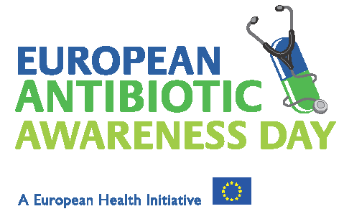
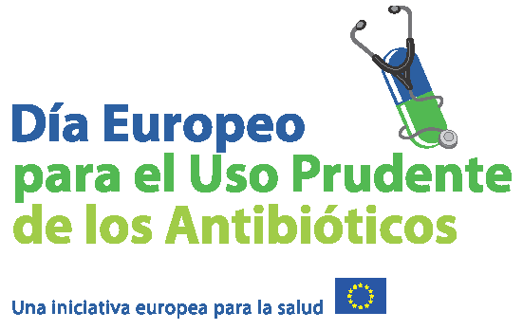
18 November
21

Slide 22
Thank you!
Any questions?

Slide 23
Acknowledgements The creation of this training material was commissioned in 2011 by ECDC to the department of Public Health Sciences of the Karolinska Institutet (SE) with the direct involvement of Senia Rosales, Erika Anne-Marie Saliba, Charlotta Zacharias and Cecilia Stålsby Lundborg. The revision and update of this training material was commissioned in 2017 by ECDC to Transmissible (NL) with the direct involvement of Anja Schreijer, Remco Schrijver, Marita van der Laar and Arnold Bosman.
Notes:
Facilitator notes:

